Slide 1

Transition Tasks
Fine Art

Slide 2
Task 1:
Watch Grayson’s Art Club - Episode 1 (This can be found on catch up via Channel 4.com or if you have Sky TV, it can be downloaded.)
Pay particular attention to alternative media being used to paint a portrait. Make notes on the artists you have seen, commenting on any styles that you like and why.

Slide 3
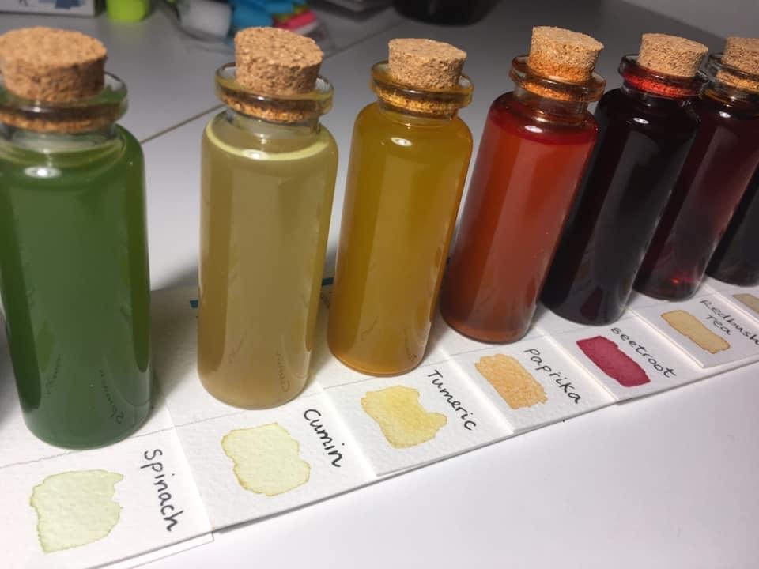
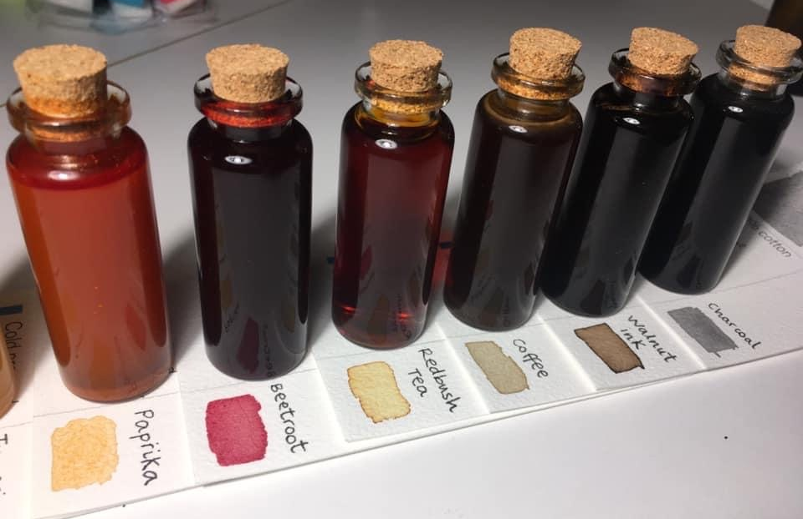
Task 2: Alternative Media
Follow the instructions to produce a collection of your own handmade paints from household liquids such as coffee, soy sauce or tomato ketchup. Be creative and innovative in the items you experiment with. Please email Miss Stevens if you require a sketchbook for these tasks.
Take a look at what you have in the cupboards at home to create your own range of natural inks. This could include; tea, coffee, beetroot, paprika, spinach, cumin, turmeric, onion skins, blueberries, red cabbage , food colourings , soy sauce etc.
Try to vary the range of tones you can create by adding different quantities of water.
Once you have created a selection of inks, present little painted swatches of each sample on an A4 page and neatly label.
Include a title at the top of the page ‘Alternative Media’. Think of your font style.
Write a mini paragraph somewhere on the same page to explain that you are creating your own range of natural inks.

Slide 4
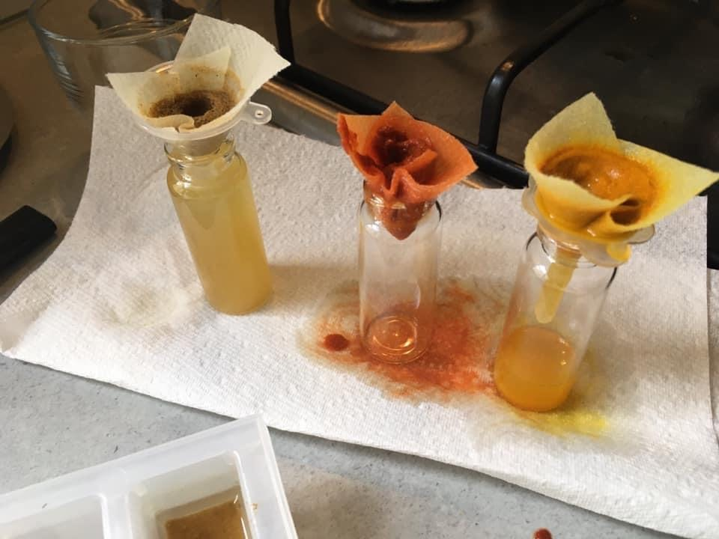
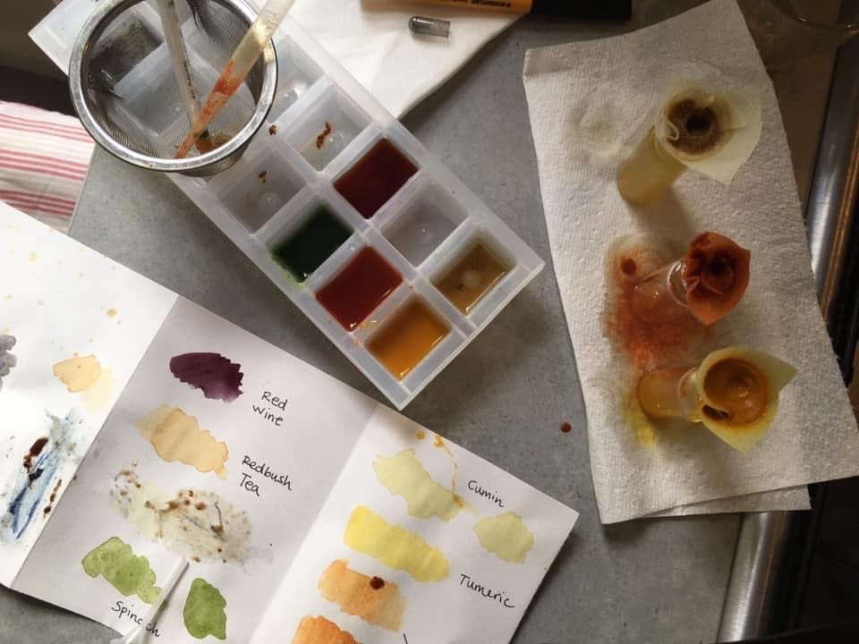
Task 2: Alternative Media
Follow the instructions to produce a collection of your own handmade paints from household liquids such as coffee, soy sauce or tomato ketchup. Be creative and innovative in the items you experiment with. Please email Miss Stevens if you require a sketchbook for these tasks.
You may need to create a filter for the powders such as paprika and turmeric to avoid little grains going into the ink. You need to achieve a liquid free from any texture if possible.
If using blueberries, bake in the oven for 15 mins, mash and filter.
Red cabbage can be boiled (5 mins for one tone, 10 mins for another tone).
Spinach—mix with water, blend and filter
Cumin, turmeric, paprika, tea and coffee can be mixed with hot water,
Beetroot– use direct from the container.

Slide 5
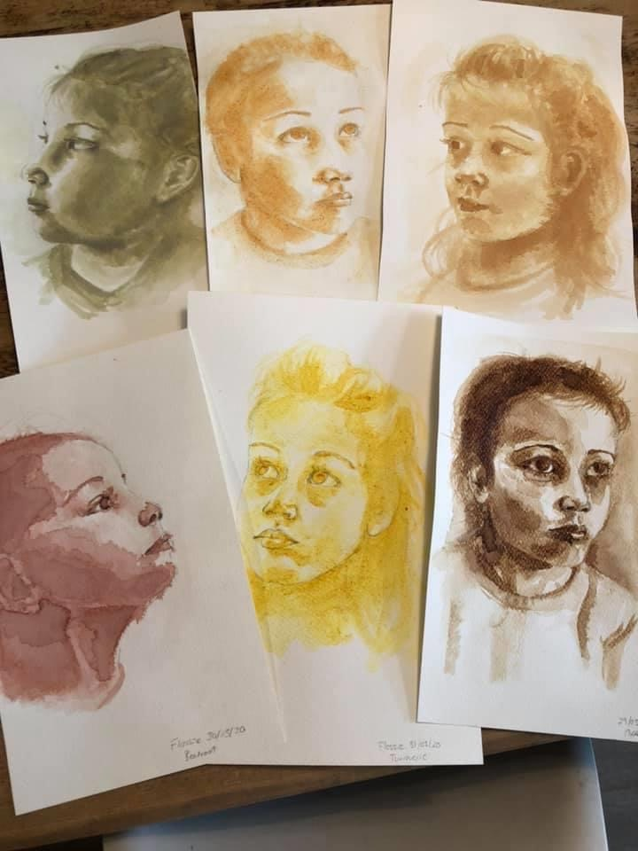
Your task is to produce a series of six A4 sized paintings using the different natural inks you have created.
The subject matter is your choice. For example you could select to draw :
Still life e.g. flowers, fruit, shells, landscapes, portraiture, animals, buildings
Within each image I am looking for:
Realism (no cartoon styles please)
Wide range of tones
Accuracy
Control of the ink to keep inside drawn lines
Directional painting
Clear light source
One natural ink per drawing (like the examples on the left)
If you don’t have a paint brush at home, be resourceful and cut a small piece of washing up sponge and use this to apply and paint your inks!
Task 3:
Take a look at the following slides for more examples

Slide 6
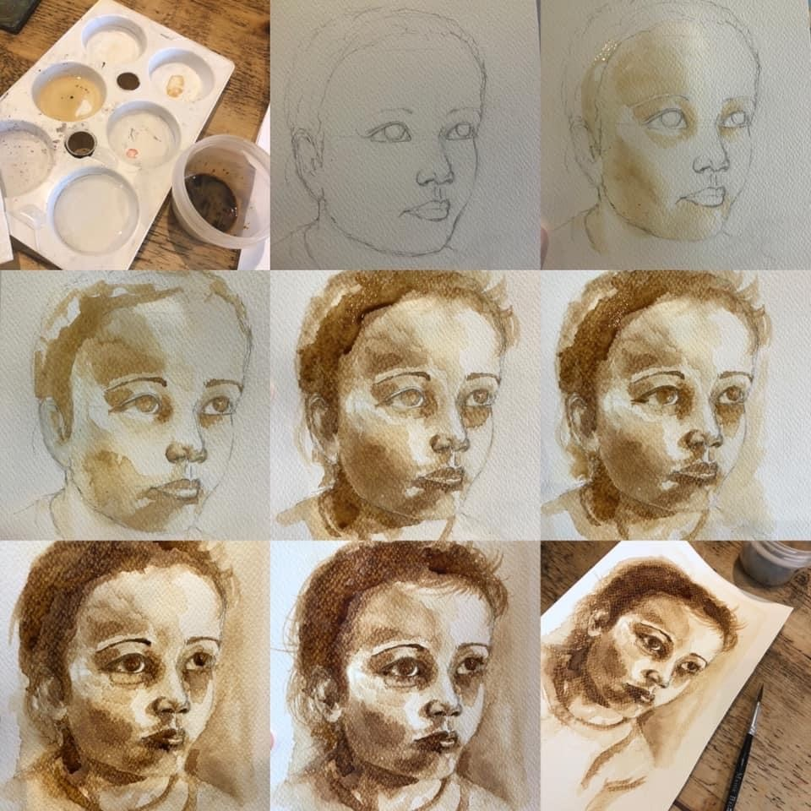
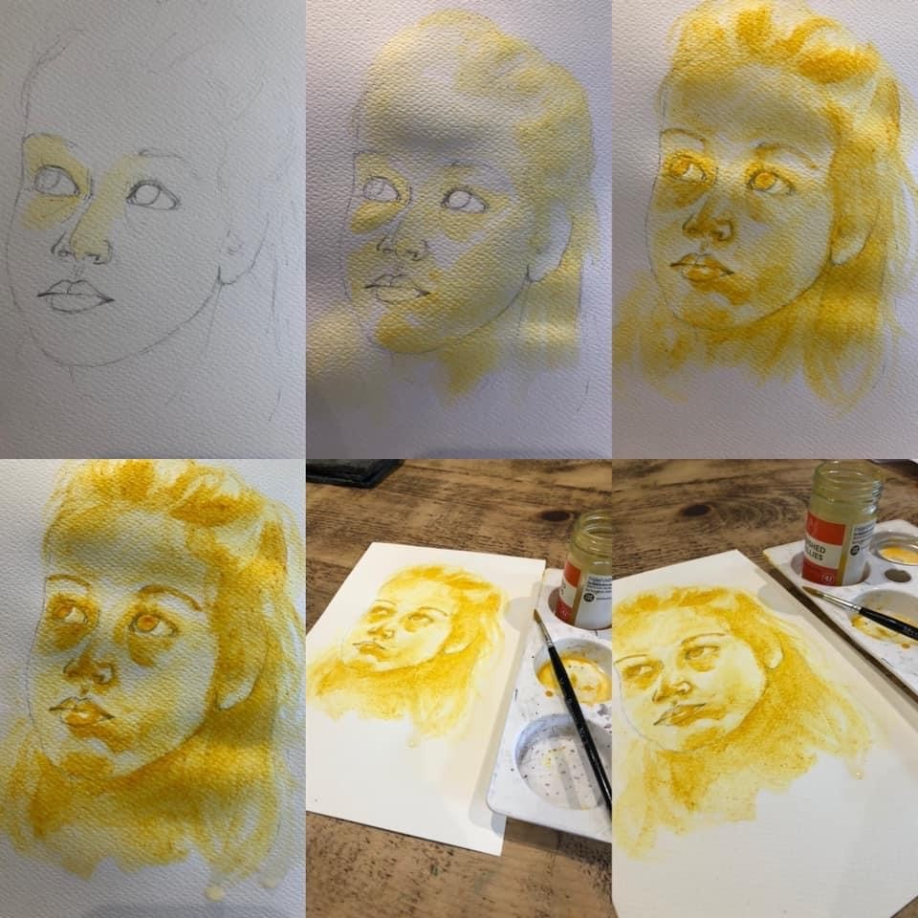
Task 3 examples

Slide 7
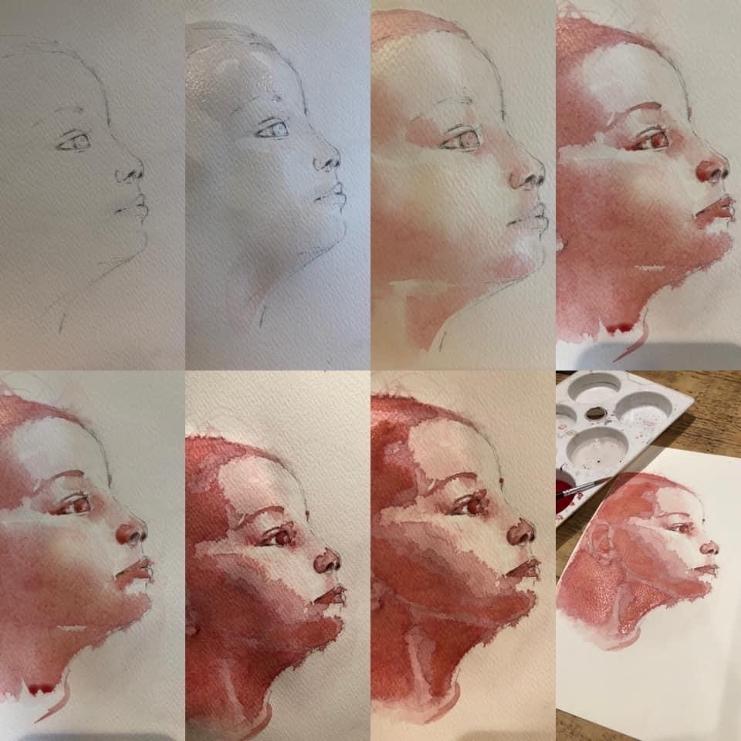
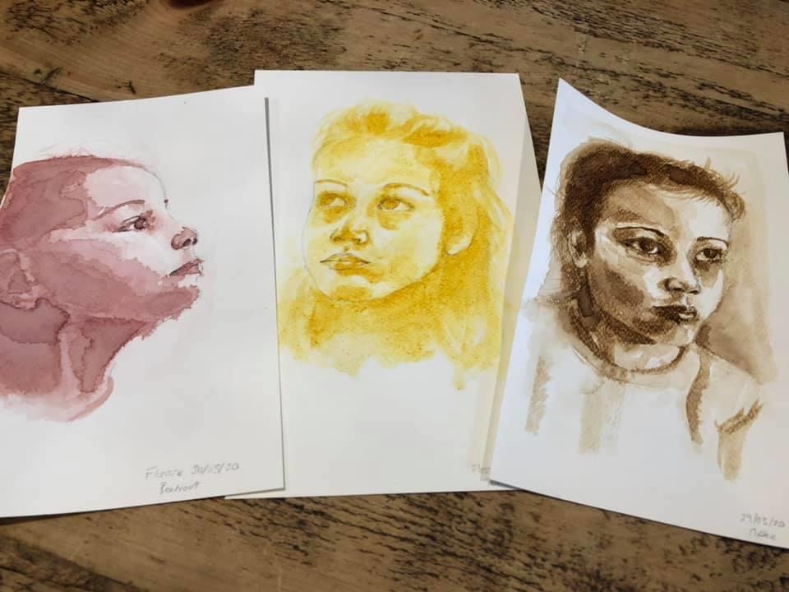
Task 3 examples

Slide 8
Please email your completed work to:
Miss Pattinson
LPattinson@thekings.staffs.sch.uk

