Slide 1

Meaningful Homeworks
Year 7

Slide 2
Autumn 1 – Faith & Identity
Task:
Research the three faiths expressed in The Life of Pi (Judaism, Christianity, Buddhism) and produce a poster which illustrates your findings.
Guidance:
Judaism (https://www.bbc.co.uk/bitesize/topics/z9prkqt/articles/zfn792p_
Christianity (https://www.bbc.co.uk/bitesize/topics/z4tb4wx/articles/zk4fxyc)
Buddhism (https://www.bbc.co.uk/bitesize/topics/zs86n39/articles/zmcsmfr)
Uses dual coding (relevant images which symbolises your findings)
Success Criteria:
Identifies what each faith believes in
Identifies which God is worshipped
Accurate spelling, punctuation and grammar
Explains which country each of the faiths originate from
Are they any special rules which they must follow? E.g. the eating of Kosher foods

Slide 3
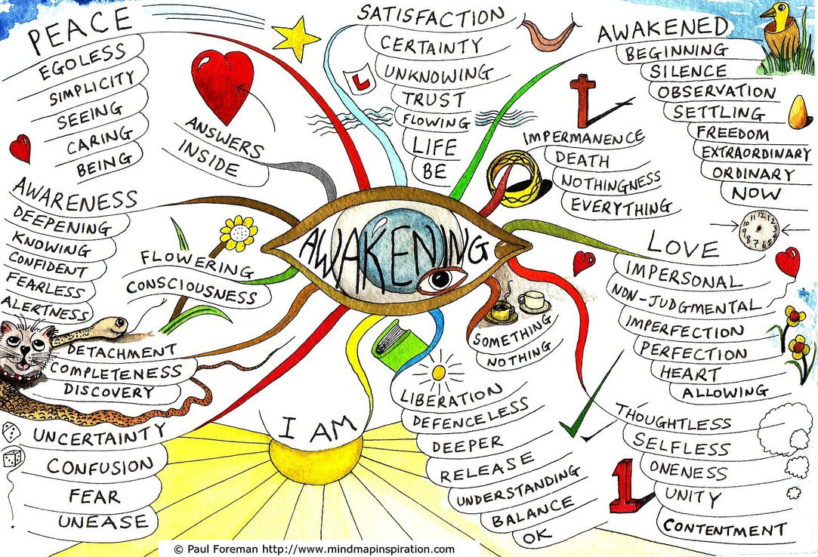
Autumn 1 – Faith & Identity
Worked example
An example of a concept map which looks at the principles of Buddhism.
Remember your poster must contain information on Christianity, Judaism and Buddhism.

