Slide 1

Meaningful Homework
WAGOLL
YEAR 7

Slide 2
Our Local World
Autumn 1

Slide 3
EXPLORE
VIPERs
In geography, you will receive two homework tasks this topic. Task 2 (VIPERS) will be awarded as Meaningful Homework, as this applies your knowledge from the first task. We have included both tasks below, so you know what you will be doing in advance. We will set one task at a time on ClassCharts.
Task 1:
Create a dual coded mind-map using the information from the knowledge organiser.
Guidance Notes:
Read the knowledge organiser carefully and highlight at least five key points in each box. Your mind-map must include your highlighted points and a minimum of five images. You may also add your own research.
Success Criteria:
Highlight the geography terms for this topic
Define at least two key terms and use them in a sentence
Classify information into social, economic and environmental factors
Explain how one piece of information is connected/important to you e.g. population growth.
Task 2:
Using all of the information on your knowledge organiser, answer the VIPERs question below in full sentences.
Guidance Notes:
Vocabulary: Urbanisation is the change that occurs to a town/city does it change
Getting smaller b) getting larger c) stays the same
Infer: ‘Globalisation has been taking place for hundreds of years, but has sped up enormously over the last half-century‘ Explain what the changes that this has created.
Predict: How might the area of Kidsgrove change in the future?
Explain: explain the advantages of being sustainable’.
Review: What impact has urbanisation had on your local area?
Success Criteria:
Highlight the geography terms for this topic
Respond to the command word in the question
Select and use evidence from the information boxes in your answer.

Slide 4
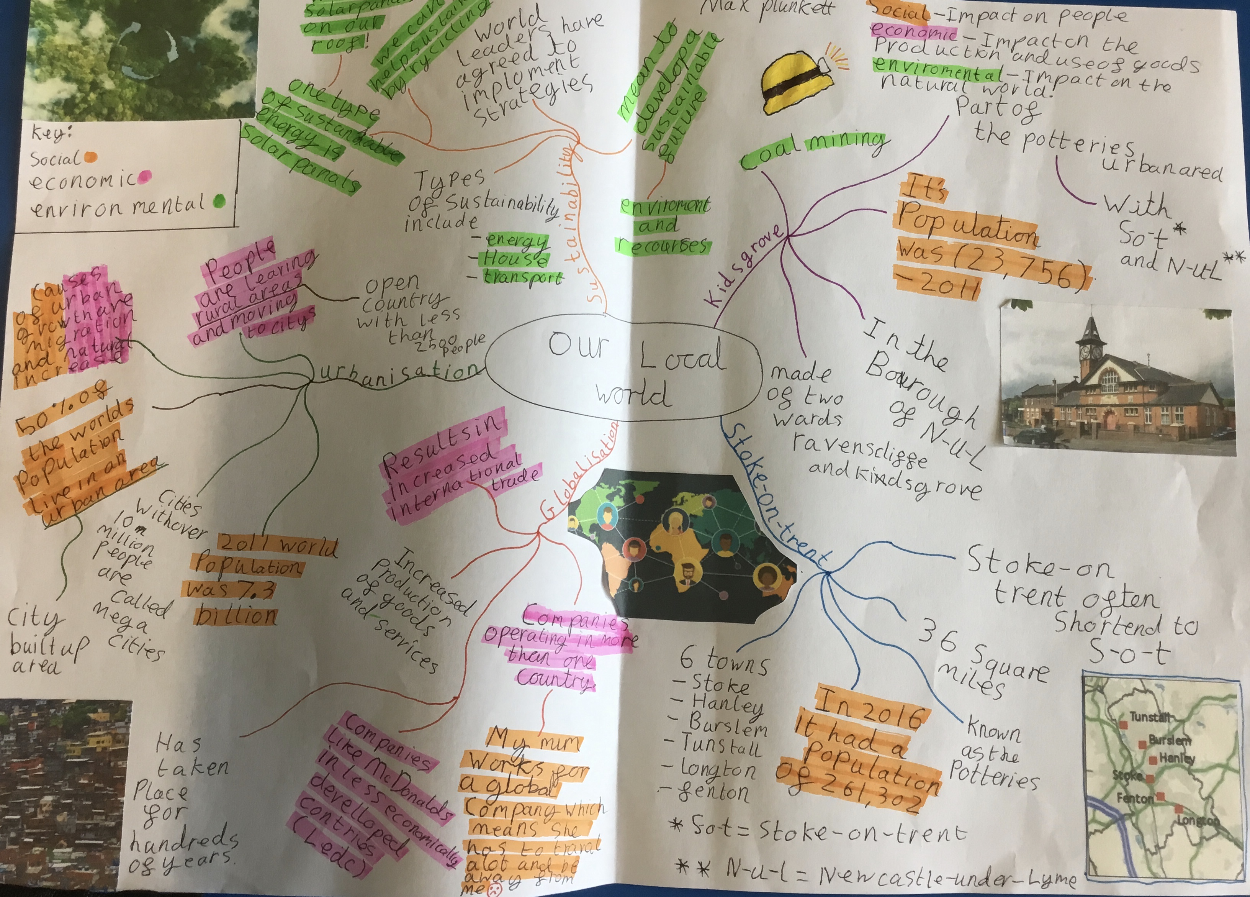
This is an Example of a good 'EXPLORE' homework
the topic used in this example is the same as your homework task. Remember to use your own ideas and research too.
EXPLORE
Strength:
Classified the key information into social, economic and environmental categories.
Weakness:
Missed opportunity to link one idea to your personal geographies.
Next step:
Explain how one of your highlighted facts could impact your personally.

Slide 5
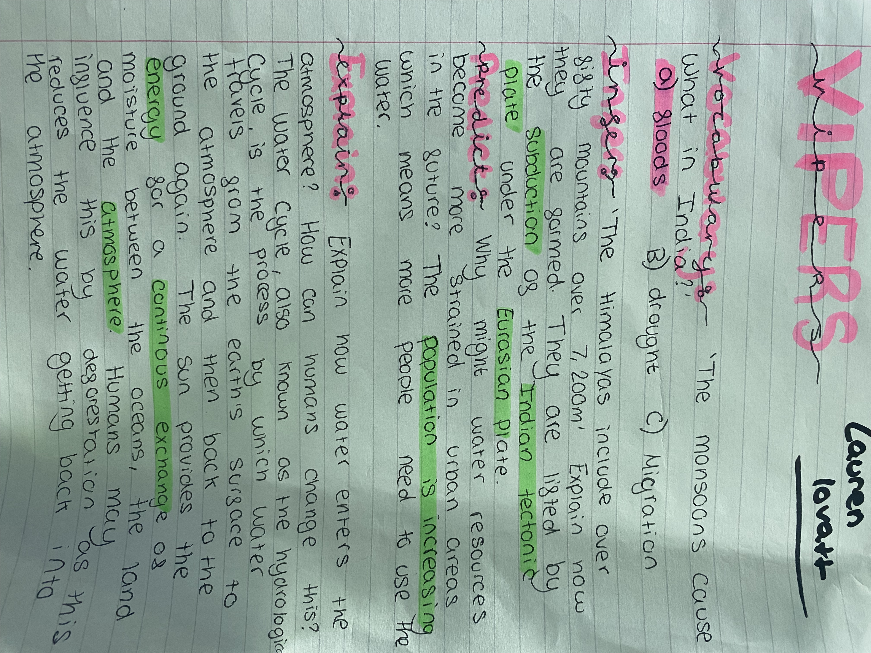
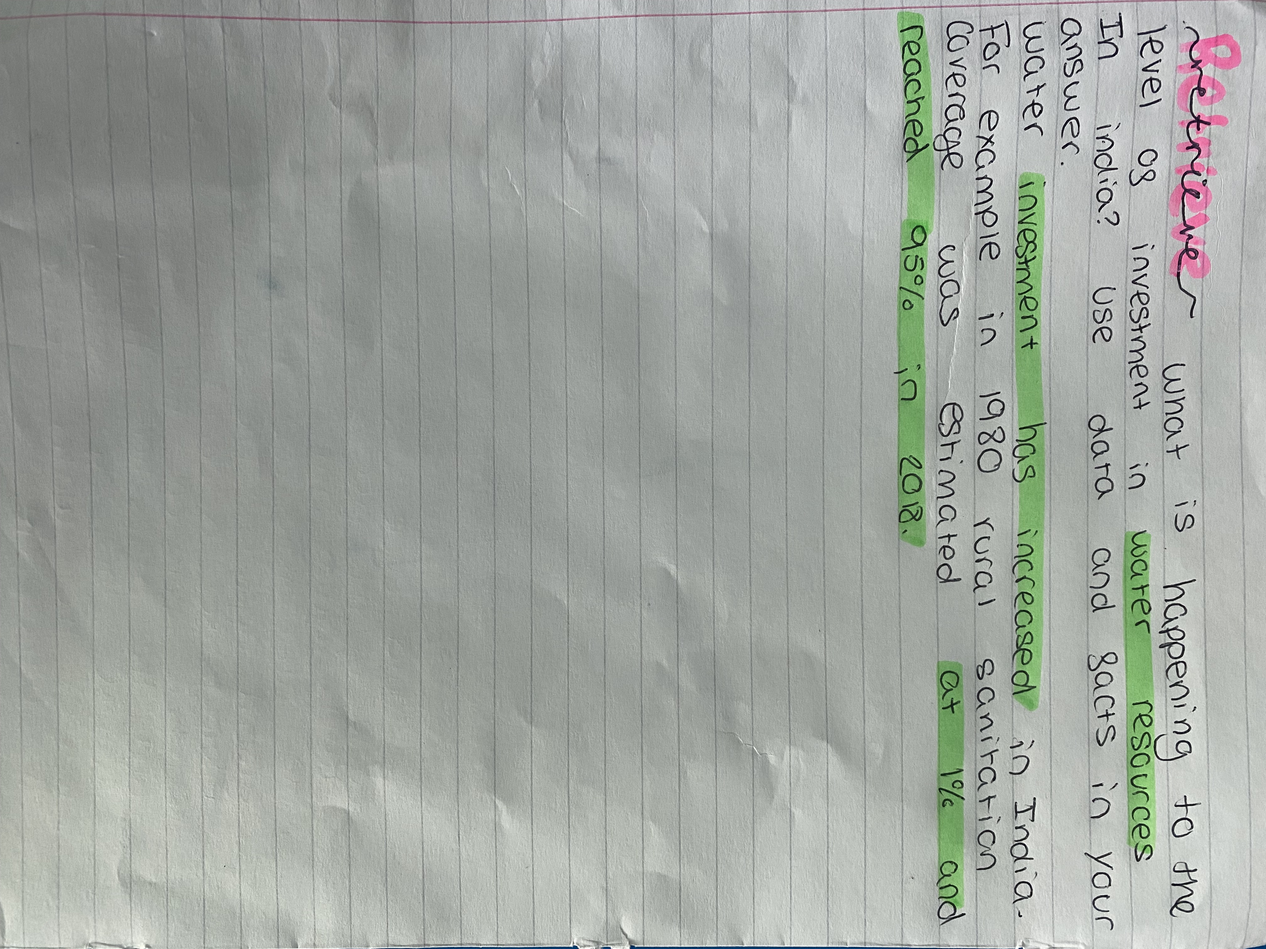
This is an Example of a good 'vipers' homework the questions used in this example may be different from your homework task, this is to give you the opportunity to apply your own understanding.
Strength:
Key terms for the topic used in each answer and specific example used.
Weakness:
Giving a second reason for the predict question.
Next Step:
How might quality of life affect water supply?
VIPERs

