Slide 1

Meaningful Homeworks
Year 10

Slide 2
Autumn 1 - A Christmas Carol (1)
Task: Single-word analysis based on an extract from the text, linking to relevant subject terminology and contextual information
Guidance:
Read the extract
Consider the highlighted words. They have been chosen because there is lots you can say about them.
Try and think of up to three reasons as to why each word has been used and write these down. Consider the following questions when you think of your reasons. Of all the words, Dickens could have used, why this one? What is he trying to say about the topic being discussed?
What does the writer want to happen when people read this extract? How does this word help?
What does the writer need the reader to think, feel or question in order to get what he wants? How does this word help them to achieve this?
Extension: Choose two of the words. Link your ‘reasons’ together as to why Dickens uses these specific words. Remember, consider what Dickens wants to achieve in this part of the story and what he needs his reader to think, feel or question in order to achieve it.
Success Criteria
Reasons as to why each word has been done can be completed as a mind-map/bullet-point list for each word.
Consider the effect and meaning created by each language choice.

Slide 3
Extract
Foggier yet, and colder. Piercing, searching, biting cold. If the good Saint Dunstan had but nipped the Evil Spirit’s nose with a touch of such weather as that, instead of using his familiar weapons, then indeed he would have roared to lusty purpose. The owner of one scant young nose, gnawed and mumbled by the hungry cold as bones are gnawed by dogs, stooped down at Scrooge’s keyhole to regale him with a Christmas carol: but at the first sound of
“God bless you, merry gentleman!
May nothing you dismay!”
Scrooge seized the ruler with such energy of action, that the singer fled in terror, leaving the keyhole to the fog and even more congenial frost.

Slide 4
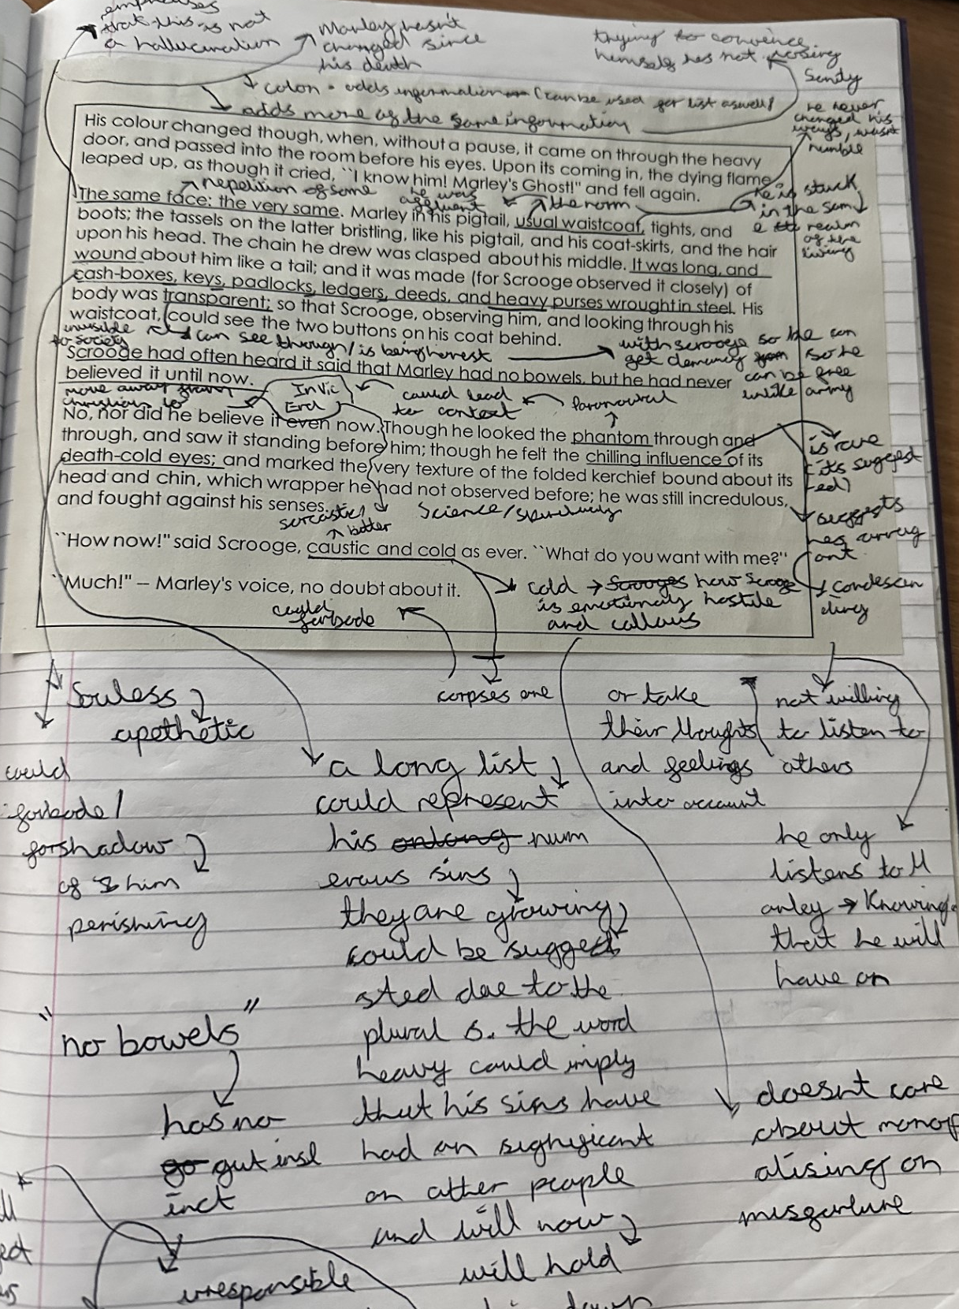
Worked example
Note: this task is not the same but shows the same skills necessary for the task you have been given.

