Slide 1

Meaningful Homeworks
Year 8

Slide 2
Autumn 1
Task 1

Slide 3
Autumn 1 – Of Mice & Men (HWK 1)
Task:
Research and produce a poster on class segregation in America in the 1920s
Guidance:
Use the following sources to enable you to produce your poster
https://www.bbc.co.uk/bitesize/guides/zpy8msg/revision/1
https://www.bbc.co.uk/bitesize/guides/zcpcwmn/revision/1
Remember:
Submit work to your teacher in class, via Email or Weduc
Outstanding work will be rewarded with Classcharts points and a Pride of the King's nomination.
Success Criteria:
Accurate spelling, punctuation and grammar
Clear writing in bullet-points
Key dates and names of influential people
Include reveal images/drawing
Facts and statistics

Slide 4
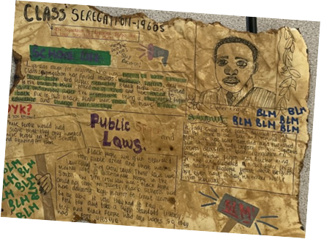
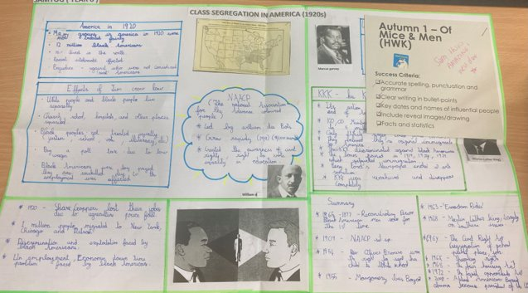
Autumn 1 – Of Mice & Men (HWK 1)

Slide 5
Autumn 1
Task 2

Slide 6
Autumn 1 – Of Mice & Men (HWK 2)
Task:
Read and complete the VIPERS questions on Women’s Rights in the 1920s
Guidance:
Read the information sheet
Highlighting two sentences in each paragraph
Give each paragraph a title/sub-heading
Summarising each paragraph in 2 bullet-points
Answer the questions about the advertisements
Remember:
Submit work to your teacher in class, via Email or Weduc
Outstanding work will be rewarded with Classcharts points and a Pride of the King's nomination.
Success Criteria:
Link the text to the novel (Of Mice and Men)
Show a clear understanding of gender roles in the 1920s
Summarise information clearly
Answer in full sentences (where appropriate)

Slide 7
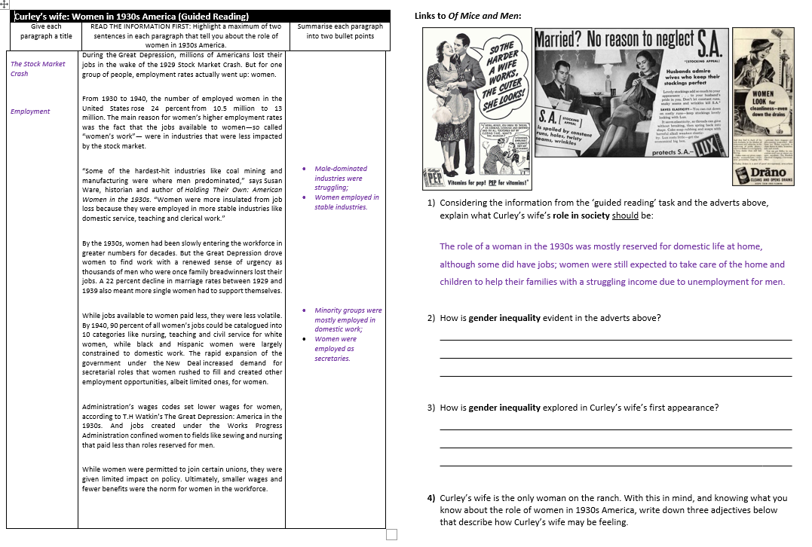
Autumn 1 – Of Mice & Men (HWK 2)
Note: This worked example is only partially complete to allow for your own original ideas.

