Slide 1

Meaningful Homeworks
Year 9

Slide 2
Autumn 1 – Crime and Punishment (HWK 1) - planning/annotation sheet in KS3 resources AUTUMN 1 - need to complete 2 paragraph Q2 response
Task: Answer the comprehension questions about the extract The Woman in Black. THEN;
B) Complete the 'Reduce, transform, summarise' worksheet based on what you have read.
Guidance: You must answer all the questions in full sentences using evidence to support your ideas, where appropriate.
Remember:
Submit work to your teacher in class, via Email or in person
Outstanding work will be rewarded with Classcharts points and a Pride of the King's nomination
Printed copies are available from your teacher if needed
Success Criteria:
All answers written in full sentences
Accurate SPaG
Clear understanding of the text
Analysis of one language device as a quotation explosion
Accurate subject terminology
Ambitious vocabulary

Slide 3
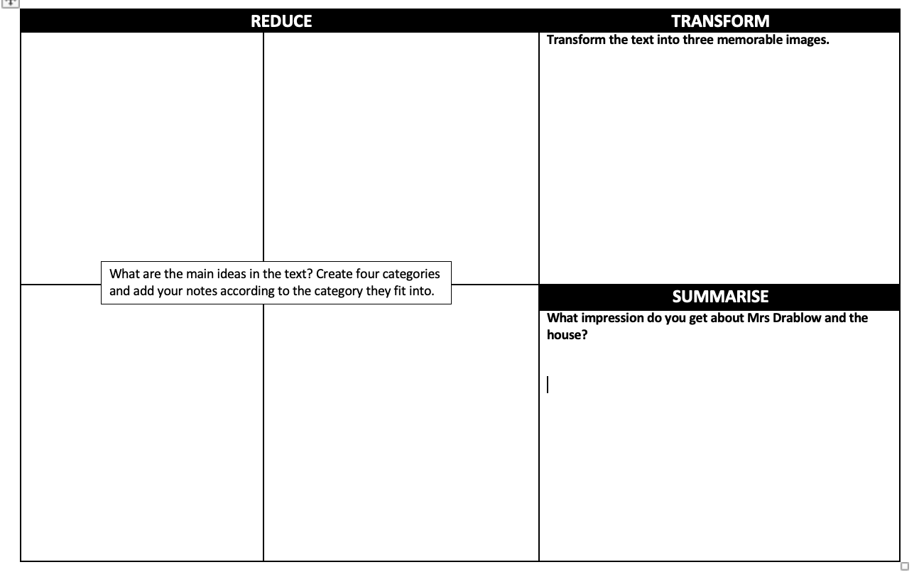

Slide 4
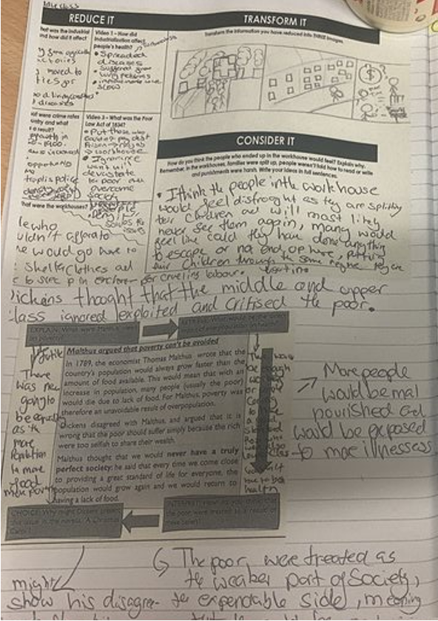
Autumn 1 – Crime and Punishment (HWK 1)
A similar example which focuses on comprehension of a different text. The student has offered detailed note-taking which has helped them with the next task below.
Task: Answer the comprehension questions about the extract The Woman in Black. THEN;
B) Complete the 'Reduce, transform, summarise' worksheet based on what you have read.
Guidance: You must answer all the questions in full sentences using evidence to support your ideas, where appropriate.
Remember:
Submit work to your teacher in class, via Email or in person
Outstanding work will be rewarded with Classcharts points and a Pride of the King's nomination
Printed copies are available from your teacher if needed
Success Criteria:
All answers written in full sentences
Accurate SPaG
Clear understanding of the text
Analysis of one language device as a quotation explosion
Accurate subject terminology
Ambitious vocabulary

