Slide 1

Meaningful Homework
WAGOLL
YEAR 7

Slide 2
Amazing Places:
A Risky World
Autumn 2

Slide 3
EXPLORE
VIPERs
In geography, you will receive two homework tasks this topic. Task 2 (VIPERS) will be awarded as Meaningful Homework, as this applies your knowledge from the first task. We have included both tasks below, so you know what you will be doing in advance. We will set one task at a time on ClassCharts.
Task 1:
Create a dual coded mind-map using the information from the knowledge organiser.
Guidance Notes:
Read the knowledge organiser carefully and highlight at least five key points in each box. Your mind-map must include your highlighted points and a minimum of five images. You may also add your own research.
Success Criteria:
Highlight the geography terms for this topic
Define at least two key terms and use them in a sentence
Classify information into social, economic and environmental factors
Explain how one piece of information is connected/important to you e.g. population growth.
Task 2:
Using all of the information on your knowledge organiser, answer the VIPERs question below in full sentences.
Guidance Notes:
Vocabulary: Greenhouse gasses are continuing to rise what does this mean for temperatures.
a) Temperature decrease b) Temperature increase c) temperature stays the same
Infer: ‘thermometers have shown a clear warming of the Earth's temperature over the past few decades ‘ Explain what changes this has created.
Predict: How might the UK be impacted by climate change in the future?
Explain: explain how people will have to adapt to climate change.
Review: Assess which hazard you think presents the biggest threat to humans? Why?
Success Criteria:
Highlight the geography terms for this topic
Respond to the command word in the question
Select and use evidence from the information boxes in your answer.

Slide 4
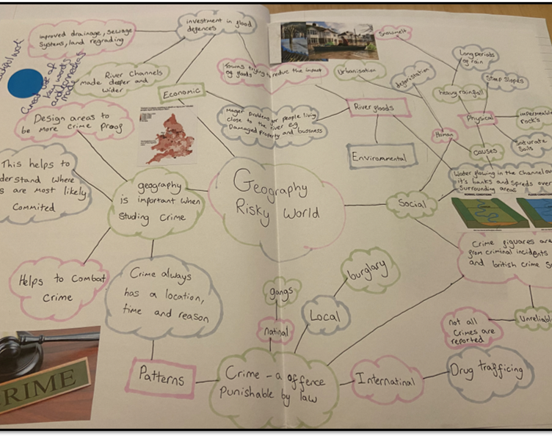
This is an Example of a good 'EXPLORE' homework
the topic used in this example is the same as homework task, remember to include your own ideas and research too.
EXPLORE
Strength:
You have identified both a human and physical risk
Weakness:
Used scale words but not applied the wider context
And Next Step:
Explain why certain crimes would be found at different scales

Slide 5
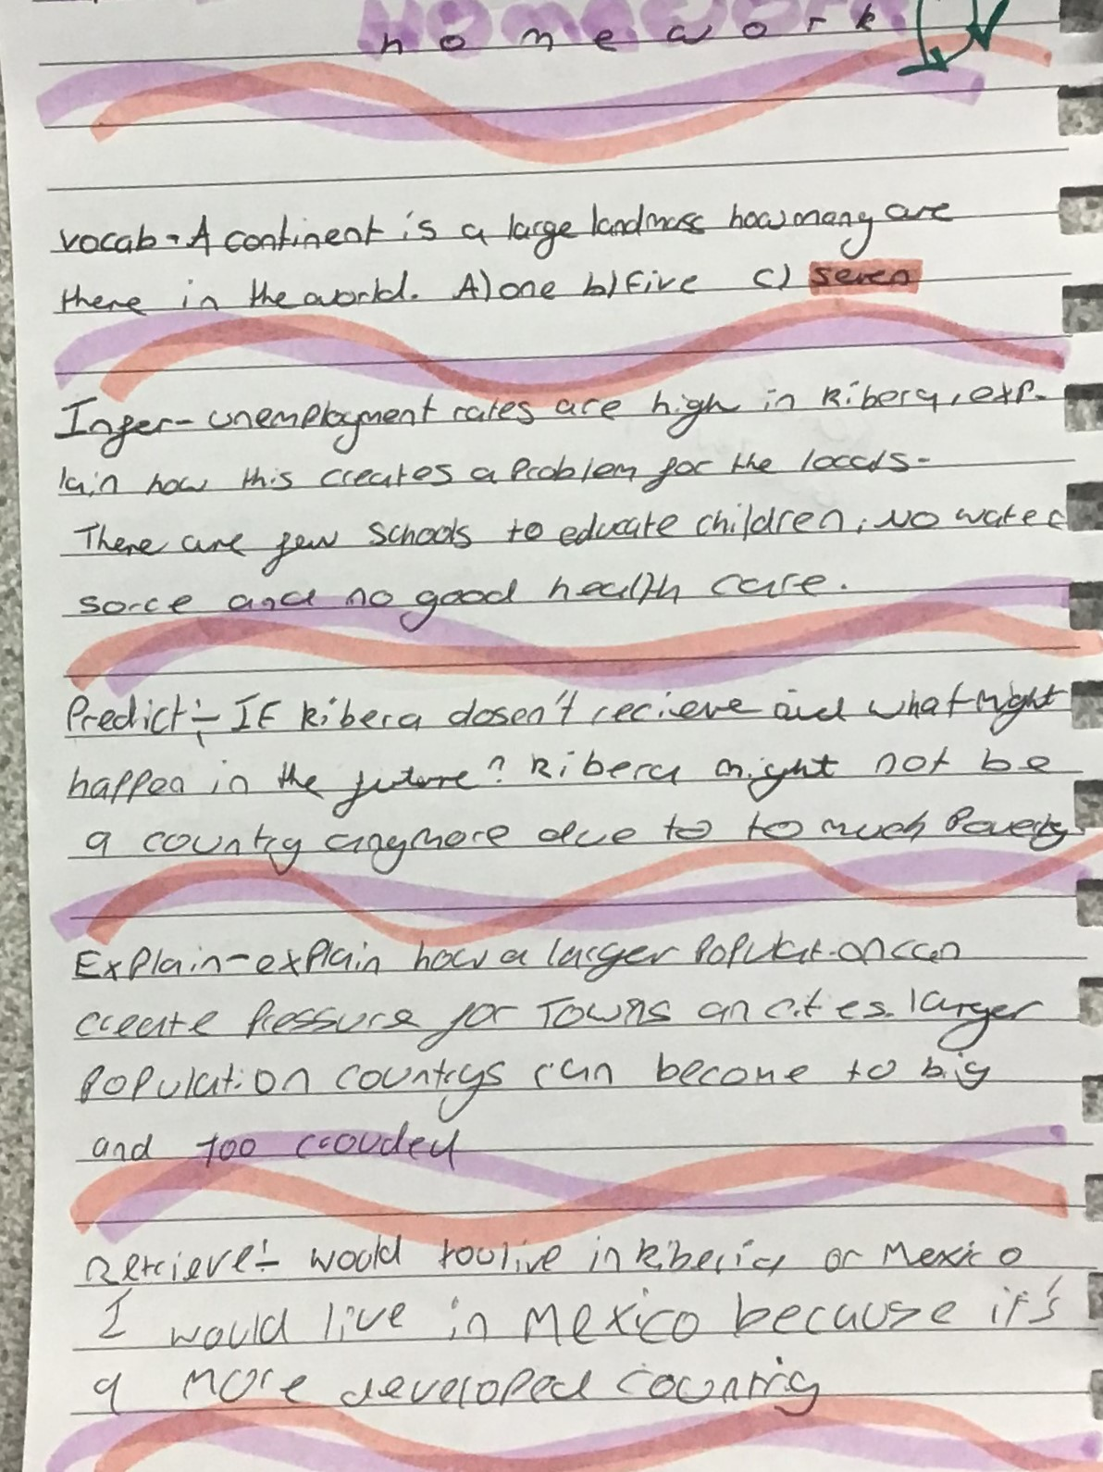
This is an Example of a good 'vipers' homework the questions used in this example may be different from your homework task, this is to give you the opportunity to apply your own understanding.
Strength:
Using key ideas from lesson e.g. development.
Weakness:
Giving a second reason for each answer.
Next Step:
Explain the negative impact of an area becoming overcrowded.
VIPERs

