Slide 1
A Fragile World
Autumn 1 – Autumn 2

Slide 2
EXPLORE
VIPERs
In geography, you will receive two homework tasks this topic. Task 2 (VIPERS) will be awarded as Meaningful Homework, as this applies your knowledge from the first task. We have included both tasks below, so you know what you will be doing in advance. We will set one task at a time on ClassCharts.
Task 1:
Create a dual coded mind-map using the information from the knowledge organiser.
Guidance Notes:
Read the knowledge organiser carefully and highlight at least five key points in each box. Your mind-map must include your highlighted points and a minimum of five images. You may also add your own research.
Success Criteria:
Highlight the geography terms for this topic
Define at least two key terms and use them in a sentence
Classify information into social, economic and environmental factors
Explain how one piece of information is connected/important to you e.g. differences in quality of life.
Task 2:
Using all of the information on your knowledge organiser, answer the VIPERs question below in full sentences.
Guidance Notes:
Vocabulary: ‘When a glacier moves downhill it erodes everything in its path through abrasion and plucking.’
deposits b) wears away c) transports
Infer: ‘The impacts of climate warming in Alaska are already occurring. ‘ Explain how we know this.
Predict: why might the job opportunities be different across America?
Explain: explain how and why plants need to adapt to desert climates.
Retrieve: Which type of job would you most like to have a why?
Success Criteria:
Highlight the geography terms for this topic
Respond to the command word in the question
Select and use evidence from the information boxes in your answer.

Slide 3
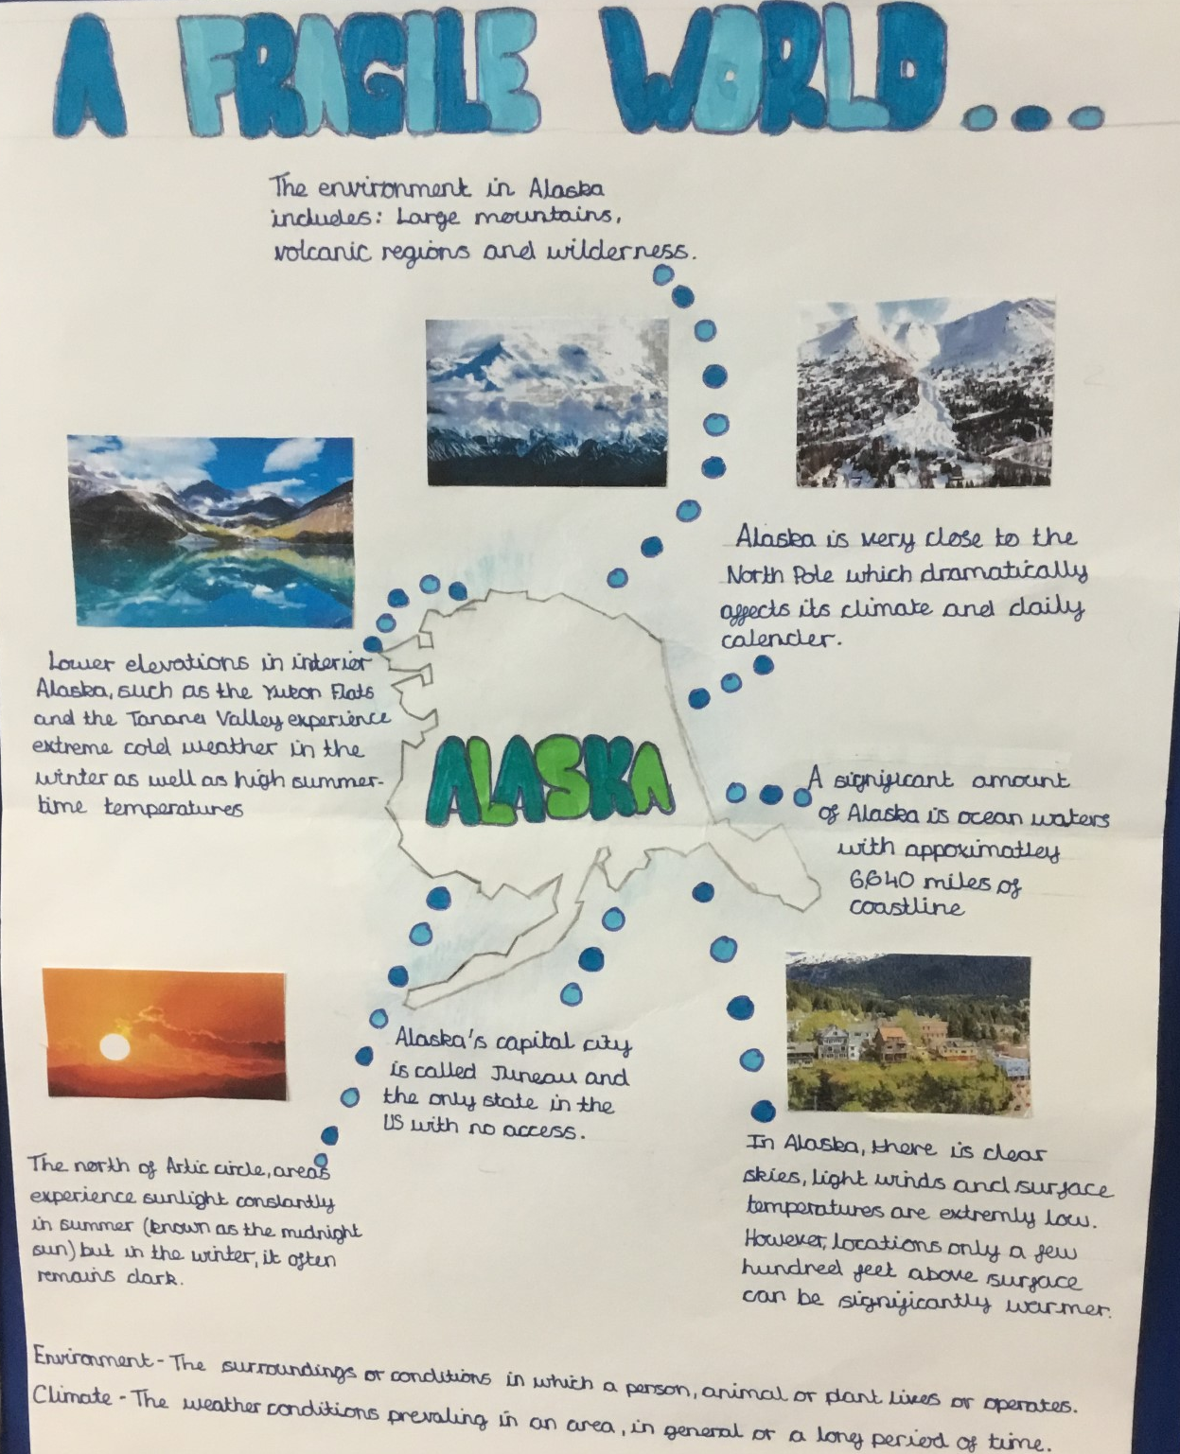
This is an Example of a good 'EXPLORE' homework
the topic used in this example is the same as your homework task. Remember to use your own ideas and research too.
EXPLORE
Strength:
Clear geographical research has been done by the accurate imagery used
Weakness:
Connection to key terminology
And Next Step:
Consider how you might link in the key terms environment and climate to your information

Slide 4
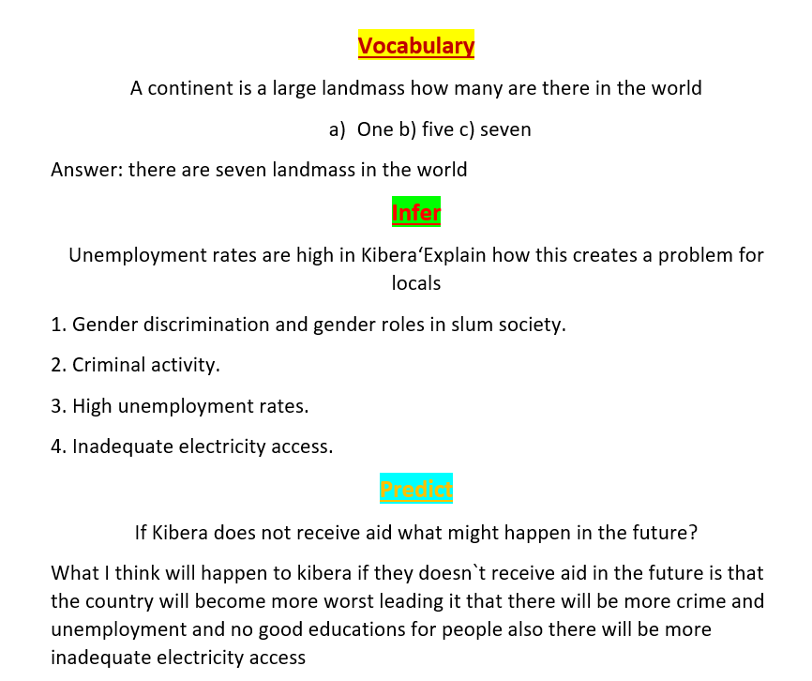
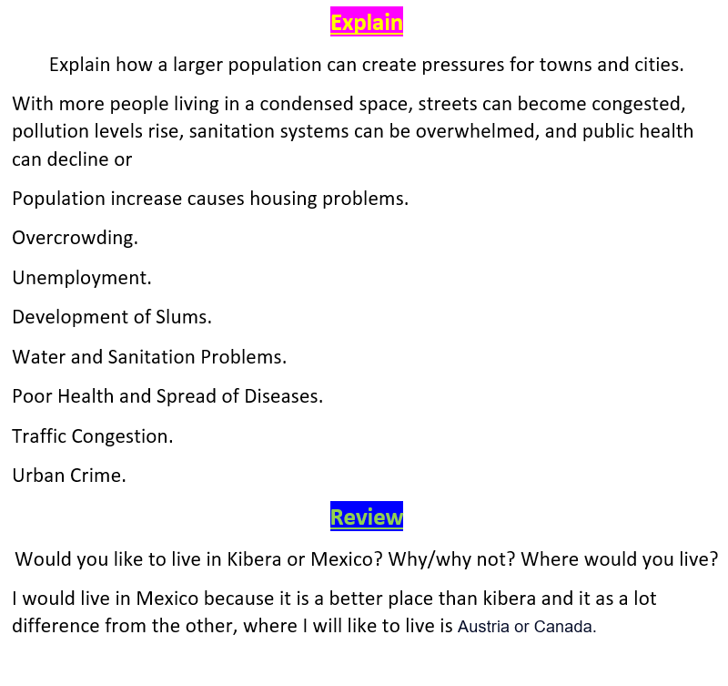
This is an Example of a good 'vipers' homework the questions used in this example may be different from your homework task, this is to give you the opportunity to apply your own understanding.
Strength: Place detail is used effectively e.g. Kibera
Weakness: giving reasons why when responding to 'explain' questions
Next Step: Why does unemployment lead to higher crime rates in Kibera?
VIPERs

