Slide 1
Meaningful Homework Autumn 2
Task:
You have started participating in your favourite sport outside of school and have been asked to purchase the relevant clothing, equipment and technology for your sport. Your parents / carers have asked you to justify why you require this clothing, equipment and technology and have asked you to prepare a mini presentation on this. For each item, you must create a new slide, describing what the item is, why it is required for your sport, what would happen if you did not have this item for your sport. You also need to research and include the cost of each item.
Success criteria:
I have described the purpose of each piece of clothing / equipment / technology
I have described why each piece of clothing / equipment / technology is needed in golf
I have explained whatt would happen if the individual did not have the piece of clothing / equipment / technology for their sport
Guidance:
Use lesson notes
Use the internet to research your sport and the required clothing / equipment / technology

Slide 2
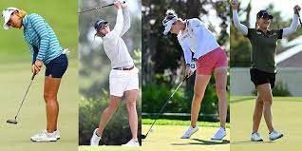
Clothing, equipment and technology in Golf

Slide 3
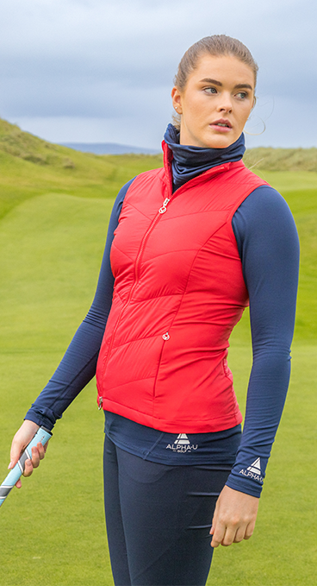
Clothing 1- Compression clothing:
An important type of clothing that I would need to wear for Golf is compression clothing; pieces of clothing that fit tightly around the skin. Compression clothing provides support for people who must perform for prolonged periods or have poor blood circulation, it fits snugly against the skin and applies a gentle pressure to various parts of the body. This pressure is what is believed to improve blood flow, reduce muscle vibration, and increase proprioception (awareness of body position and movement) in the wearer.
Benefits of compression clothing:
Often in golf compression clothing is often worn as a base layer underneath golf shirts and pants. The compression fabric can help improve circulation, which may reduce muscle soreness and fatigue during and after a round of golf. Compression garments may also provide additional support to muscles and joints, which could reduce the risk of injury. All of this is great as I will be starting out in this activity, and therefore will suffer from muscle soreness and fatigue, and this will help to aid recovery so that I do not give up with the sport.
A benefit of compression clothing in golf is that it helps to improve the range of motion. The snug fit of compression garments can help keep muscles and joints in proper alignment, which may lead to more efficient and effective golf swings. This will benefit me as I am new to the sport and need all the assistance possible. It has been mentioned previously that the pressure from the compression fabric can act as a reminder to keep the arms, shoulders, and hips in the proper position throughout the swing, which would be fantastic for a newcomer. It will provide support to my joints, ligaments, and muscles and this is essential to my needs as I am not that physically active. Compression clothing can also be used to improve my posture and can be worn before, after and during any sport or physical activity.
However, with compression clothing there is no conclusive evidence that compression clothing provides a significant performance boost in golf, but many golfers find them to be comfortable and beneficial for their game. So if I invest in this it would help to increase my confidence and my experience within the sport.
Examples of compression clothing would be compression ankle socks, sleeves, shorts, shirts, and bodysuits.
Limitations of compression clothing are:​
Can cause pain to those who are not used to wearing them ​
Some performers may find that they are too tight​
Can affect participants thoughts on their body image

Slide 4
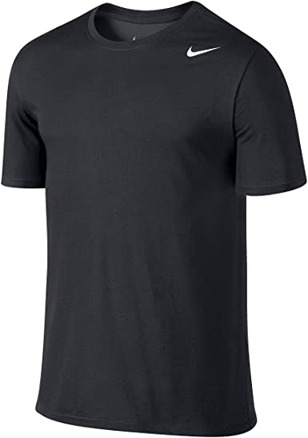
Clothing 2 - Thermoregulation clothing: Dri Fit
A second important type of clothing I will need to wear while participating in Golf is thermoregulation clothing such as dri-fit. It allows the body to keep warm during exercise, so it can use the heat generated by the body to maintain its core temperature. The body can then retain a stable body temperature allowing me to perform at the best of my ability without affecting my safety. Wearing dri-fit clothing will ensure that I am not at risk of hypothermia (the body being too cold) or hyperthermia (the body being too hot) while participating in physical activity outdoors. This will help keep me cool and prevent heat exhaustion or heat stroke. These garments are often made from lightweight, breathable materials like polyester or nylon. If my body temperature remains at a comfortable temperature, I am much more likely to have a nice experience that I will want to repeat.
In colder weather, thermoregulation clothing can help trap heat close to the body and prevent it from escaping, which can help keep me warm and prevent hypothermia and participate all year long. These garments are often made from insulating materials like fleece or wool and may also have features like wind resistance or water resistance.
As previously mentioned, an example of thermoregulation clothing would be a dri fit t-shirts as they are made from a lightweight material which helps performers to stay mobile and permits sweat to move away from the body. It also allows improved breathability to maximize comfort further as well as prevent bad body odour as the air is able to circulate. This is important while participating in Golf as participants are often at risk of hypothermia and wearing dri fit clothing can help
with both the heating and cooling process of the body. The polyester material retains less moisture and perspiration, so that the performer can stay dry while participating in any physical activity regardless of the intensity. A dri fit t-shirt would improve the performance of the participant as the top would still be light weight as the material forces sweat to evaporate rather than sitting in the material and restricting my performance.
Overall, thermoregulation clothing can be a valuable addition to a golfer's wardrobe, helping them stay comfortable and focused on their game in a range of weather conditions. It's important to choose clothing that is appropriate for the specific weather conditions and to adjust layers as needed to maintain a comfortable body temperature.
However, thermoregulation clothing also has many negative factors such as:​
Clothing items can be quite expensive (however this will not affect Priya)​
Not suitable for those with sensitive skin​
Tends to develop an odour​
The fabric clings to your body and some participates may not like or feel comfortable in the clothing items ​
Can be susceptible to damage​
Can affect participants thoughts on their body image​

Slide 5
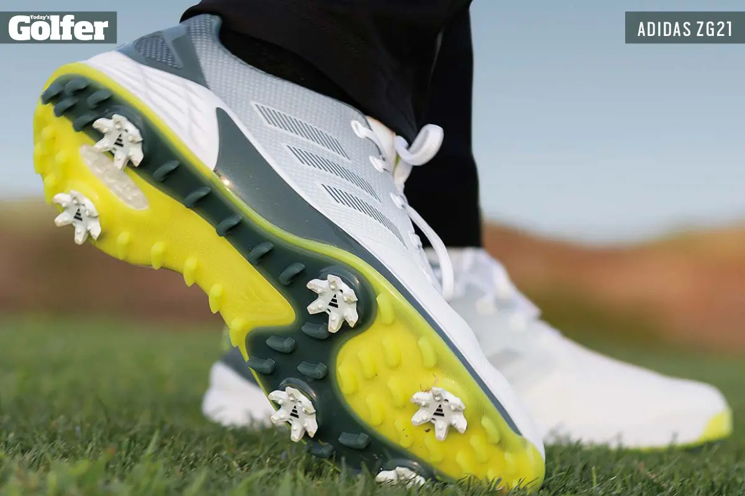
Equipment 1 - Golf shoes:
An important piece of sports equipment I would need to participate in Golf is Golf shoes. Ideally my golf shoes would have spikes as they have been designed to improve performance and safety on uneven surfaces and in slippery conditions. Modern day golf shoes have a set of sharp studs on the bottom of the outsole, called “spikes” and these offer extra grip on wet/muddy courses and on uneven surfaces so would provide additionally safety aspects.
Golf shoes are designed to provide support and cushioning for the feet, which can help reduce fatigue and discomfort during a round of golf. You can also get golf shoes that have additional features like breathable materials and moisture-wicking properties to keep the feet dry and comfortable, all enhancing the experience and increasing the chance that I will continue to participate in the sport.
Another benefit that these golf shoes can provide is arch support. Arch support is crucial while engaging in golf as it helps prevent injuries and provides stability when swinging. This will also make it more comfortable for me as I will often be covering long distances while walking the course.
These specialised shoes permit the performer to generate more power through their legs as the grip provided by the shoes allow the participant to stay grounded, resulting in greater distance.
Golf shoes are typically made with high-quality materials and construction, which can help them last for several seasons with proper care and maintenance which is important so that I do not have to continually replace her equipment.
Limitations:
However, golf shoes have several negative factors and limitations such as:​
Over time the cleats wear down causing them to lose their grip​
Spikeless shoes can be wore on and off of the court whereas spiked golf shoes cannot

Slide 6
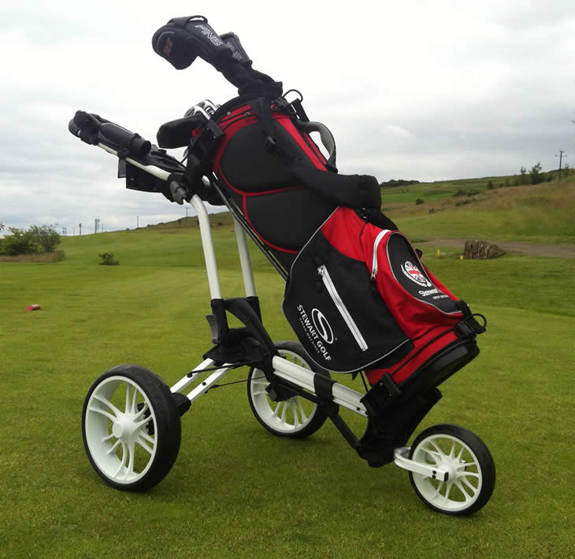
Equipment 2 - Golf trolley
A second important piece of sports equipment that I would need to participate in Golf is a golf cart/trolley. This would benefit me as I would not need to carry around all the required equipment for golf. Golf trolleys can save time and energy by allowing golfers to travel quickly between holes, particularly on larger courses with long distances between holes. This would improve my safety as carrying extra weight could cause me to get tired very quickly which could lead to an injury and this will only have a negative impact on my re-introduction to physical activity.
Using a golf trolley has many other benefits:
Health benefits: Pushing a golf trolley can provide a low-impact form of exercise that can improve cardiovascular health, burn calories, and promote better posture which would be a great reintroduction into physical activity. Golfers can have a lot of equipment and if I use a golf trolley it will provide me with a convenient and efficient way to transport my equipment around the golf course, without the need for a motorized vehicle, which brings about environmental benefits. This is due to not using a Golf cart/buggy which would produce carbon emissions. So a trolley is more eco-friendly. Using a trolley will also help to reduce damage to the course caused by motorized vehicles. This can help to preserve the natural beauty and quality of the course for future golfers. I would also save money in the long run as it is a much more cost-effective alternative to renting a golf buggy or hiring a caddy.
Therefore, investing in a gold trolley/cart would be a great investment for me
However, the limitations are:​
They can be damaged due to weather conditions​
Expensive -Renting a golf buggy can add to the overall cost of playing golf, particularly if it is required for every round.
They can easily slide, skid, and sink when the course/turf is wet due to the weather
Golf buggies can be dangerous if not operated safely, particularly if driven at high speeds or on uneven terrain. Golfers can also be at risk of injury if they fall out of the buggy or if the buggy overturns.
Golf buggies are not always able to access all areas of the golf course, particularly on hilly terrain or around water hazards. This can limit a golfer's ability to reach certain areas of the course and may require them to walk part of the way.

Slide 7
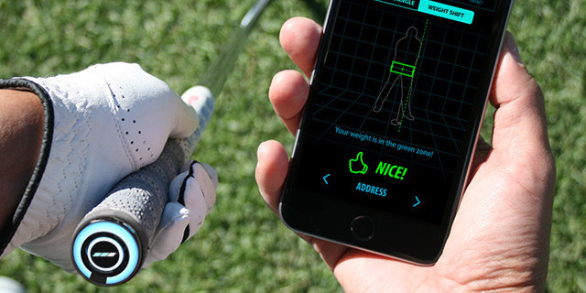
Technology 1- swing sensors:
A piece of technology I could use while participating in golf is swing sensors; these are sensors that are attached to the performer’s gloves or clubs, and they are used to measure the swing metrics, 3D animations, swing speed, tempo, club path and shaft angles.
They also help the performer to improve their distance, control, and accuracy and to optimise their swing, therefore allowing me to improve my level of performance further as they provide tips on how they can improve their
technique. The benefits of using a swing sensor will also allow me to monitor how far I have enhanced my performance in golf over a period of time. I will also be able to monitor my performance over time which will help to show where I am improving, this will help to increase my confidence as I achieve new skills and goals. The Swings sensors will help me to continue to enhance my performance in the future as they help participants to diagnose issues and offer clear feedback both during and after practice, this is great as I will have limited knowledge of the sport and having an aid to provide feedback to me all the time will fill this gap of inexperience.
​
​
Limitations such as:​
They feature lots of data and numbers that the participant may find difficult to read​
The sensors have to be transported from one club to another club which will reduce the participants playing time​
There is other devices that will provide more relevant information​
Participants can often be faced with connection problems during playing time

Slide 8
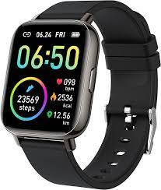
Technology 2 - Fitness watch:
A piece of technology I could use while participating in golf is a fitness watch, such as an Apple watch or Fitbit, as they offer personalised fitness advice and provide immediate health feedback to the participant. This would help to improve performance as it will allow me to monitor my heart rate, calories burnt, and step counts. This can be helpful as I can monitor my overall physical activity levels and track my progress towards my fitness goals.
This equipment also allows the performer to check their sleep data allowing me to visibly see how my sleep pattern has improved because of my participation in physical activity. This is an important factor as I do struggle with my sleep so would be great to monitor it. It will also help me to know that I am getting enough sleep to help with recovery from physical activity.
Limitations are:​
Obsessive thoughts over fitness goals​
They track and store the participants data​
Not all date recorded will be correct​ as the accuracy of the data can vary depending on factors such as the quality of the sensors and the fit of the watch. This can affect the accuracy of measurements such as distance traveled, heart rate, and calorie burn.
Fitness watches can have limited battery life, especially if they are used for activities such as GPS tracking and heart rate monitoring. This can be a limitation for Priya who want to use her watch for an entire round of golf without having to recharge.
Can be expensive.
As I am really committed to school and want to create a better work life balance I can use golf as an escape, but I could still keep up to speed and connected with alerts for incoming calls, messages, and other notifications on my smart watch, keeping me in contact with friends and family whilst playing.

