Slide 1

Meaningful Homeworks
Year 10

Slide 2
Autumn 2 - A Christmas Carol
Task: Using the theme of “guilt” as the stimulus, and the quotation provided, complete the quotation drill/ in-depth analysis, linking to other parts of the text
Guidance:
Read the quotation at the top of your sheet
Complete each task
How does Dickens present ideas about guilt? Write one paragraph using the quotation you have just analysed. You may wish to use PETAL.
Success criteria:
Tasks to be completed in note-form to ensure you can get down as many ideas
Paragraph to be written in full sentences and include clear points, a developed explanation, evidence from the text, multiple inferences and a link to context/ the reader.

Slide 3

Complete the quotation drill before answering the quick question using the line you have analysed in the grid.
‘The chain he drew was clasped about his middle. It was long, and… made of cash-boxes, keys, padlocks, ledgers, deeds, and heavy purses wrought in steel.’
Who/what is the quotation about? What does the quotation mean? What does the quotation suggest? | What is Marley’s chain symbolic of? Why use a chain to symbolise this? What are the connotations of a chain? | Marley adopts the appearance of a Victorian prisoner. What does this tell us about society during this time? | Discuss the significance of ‘weight’ in this quotation.
What is Dickens’ authorial intent? What is he trying to say about the consequences of one’s actions through this quotation? | How can you connect this quotation to other areas of the text? Consider ideas from all staves. | Complete single word analysis on ‘clasped’. What does this tell us about the chain?
Now write a paragraph which answers this question. In your response, use the quotation you have just analysed: How does Dickens present ideas about guilt?
Which topics can this quotation be filed under? One has already been done for you:
- Consequences
Notes:
@SPryke2

Slide 4
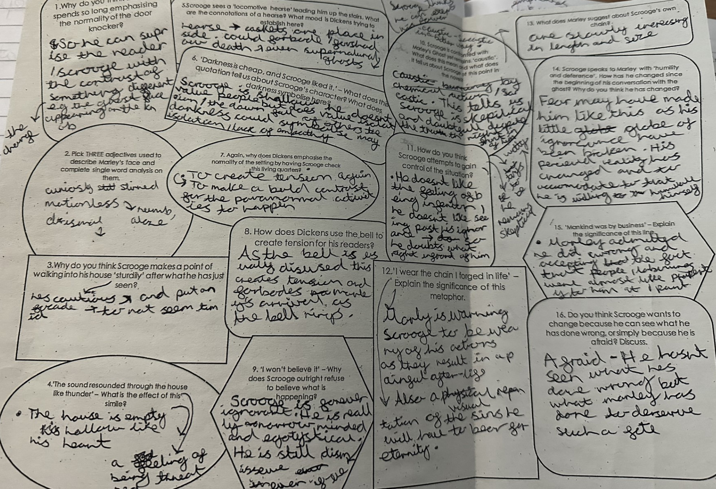
Autumn 2 - A Christmas Carol
Worked Example
Note: this task is not the same but shows the same skills necessary for the task you have been given.

