Slide 1
Autumn 2

Slide 2
Autumn 2 – Diversity and Poetry (HWK 1)
Task:
Read the unseen poem 'Island Man' and answer the VIPERS questions.
Guidance:
Accurate use of SPaG
Show an understanding of the extract
Accurately identify poetic devices
Make inferences about the use of colour
Summarise the differences
Use precise academic vocabulary
Success Criteria:
SY – Summary
WT – Writer technique
I – Inference
SP – Spelling
AV/KW – Ambitious vocabulary/ keywords
P – Punctuation is used accurately

Slide 3
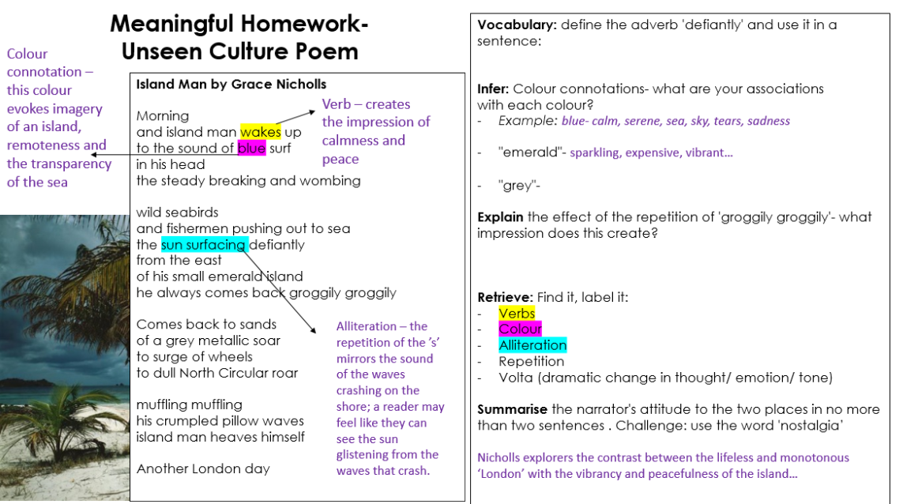
Autumn 2 – Diversity and Poetry (HWK 1)
Note: This worked example is only partially complete to allow for your own original ideas.

