Slide 1

Meaningful Homeworks
Year 9

Slide 2
Autumn 2 – Discursive Writing (HWK 1)
Task: The Secretary of State for Education has said - ‘Schools should have longer days to help students catch up from the pandemic. All students should have to do an extra two hours of school every day.’
Write an article for a news website to give your views on this.
Guidance:
Complete each task within the allocated time to support you with planning your article.
Remember:
Submit work to your teacher in class, via Email or Weduc
Outstanding work will be rewarded with Classcharts points and a Pride of the King's nomination.
Success Criteria:
Each task completed in the alloted time
Ambitious vocabulary
Use of, at least, three langauge devices
Use of, at least, three pieces of punctuation
Accurate SPaG
Use of DAFORREST features

Slide 3
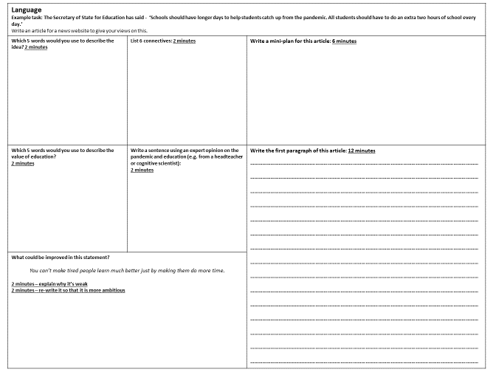

Slide 4
Autumn 2 – Discursive Writing (HWK 1)
Task: The Secretary of State for Education has said - ‘Schools should have longer days to help students catch up from the pandemic. All students should have to do an extra two hours of school every day.’
Write an article for a news website to give your views on this.
Guidance:
Complete each task within the allocated time to support you with planning your article.
Remember:
Submit work to your teacher in class, via Email or Weduc
Outstanding work will be rewarded with Classcharts points and a Pride of the King's nomination.
Success Criteria:
Each task completed in the alloted time
Ambitious vocabulary
Use of, at least, three langauge devices
Use of, at least, three pieces of punctuation
Accurate SPaG
Use of DAFORREST features
As it has recently come to light that schools are advocating for longer days to counteract the effects of the COVID pandemic, I am writing to you, as a student, to outline my concerns about the devastating, distressing and damaging effects of burnout for school students.
Impactful, eternal and regimented are three of the words which I understand would sum up most school experiences. However, with a 25% increase in the number of students suffering from mental health issues due to anxiety, stress and depression, do you believe that forcing them into school for another two hours a day is going to have such a beneficial impact?
It is not only students who are concerned: experts studying the psychology of young people claim that "arriving at school at 7am and studying until 4pm is not effective scheduling for the brains of youngsters who are bound to become overloaded with information and unable to process it".
A teacher example which shows some use of a range of punctuation, sentence length, and DAFORREST techniques.

