Slide 1

Transition Tasks
Biology

Slide 2
SI Units
Every measurement must have a size (eg 2.7) and a unit (eg metres or ºC). Sometimes, there are different units available for the same type of measurement. For example, ounces, pounds, kilograms and tonnes are all used as units for mass. To reduce confusion, and to help with conversion between different units, there is a standard system of units called the SI units which are used for most scientific purposes.
These units have all been defined by experiment so that the size of, say, a metre in the UK is the same as a metre in China.
The seven SI base units are:
Physical quantity | Usual quantity symbol | Unit | Abbreviation
mass | m | kilogram | kg
length | l or x | metre | m
time | t | second | s
electric current | I | ampere | A
temperature | T | kelvin | K
amount of substance | N | mole | mol
luminous intensity | (not used at A-level) | candela | cd

Slide 3
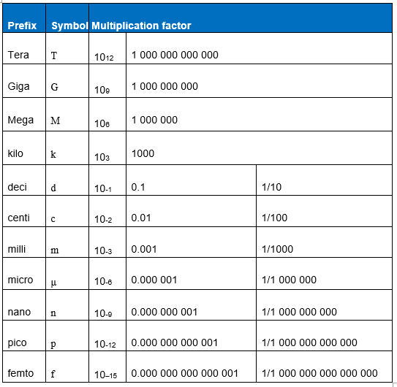
SI Units
All other units can be derived from the SI base units.
For example, area is measured in square metres (written as m²) and speed is measured in metres per second (written as ms^{–1}).
It is not always appropriate to use a full unit. For example, measuring the width of a hair or the distance from Manchester to London in metres would cause the numbers to be difficult to work with.
Prefixes are used to multiply each of the units. You will be familiar with centi (meaning 1/100), kilo (1000) and milli (1/1000) from centimetres, kilometres and millimetres.
There is a wide range of prefixes. The majority of quantities in scientific contexts will be quoted using the prefixes that are multiples of 1000. For example, a distance of 33 000 m would be quoted as 33 km.
The most common prefixes you will encounter are:

Slide 4
Task 1:
Put the following in order of size:
height of an elephant; length of DNA strand; width of a hair; height of a tree; width of a sodium ion; length of a nerve cell; length of a heart; width of a red blood cell; size of a virus; length of a finger; length of a mosquito; length of a human digestive system; width of a field; length of a water molecule.

Slide 5
Task 2:
All life on Earth exists as cells. These have basic features in common. Complete the table:
Structure | Function
Cell-surface membrane
Chloroplast
Cell vacuole
Mitochondria
Nucleus
Cell wall
Chromosomes
Ribosomes
Draw the structure of a plant cell and an animal cell. On each cell, add labels showing each of the structures in the table, if they exist.

Slide 6
Task 3: Photo synthesis and Respirations
 | Photosynthesis | Aerobic respiration
Which organisms carry out this process?
Where in the organisms does the process take place?
Energy store at the beginning of the process | Sun
Energy store at the end of the process |  | In cells
Reactants needed for the process
Products of the process
Overall word equation
Balanced symbol equation for the overall process
Complete the table. Which of the answers for aerobic respiration would be different for anaerobic respiration? Add these answers to the table.

Slide 7
Task 4:
Match the examples to the principle(s) involved. For each, give a brief description of why it is relevant.
Osmosis
Diffusion
Active Transport
Changing surface area or length
Examples
Drinking a sports drink after exercise
Gas exchange in the lungs
Absorbing nutrients from food into the body
Moving ions into cells
The effect of salt on slugs
Penguins huddling together to keep warm
Potato pieces get heavier when put in pure water
Potato pieces get lighter when put in very salty water
Cacti do not have thin, large leaves

Slide 8
Task 5:
A student investigated an area of moorland where succession was occurring. She used quadrats to measure the area covered by different plant species, bare ground and surface water every 10 metres along a transect. She also recorded the depth of soil at each quadrat. Her results are shown in the table.
 | Area covered in each quadrat A to E in cm²
 | A | B | C | D | E
Bog moss | 55 | 40 | 10 | – | –
Bell heather | – | – | – | 15 | 10
Sundew | 10 | 5 | – | – | –
Ling | – | – | – | 15 | 20
Bilberry | – | – | – | 15 | 25
Heath grass | – | – | 30 | 10 | 5
Soft rush | – | 30 | 20 | 5 | 5
Sheep’s fescue | – | – | 25 | 35 | 30
Bare ground | 20 | 15 | 10 | 5 | 5
Surface water | 15 | 10 | 5 | – | –
Soil depth / cm | 3.2 | 4.7 | 8.2 | 11.5 | 14.8
– indicates zero cover.
Calculate:
the mode area of soft rush in the sample
the mean soil depth
the median amount of bare ground in the sample.

Slide 9
Task 6:
Lung cancer, chronic bronchitis and coronary heart disease (CHD) are associated with smoking. Tables 1 and 2 give the total numbers of deaths from these diseases in the UK in 1974.
Table 1 Men
Table 1 Women
Age/years | Number of deaths (in thousands)
 | lung cancer | chronic bronchitis | coronary heart disease
35-64 | 11.5 | 4.2 | 31.7
65-74 | 12.6 | 8.5 | 33.3
75+ | 5.8 | 8.1 | 29.1
Total (35-75+) | 29.9 | 20.8 | 94.1
Age/years | Number of deaths
 | (in thousands)
 | lung cancer | chronic bronchitis | Coronary heart disease
35–64 | 3.2 | 1.3 | 8.4
65–74 | 2.6 | 1.9 | 18.2
75+ | 1.8 | 3.5 | 42.3
Total (35–75+) | 7.6 | 6.7 | 68.9
Please answer the questions on the next slide:

Slide 10
Task 6 Questions
Of the men who died aged 35-64 from one of these three causes, what percentage of them died of lung cancer?
What percentage of deaths from chronic bronchitis in women happened to women aged 65-74?
Deaths from lung cancer drop as people get older. Is there a bigger percentage difference for men or women from 35-64 to 75+?
What fraction of coronary heart disease deaths of men over 34 are in the
75+ bracket? What about for women?

Slide 11
Please email your completed work to:
Miss Butler
EButler@thekings.staffs.sch.uk

