Slide 1

Transition Tasks
Information Technology

Slide 2
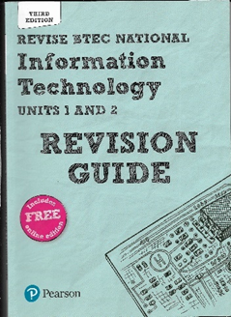
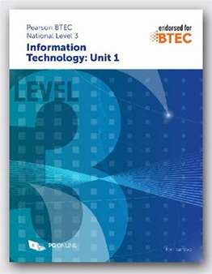
Recommended Resources
https://www.bbc.co.uk/bitesize/levels/z98jmp3 - Whilst aimed at GCSE, this will also provide useful information on many areas, especially if you did not do GCSE Computing. You can use the information in the ICT, Computing and Digital Technology areas
https://www.bbc.co.uk/news/technology - this area of the BBC news website will provide you with up-to-date information on technology development
https://www.knowitallninja.com/ - a website dedicated to L3 BTEC. Especially useful for Unit 1
https://www.thinkuknow.co.uk/ - website for e-safety advice
Pearson Textbook – can be purchased online
PG Online textbook – excellent for Unit 1 theory
Pearson Revision Guide – invaluable for the externally assessed units

Slide 3

Task 1: Digital Divide
Digital divide
The digital divide is one ethical, social and moral issue surrounding the use of IT.
Complete the following using the recommended resources:
Define the term digital divide
Explain causes of the digital divide
Find evidence to prove that the digital divide exists, i.e. the % of people with internet connection across countries
What are the impacts of the digital divide for individuals, businesses and society as a whole?
What can businesses or other organisations do in order to minimise the digital divide and its consequences?
You can present this as either a PowerPoint presentation or a word document. Include a bibliography of the sources that you have used.

Slide 4
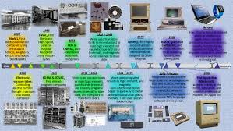
Task 2: History of computing
Charles Babbage is considered to be the father of the concept of the programmable computer, as long ago as 1820. However, it has taken many years for computers to be as commonplace as they are today.
Investigate Charles Babbage and other important figures in the history of commuting:
Ada Lovelace
Alan Turing
Tim Berners-Lee
Alan Sugar
Present your work as a word-processed document to include background information on each person, an image, what they did that is so significant in the history of computing. Remember to include a bibliography

Slide 5

Task 3: Social Media
Facebook is now the most widely used social media platform, but it was not the first, nor was it invented for the purpose that it is used for today.
Produce a word processed report about social media use that includes:
The names of a range of social media platforms with information about when, where, why they were launched
Data and analysis about the use of social media – which are the most used platforms, is this different across different countries, continents, or age groups
Benefits and limitations of social media use for (a) individuals and (b) business organisations
At least one example of where an individual has had their career impacted due to improper social media use
A bibliography

Slide 6

Task 4: Connectivity
Read this article from the bbc: https://www.bbc.co.uk/news/technology-52414280
What is an Ethernet cable?
What is bandwidth?
Why does more people using the internet affect the speed?
Why would gaming need a faster speed than general browsing?
What are drawbacks of using wired and wireless methods for big organisations?
Present your answers as two word-processed files

Slide 7

Task 5: Emerging Technology
Emerging technology is new technology. Select FOUR from the following:
Artificial intelligence
Biometrics
Robotics
Virtual reality
Drones
Augmented reality
3D printing
Internet of things
For each one you select do the following
Explain what this technology is
Explain how it could be used by individuals at home
Explain how it could be used within the workplace
Implications of these emerging technologies -both positive and negative
Present the tasks as a word-processed document or a PowerPoint presentation

Slide 8
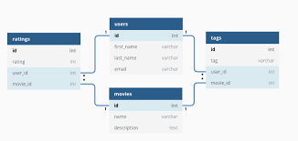
Task 6: Database Key Terms
Use the suggested resources to define the following terms which are used in databases:
Database
Table
Field
Record
Data type
Validation
Verification
Flat file database
Relational database
Primary key
Query
Form
Explain who might use a database and what for?
Analyse the benefits and limitations of using a database rather than paper records
Present the tasks as a word-processed document or either a PowerPoint presentation with images if you think this will help.

Slide 9
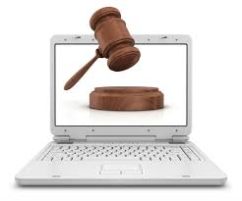
Task 7: Legal Issues
The Computer Misuse Act is one of the laws that relate to ICT use.
Research the following and present in a word-processed document:
The main role of the law, i.e. what does it say is illegal
The impact on organisations of the law
The impact on individuals of the law
The consequences of not following the law on (a) an individual and (b) a business
A news story where an organisation has failed to comply with this law, and the outcome of the incident
Present the tasks as a word-processed document or either a PowerPoint presentation with images if you think this will help.

Slide 10
Please email your completed work to:
Mr Aslam
ZAslam@thekings.staffs.sch.uk

