Slide 1

Transition Tasks
Criminology

Slide 2
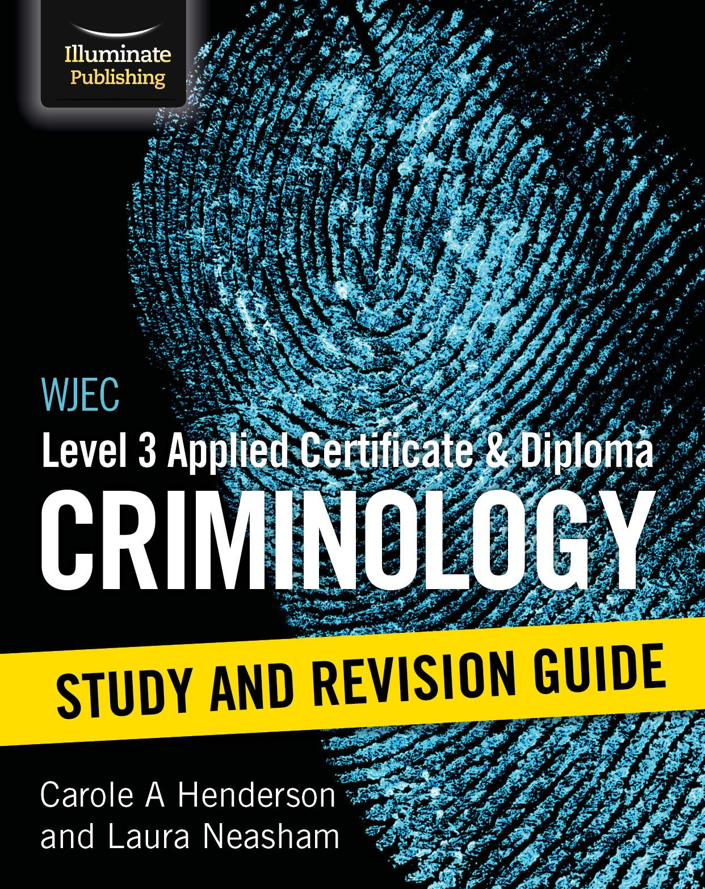
Book Recommendation:
This book is full of revision tips and practice exam questions. It has been written by the principal examiner and principal moderator and therefore gives an insight on what they expect to see in a good exam answer

Slide 3
Task 1 (Links to Unit 1 and 2):
Record your views on the crime in each documentary- did you notice any changes?
Amanda Knox- https://www.youtube.com/watch?v=erla7Ley4Tw
Young gunman - https://www.youtube.com/watch?v=h3O3bh59dRA
Robert Napper - https://www.youtube.com/watch?v=JW1iDijmSOE
Damilola Taylor - https://www.youtube.com/watch?v=JA8669b7gKk&t=2s
Stephen Lawrence https://www.youtube.com/watch?v=ZsHwKPE0mjU&t=28s
Timothy Evans - https://www.youtube.com/watch?v=YSL_zNIxM-k

Slide 4
Task 2 (Links to Unit 2):
Research and make notes on the different explanations for criminal behaviour.
Genetic theories – XYY and Twin studies
Physiological theories – Cesare Lombroso and William Sheldon
Learning theories – Bandura
Psychodynamic theories – Sigmund Freud
Psychological theories – Hans Eysenck
Social structure theories – Marxism
Functionalist theories – Robert Merton’s strain theory

Slide 5
Task 3 (Links to Unit 1):
Research and create a PowerPoint covering definitions and examples of the following:
The Broken windows theory – briefly explain this theory.
Differential association theory by Sutherland - briefly explain this theory
Define these types of crime and give examples:
State crime
Green crime
White collar crime
Hate crime

Slide 6
Task 4 (Links to Unit 1):
Watch the documentary and answer the questions about honour crime
https://www.youtube.com/watch?v=1HPjiYkyh04
What is honour crime?
Who is often the victim of honour crime?
Find examples of honour crime cases in the news – outline the charges, crimes committed, sentences given etc.
Why is honour crime hard to uncover, prosecute and prevent?

Slide 7
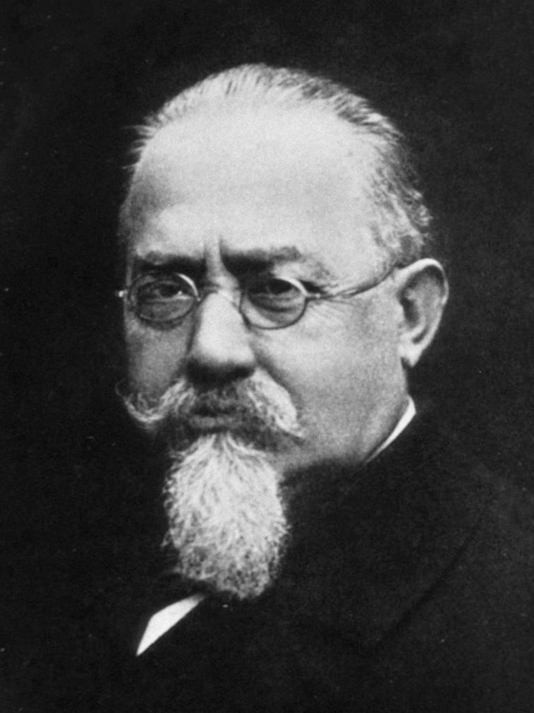
Influential person: Cesare Lombroso
Lombroso was an Italian psychiatrist and military doctor who developed theories about criminals. Known as the ‘Father of Modern Criminology’, he pioneered the use of scientific methods in criminology. He argued that the criminal is a separate species, a species that is between modern and primitive humans. He argued that a ‘born criminal’ could be determined by the physical shape of the head and face. He also claimed that criminality was heritable.

Slide 8
Please email your completed work to:
Miss Bailey JBailey@thekings.staffs.sch.uk

