Slide 1

Transition Tasks
Engineering

Slide 2
Unit 4: Applied Commercial and Quality Principles in Engineering
The unit in brief – You are required to explore commercial engineering. The key business activities, sot control, quality systems and value management, which is used by engineering organisations to create value.

Slide 3
Unit 4: Applied Commercial and Quality Principles in Engineering
Engineering organisations use a wide range of systems and methods to ensure that they are competitive. For example, organisations can develop a competitive advantage by increasing the quality of their products, innovating with new product designs or reducing the cost of their operations. Well-known brands that have successfully produced a competitive advantage in this way include Dyson, Rolls-Royce and Škoda.
In this unit, you will explore how key business activities and trade considerations influence engineering organisations and are used to create a competitive advantage. You will understand why organisations need to control costs and how they make decisions, applying an activity-based costing methodology. You will also understand what is meant by quality and why it means different things to different people; you will investigate quality systems, including quality assurance and control. Finally, you will explore value management as a process to create value in an organisation.
The quality systems and value management principles and processes provide a foundation for business process improvement techniques, such as Lean and Six Sigma, which many engineering organisations follow to ensure continuous improvement. It has not been possible to include these methodologies as part of this unit; however, should you encounter them in the workplace then this unit provides a basis for understanding and applying them.
As an engineer, it is important that you understand some of the commercial and competitive considerations which ensure that engineering organisations thrive. You will need to apply these principles to technical engineering projects to ensure that they add value to the organisation and are profitable. This unit will help to prepare you for an engineering apprenticeship, higher education and technician-level engineering roles.

Slide 4





Task: Examine business functions that help engineering organisations thrive
In order to be successful you need to:
Write a report on one local, national or international engineering company.
Guidance
Research the key activities of the different business functions within your chosen engineering organisation.
Research the organisations supply chains management & resource management.
Research how the engineering organisations markets and sells the product or services it provides.

Slide 5
Task: Examine trade considerations that help engineering organisations thrive
In order to be successful you need to:
Write a report on one local, national or international engineering company.
Guidance
Research how the engineering organisation trades and relates to their customers.
Research how the organisation recruits staff.
Explain the management and finance situation of the engineering organisation.

Slide 6
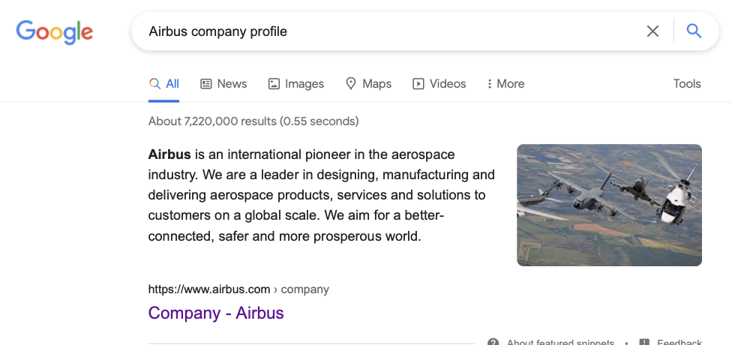
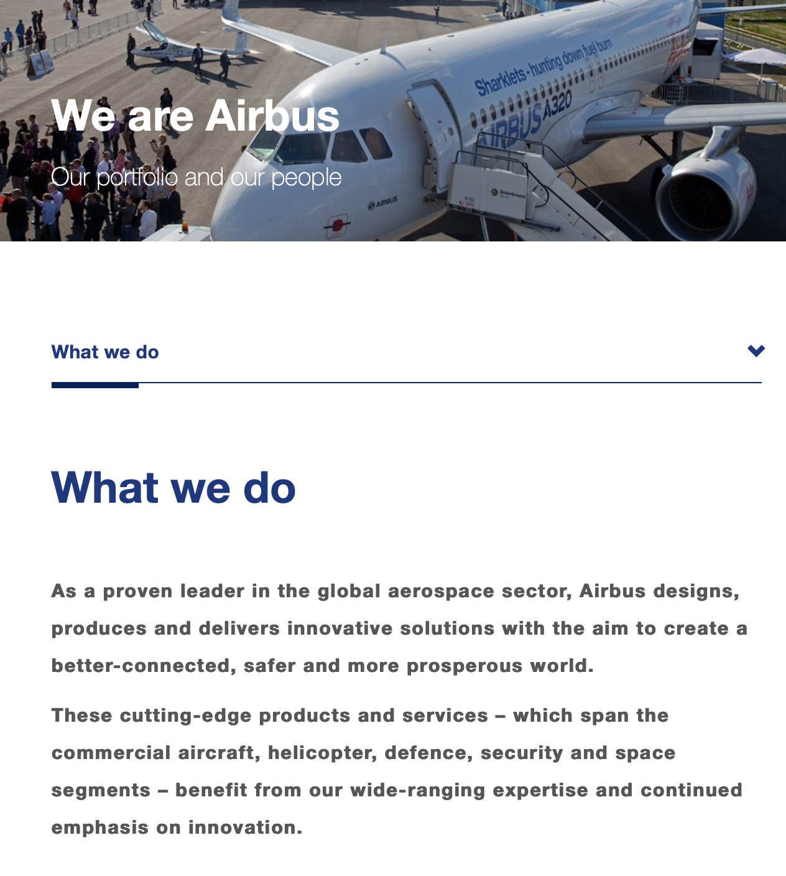
Hints, tips & know how guide
Task: Examine business functions that help engineering organisations thrive
In order to be successful you need to:
Write a report on one local, national or international engineering company.
Guidance.
Research the key activities of the different business functions within your chosen engineering organisation.

Slide 7
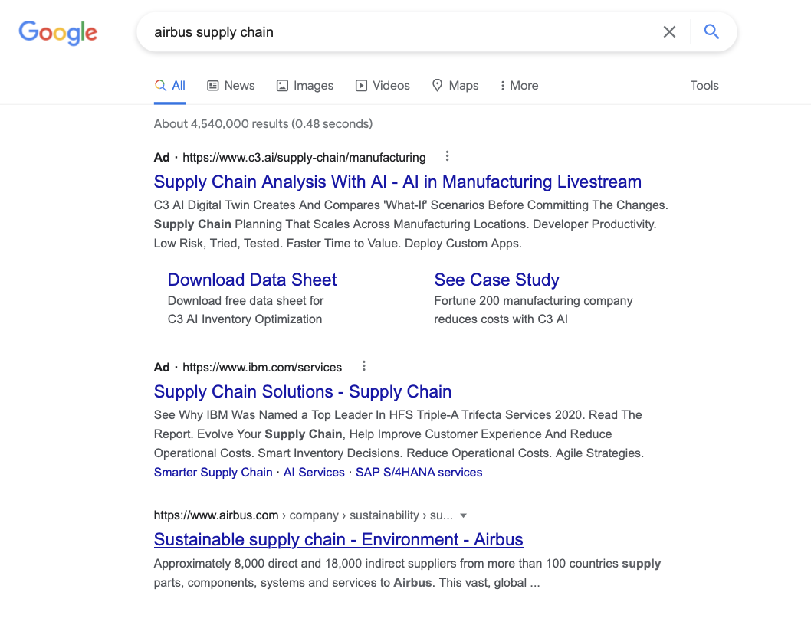
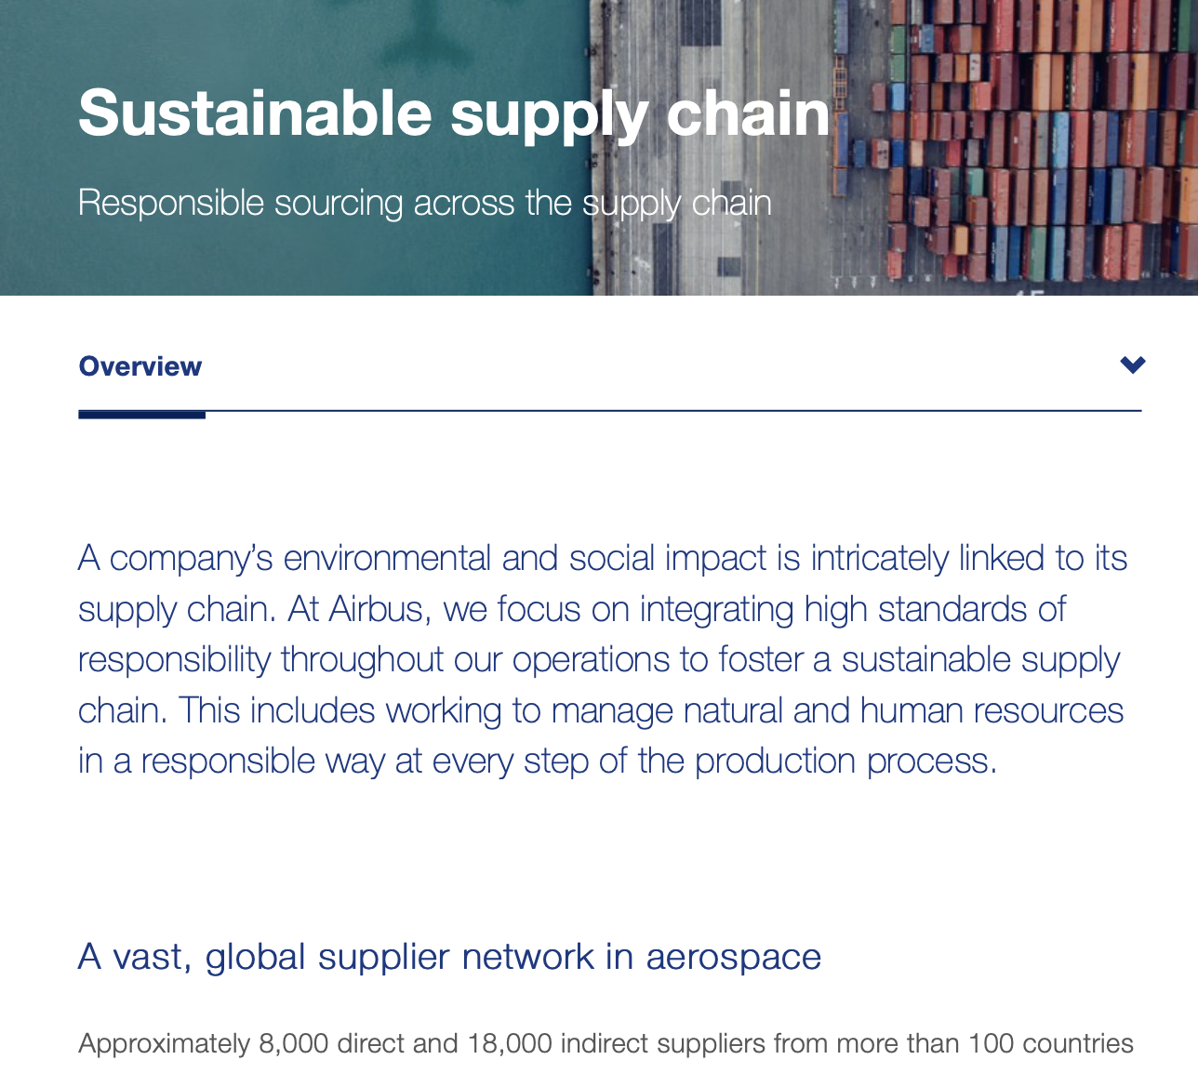
Task: Examine business functions that help engineering organisations thrive
In order to be successful you need to:
Write a report on one local, national or international engineering company.
Guidance
Research the organisations supply chains management & resource management.

Slide 8
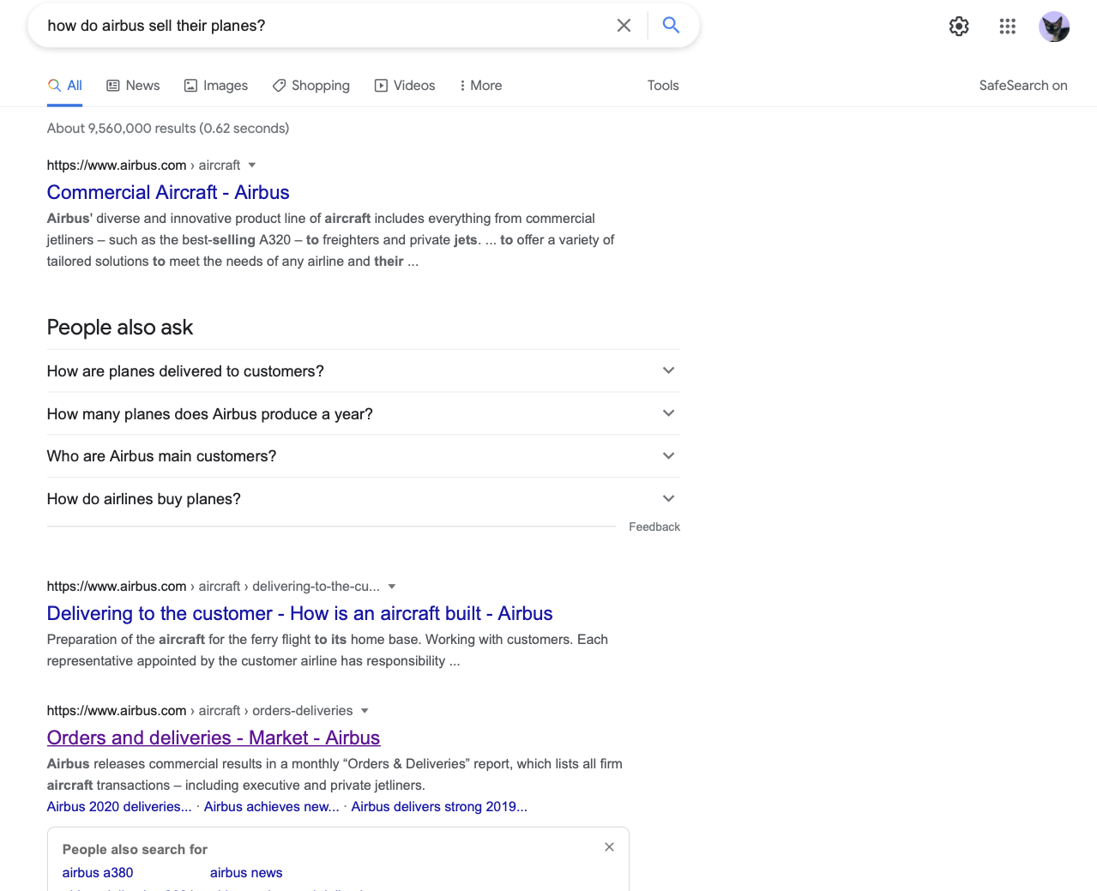
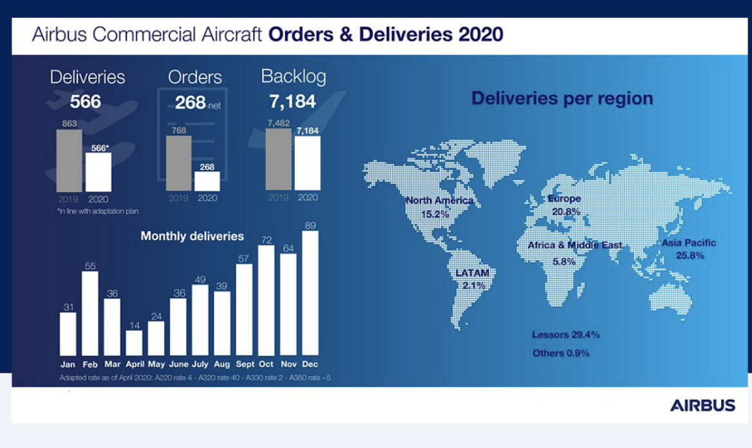
Task: Examine business functions that help engineering organisations thrive
In order to be successful you need to:
Write a report on one local, national or international engineering company.
Guidance
Research how the engineering organisations markets and sells the product or services it provides.

Slide 9
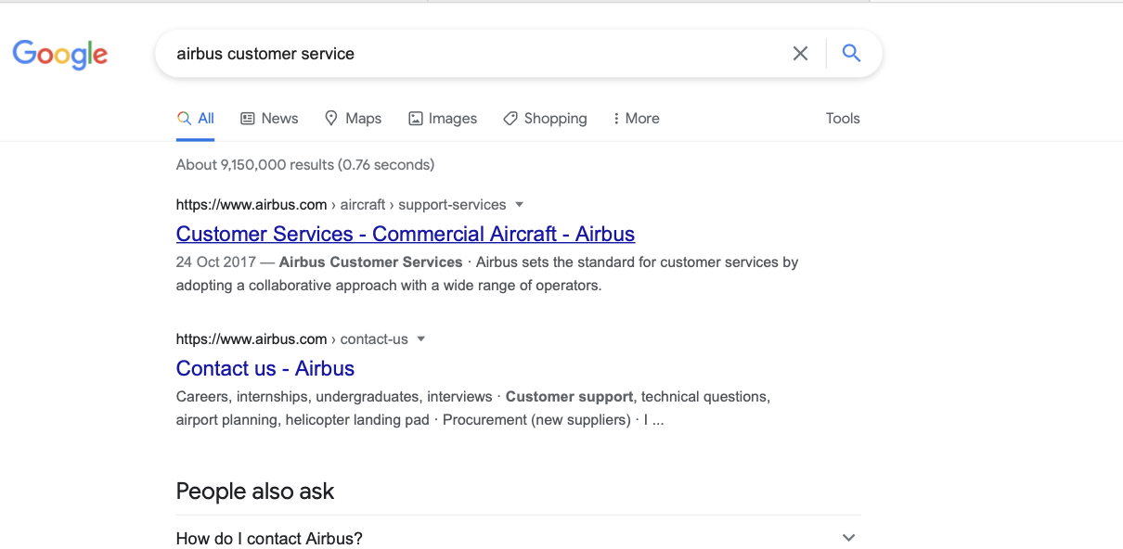
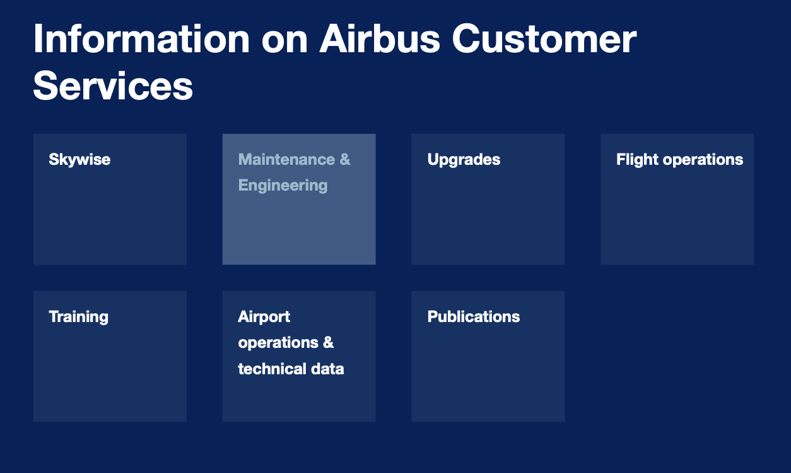
Task: Examine trade considerations that help engineering organisations thrive
In order to be successful you need to:
Write a report on one local, national or international engineering company.
Guidance.
Research how the engineering organisation trades and relates to their customers.

Slide 10
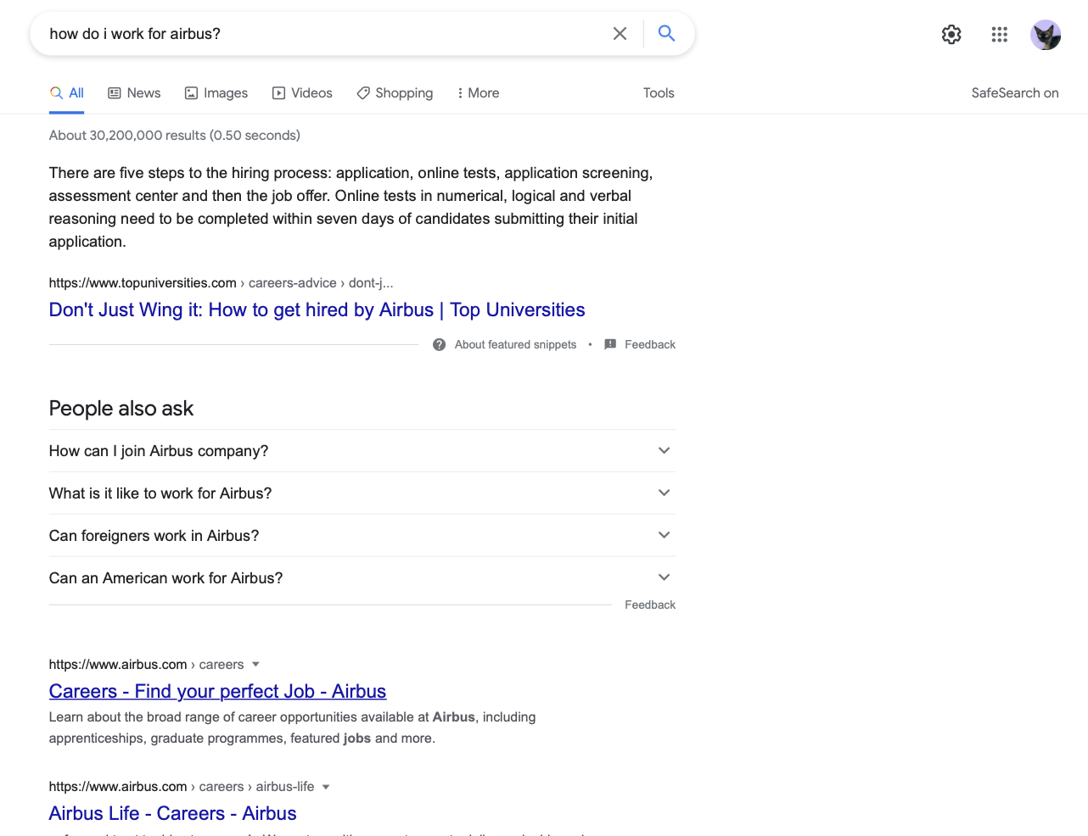
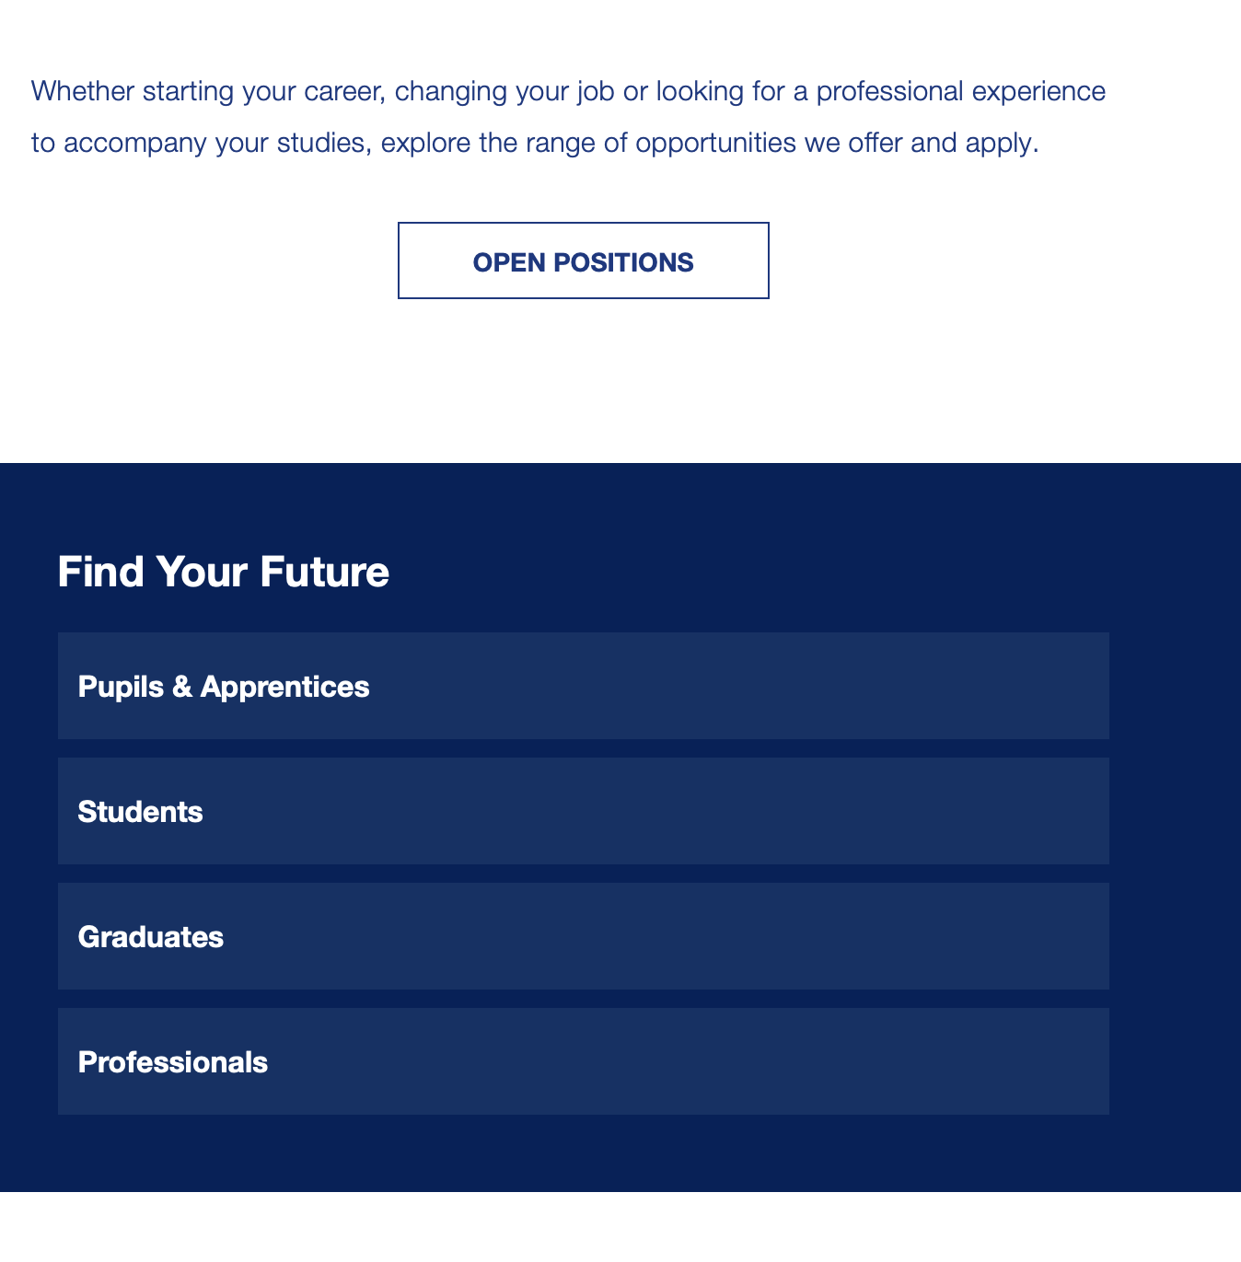
Task: Examine trade considerations that help engineering organisations thrive
In order to be successful you need to:
Write a report on one local, national or international engineering company.
Guidance
Research how the organisation recruits staff.

Slide 11
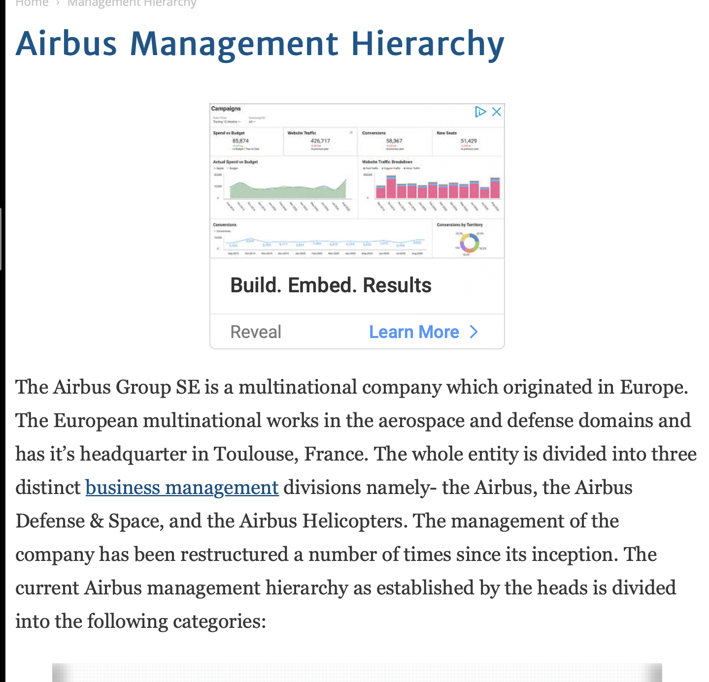
Task: Examine trade considerations that help engineering organisations thrive
In order to be successful you need to:
Write a report on one local, national or international engineering company.
Guidance
Explain the management and finance situation of the engineering organisation.

Slide 12
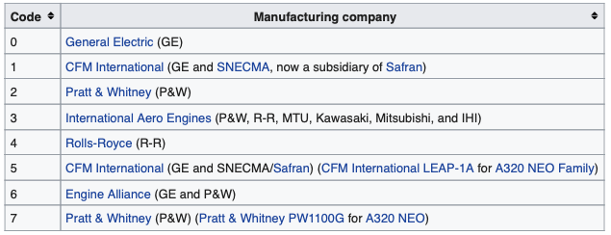
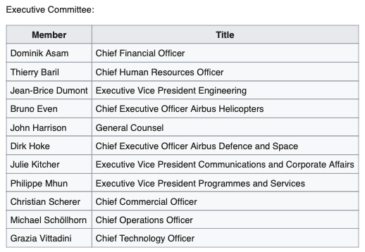
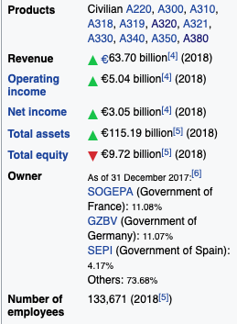
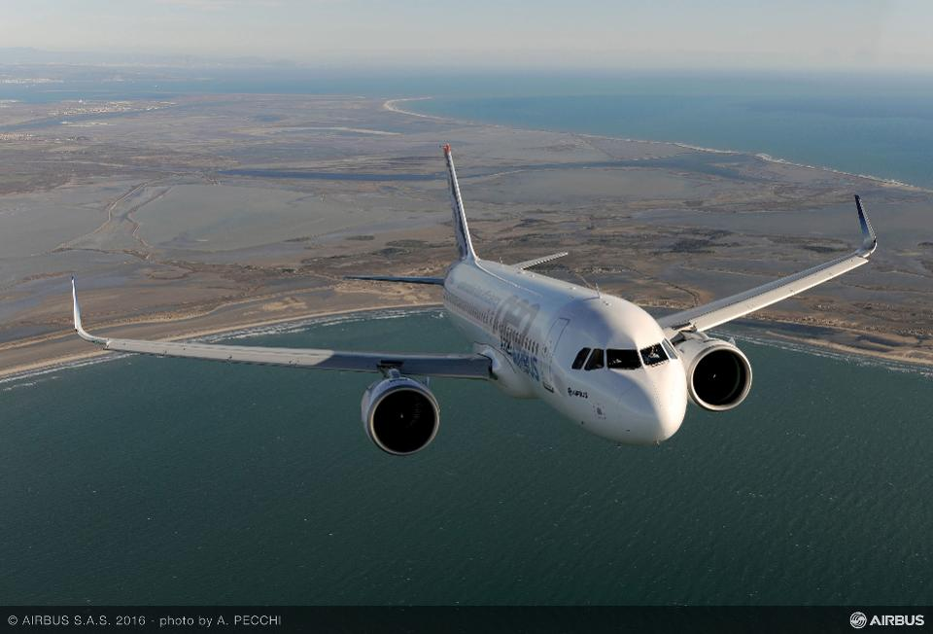
EXAMPLE
Airbus
Which engineering companies work with airbus.
Who are airbus?
Airbus is a European multinational aerospace corporation that stood as the world's second biggest aerospace and defence company in 2018.
Registered in the Netherlands and trading shares in France, Germany and Spain,
Airbus designs, manufactures and sells civil and military aerospace products worldwide and manufactures in the European Union and various other countries. The company has three divisions: Commercial Aircraft, Defence and Space, and Helicopters, the third being the largest in its industry in terms of revenues and turbine helicopter deliveries.
The company produces and markets the first commercially viable digital fly-by-wire airliner, the Airbus A320 and the world's largest passenger airliner, the A380. The 12,000th aircraft, an A220, was delivered to Delta Air Lines on 20 May 2019. By October 2016, the global Airbus fleet have performed more than 110 million flights totalling over 215 billion kilometres and carrying 12 billion passengers.
Who are the bosses?
What are the different parts of the airbus business?
Commercial aircraft.
Commercial aircraft generated 67% of total revenue for the group in 2013.^{[60]} The product portfolio of such aircraft encompasses short range models such as the A320 family and the world's largest passenger airliner, the A380.
Defence and Space.
The division Airbus Defence and Space was formed in January 2014 as part of the group restructuring from the former EADS divisions Airbus Military, Astrium, and Cassidian (composed of Cassidian Electronics – develops and manufactures sensors, radars, avionics and electronic warfare systems for military and security applications, Cassidian Air Systems – develops manned and unmanned aerial systems (UAVs), mission avionics, electronic defence and warning systems and Cassidian Systems – provides global security solutions^{[buzzword]} such as command & control, lead system integration, TETRA and TETRAPOL communication systems for public safety, industry, transportation and defence. This line of business was the first one in the world to begin field tests with TETRA Enhanced Data Service (TEDS)
Airbus Military.
The Airbus Military division, which manufactured tanker, transport and mission aircraft; Eurocopter, the world's largest helicopter supplier; Astrium, provided systems for aerial, land, naval and civilian security applications including Ariane, Galileo and Cassidian.

Slide 13
Please email your completed work to:
Mr Hinchcliffe
DHinchcliffe@thekings.staffs.sch.uk

