Slide 1
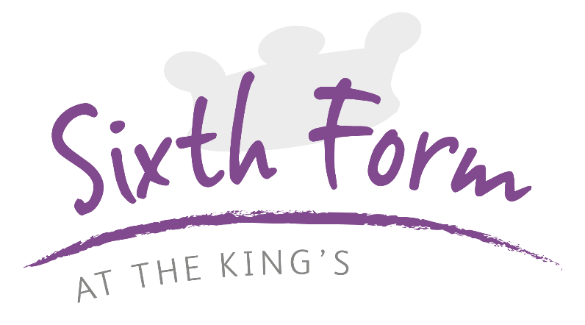
Transition Tasks
English Language

Slide 2
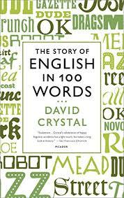
Book Recommendation:
Spanning from the fifth century when the first definitively English word was written down, this book will take you through the fascinating journey our language has made

Slide 3
Task 1:
Produce a mind map of the different types of texts we engage with in society, e.g. bus tickets, books, maps etc.

Slide 4
Task 2:
Watch this clip on text messaging by David Crystal.
Summarise his main argument using bullet points

Slide 5
Task 3:
Find 4 examples of Twitter feeds. How do we adapt our language choices when tweeting?

Slide 6
Task 4:
Write the opening to a gothic story.
Identify three devices you have used which are typical of the genre.

Slide 7
Task 5:
Using www.etymology.com
Research the word ‘boy’. How has it’s meaning changed over time?

Slide 8
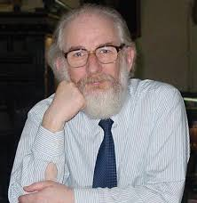
Influential person: David Crystal
David Crystal is the foremost writer and lecturer on the English language, with a worldwide reputation and over 100 books to his name. He is honorary professor of linguistics at the University of Wales and is well known for his belief that text messaging has not been a disaster to the English language. On the contrary, he argues it actually improves children’s writing and spelling.

Slide 9
Please email your completed work to:
Mr Harrison
THarrison@thekings.staffs.sch.uk

