Slide 1
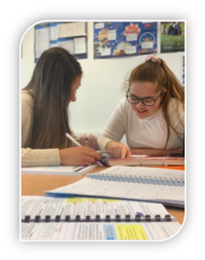
The King’s Sixth Form
‘Give back’ programme

Slide 2
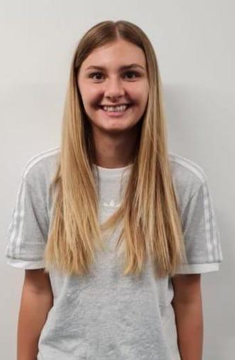
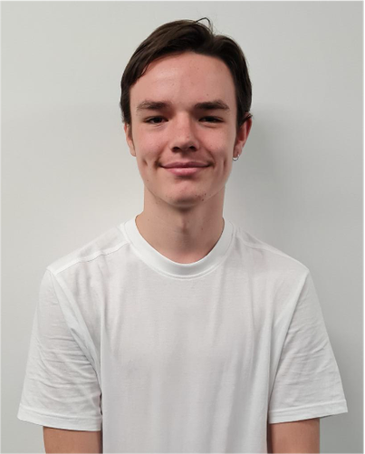
Head Boy/ Head Girl
Role
The Head Boy and the Head Girl should share a passion and commitment for The King’s Academy. They are the link between the students, staff and governors and are expected to support the school at events such as parents’ evening, extra-curricular and sporting events.
Responsibilities
The role of a Head Boy/ Head Girl is to:
act as a role model for students. This will involve proactively taking part in extra-curricular activities, completing enrichment exercises and supporting the ‘give back’ programme.
provide a positive public profile for the student body at formal events. This will include speaking in front of an audience of parents and pupils.
oversee the work of the student leadership team; meeting regularly to ensure that assigned duties are being carried out and giving support to student leaders to enable them to work on a whole school projects.
work with Miss Williams and Mrs Finnemore to initiate and develop ideas for whole school improvement
encourage and co-ordinate whole school student led events. Present and lead in assemblies and other whole school events as required
greet and communicate with students, staff, parents, school visitors, governors and other external bodies as required
attend a range of school events e.g. rewards evening, open evenings etc and
promote the ethos and work of the school by reporting key events on social media
Personal qualities
Leadership
Work well in a team
Time-management and very good organisational skills
Ability to talk confidently and appropriately to parents and staff
Ability to talk confidently and appropriately to students
Willingness to get to know the students in the lower years
Politeness
Maturity
Notes:
Target are calculated grades from your GCSE/ BTEC results in Y11. Each term, we will analyse data taken from mini assessments, mocks, teacher feedback and coursework – this will allow us to see who is making at least expected steps of progress and those who need additional help.

Slide 3
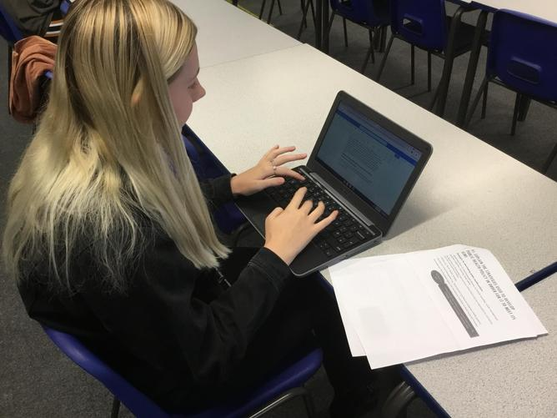

IT maintenance technician
Role
The IT maintenance technician is responsible for the daily upkeep of the suite of Chrome books in the common room. Their duties include conducting routine inspections and sanitising of devises as well as liaising with relevant staff members.
Responsibilities
The role of an IT maintenance technician is to:
maintain and monitor the suite of Chrome books in the common room by:
collect in and account for devices at the end of each day;
                perform routine cleaning and sanitising of all devices;
                inspect all devices for physical damage;
                report missing/ damaged devices to Mr Toach as soon as possible and
                sign a maintenance schedule to ensure that all routine tasks are completed
Personal qualities
Time-management and good organisational skills
Ability to talk confidently and appropriately to students and staff
Politeness
Maturity
Responsibility

Slide 4
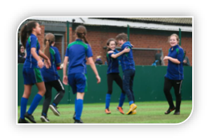
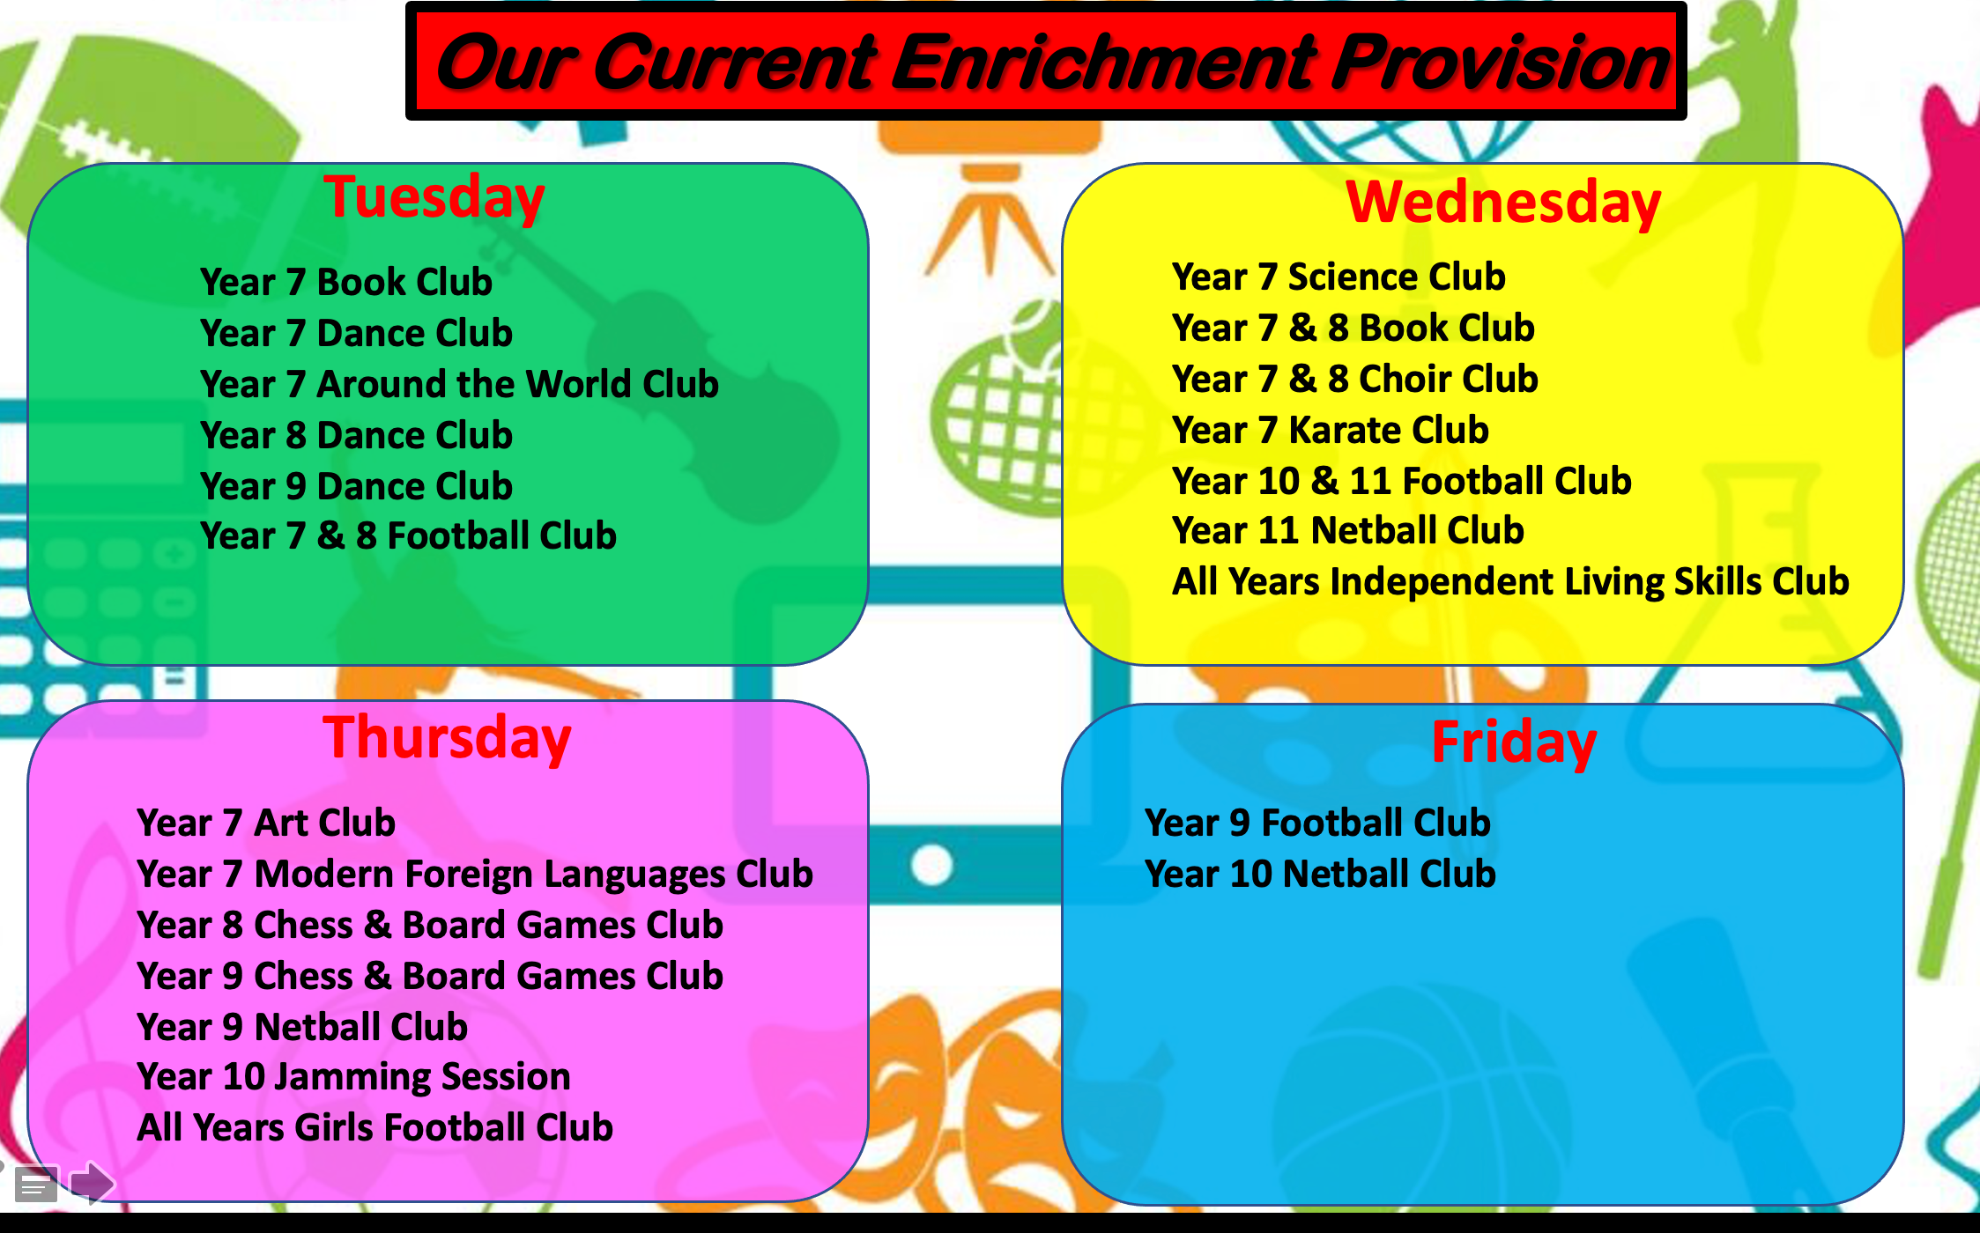
Enrichment assistants
Role
Enrichment assistants play a fundamental role is the planning and delivery of extra0curricular clubs across the school. Often, students will volunteer their time and support to subjects which they are studying as part of their A Level/ BTEC studies, meaning they are able to inspire and impart their learning on to the younger members of our school.
Responsibilities
The role of a extra curricular assistant is to:
assist the teacher with the registration of attendees;
publicise and promote the extra-curricular opportunities across the school by speaking in assemblies;
assist in coordinating and developing a suite of activities in accordance to the needs of those who attend;
support with fixtures and events where applicable;
work with students in small groups to help facilitate learning;
support with the setting up/ putting away of resources and
reinforce and model The King’s behavioural expectations
Personal qualities
Leadership
Work well in a team
Time-management and very good organisational skills
Ability to talk confidently and appropriately to students and staff
Willingness to get to know the students in the lower years.
Politeness
Maturity

Slide 5
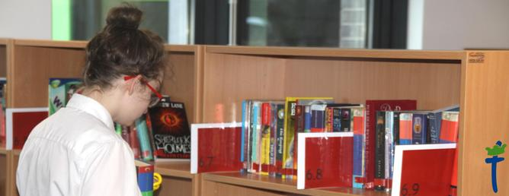
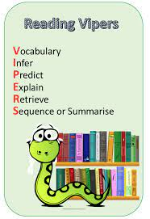
Reading mentor
Role
As directed by the Literacy Lead, Miss Brown, the reading mentor will work with targeted students in KS3 to improve their confidence and fluency in reading, with a particular focus on vocabulary and comprehension.
Responsibilities
The role of a reading mentor is to:
provide 1:1 delivery of reading intervention.
monitor pupils’ responses to learning activities and accurately record achievement/progress as directed
provide regular feedback to Miss Brown on pupils’ achievement, progress, problems, etc and
make effective use of the whole school reading strategy, VIPERS, so support with reading and comprehension.
Personal qualities
Strong listening skills
Flexibility and patience
Time-management and very good organisational skills.
Ability to talk confidently and appropriately to staff and students.
Willingness to get to know the students in the lower years.
Politeness
Maturity
Notes:
Target are calculated grades from your GCSE/ BTEC results in Y11. Each term, we will analyse data taken from mini assessments, mocks, teacher feedback and coursework – this will allow us to see who is making at least expected steps of progress and those who need additional help.

Slide 6
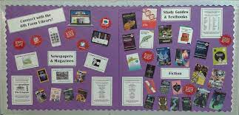
Common room monitor
Role
The common room monitor is responsible for the daily upkeep of the common room. Their duties include conducting routine inspections of furniture as well as maintaining and updating the display boards.
Responsibilities
The role of the common room monitor is to:
maintain and monitor the use of the common room by:
ensure displays remain tidy, well kept and up-to-date;
                perform routine cleaning and sanitising of tables;
                ensure the stationary area is well resourced;
                inspect the furniture for physical damage;
                report missing/ damaged items to Mrs Finnemore as soon as possible and
                sign a maintenance schedule to ensure that all routine tasks are completed.
Personal qualities
Time-management and good organisational skills
Ability to talk confidently and appropriately to students and staff
Politeness
Maturity
Responsibility

Slide 7
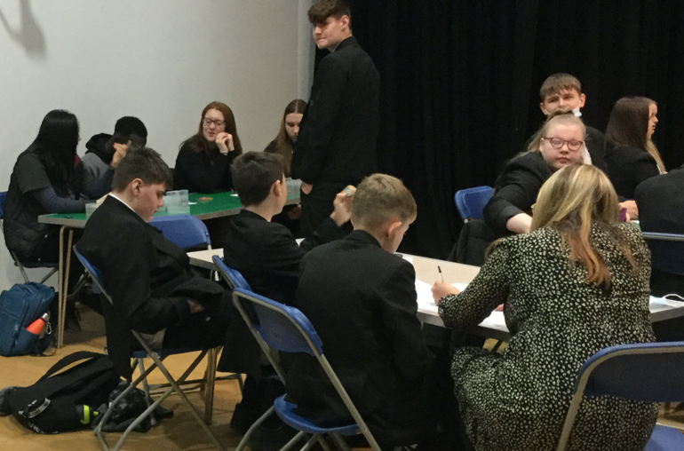
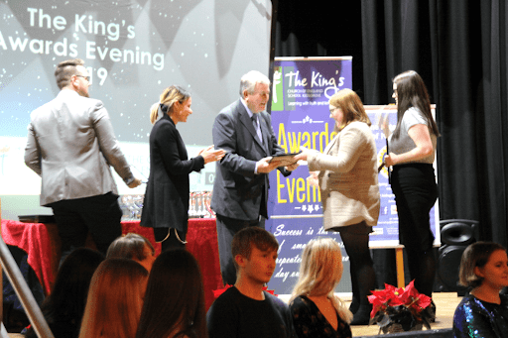
School events assistant
Role
A school events assistant supports with the planning and delivery of key school events. From taking part in the day with younger students to communicating with external visitors.
Responsibilities
The role of a school events assistant is to:
support with the planning and preparation of school events;
greet and communicate with students, staff, parents, school visitors, governors and other external bodies as required
provide tours to external visitors;
provide refreshments to external visitors;
attend a range of school events e.g. rewards evening, open evenings etc and
promote the ethos and work of the school by reporting key events on social media.
Personal qualities
Leadership
Work well in a team
Time-management and very good organisational skills
Ability to talk confidently and appropriately to students and staff
Willingness to get to know the students in the lower years.
Politeness
Maturity

