Slide 1
Techniques:
Wider podcasts

Slide 2


Slide 3
What ocean are the migrants crossing?
How many people, arriving in small boats, claim asylum?
What do the migrants purchase if they can’t afford to pay smugglers?
How could wealthy and peaceful countries support?

Slide 4
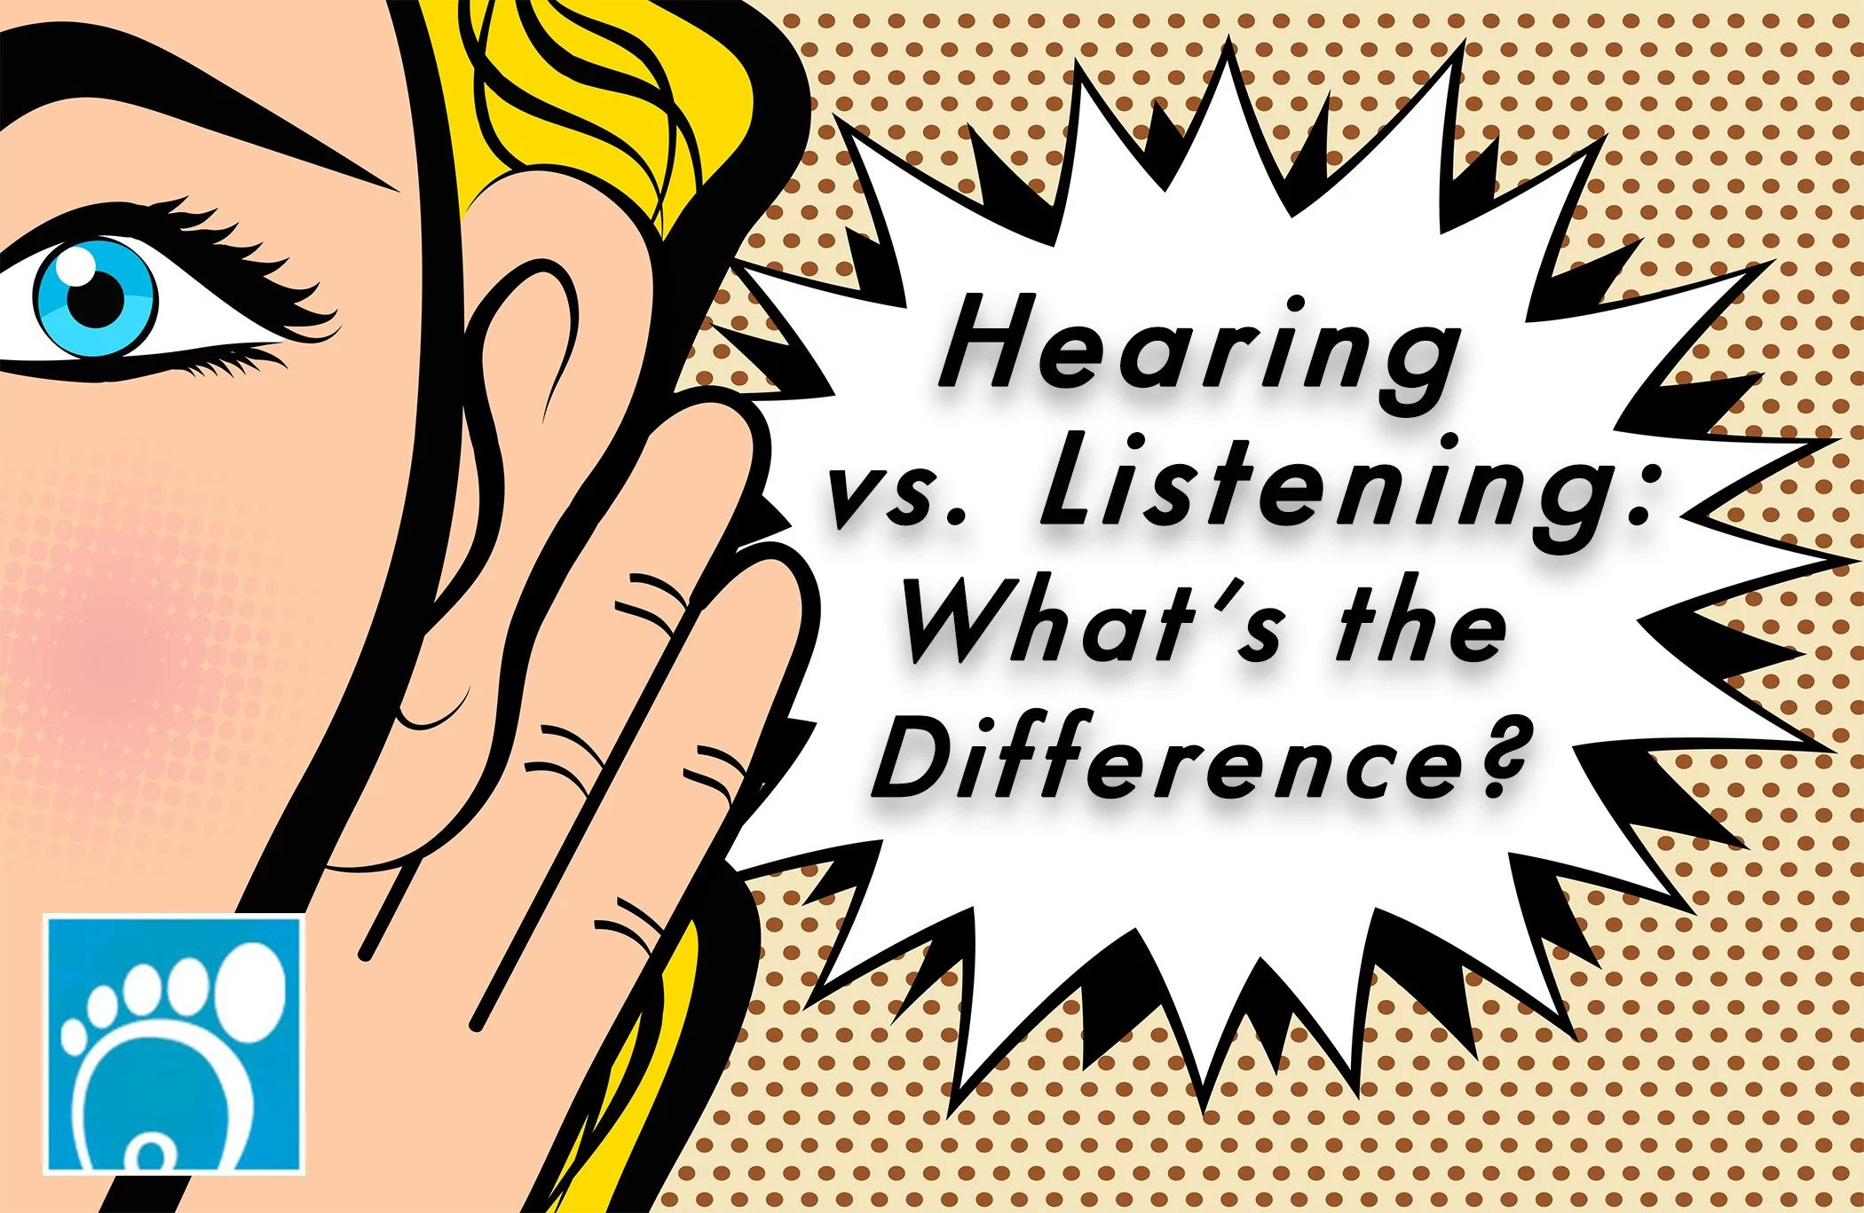
What is the difference between:
LISTENING & HEARING?

Slide 5

Listening | Hearing
Listening is passive | Hearing is active
Refers to the act of perceiving a sound through the ear | Refers to the act of making a conscious effort to perceive the sound
Does not require a conscious effort | Requires a conscious effort
Involuntary | Voluntary

Slide 6

BIG IDEA
Aural content has been proven to stimulate the brain more than visual/audio-visual content does. Because of how much exposure we have to visual media these days, our brains can switch off at the sight of it.
Listening to podcasts without visual cues forces us to engage (and saves us from eye strain). Plus, 30-second videos on apps like TikTok have significantly reduced our attention spans.
Reading a chapter of a book in one sitting seems like a lot but, when that information is delivered in podcast form, it’s a lot easier to ingest and understand.

Slide 7
Wider reading
One of the best ways you stand out during your Sixth Form studies is through the amount of independent study you undertake outside of the classroom.
Regardless of your future plans, the ability to extend yourself and research independently into your interests is an invaluable skill – this will support your university applications and/or future job applications and interviews.
All universities expect more than just classroom knowledge, which is where super- curricular activities come in; these are academic enrichment tasks that show you are interested in your studies beyond what is on the school syllabus.

Slide 8

Serna Williams
‘I’m not suppose to lose’

Slide 9
