Slide 1
Advance:
Wider Youtubing

Slide 2

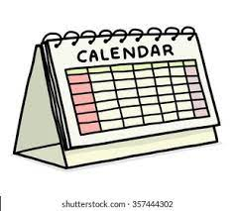

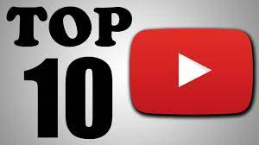
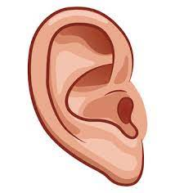

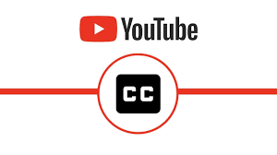
What are the benefits of using Youtube videos to revise?

Slide 3

BIG IDEA
Studies have shown that the use of short video clips allows for more efficient processing and memory recall. The visual and auditory nature of videos appeals to a wide audience and allows each user to process information in a way that’s natural to them.
It has been proven that visual stimulation encourages student interaction with content or a concept. It also creates a bigger memory imprint in a student’s mind, making teaching with videos perfect for information retention.

Slide 4
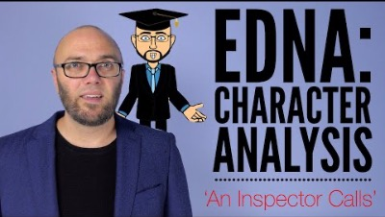

What makes an effective revision video?
Vs

Slide 5
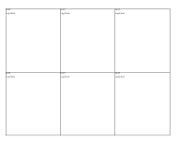

‘How is Edna presented in An Inspector Calls?’
The process
1.
2.
Be clear on what you want to learn/ revise from this clip.
This will be your success criteria. If you can return to this question at the end and answer it, you’re revision has been useful!
Divide your page into six sections. Everything you revise in the video needs to fit on this one page.
3.
Begin watching!

Slide 6
4.
5.
Give yourself time to reflect by pausing the clip every couple of minutes.
When you pause, write yourself a question based on what you have heard.
You can either answer it straight away or wait till the end to test yourself.
Once you have completed the video, you now need to traffic light your notes.
Pink – Vitally important
Yellow – Important
GREEN – Worth knowing

Slide 7
Have a go
Watch this clip as a class and using try this strategy to revise.

Slide 8
Why?
Next half term, your teachers are going to be including some of these revision strategies both when setting class work and homework.

