Slide 1

Transition Tasks
Maths

Slide 2
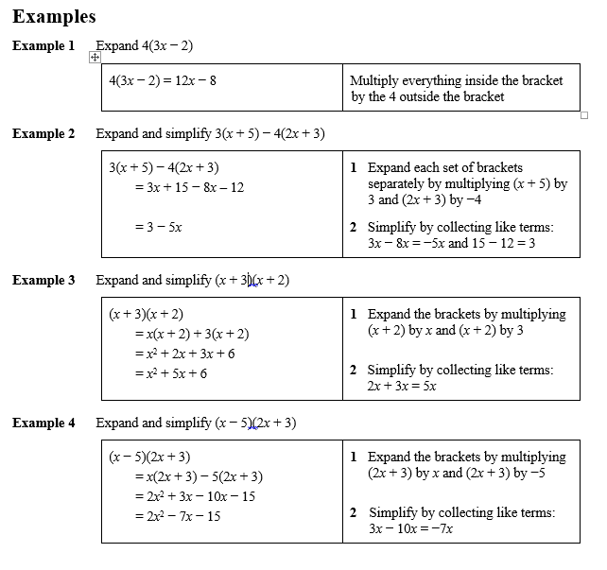
Expanding brackets and simplifying expressions
Key points
When you expand one set of brackets you must multiply everything inside the bracket by what is outside.
When you expand two linear expressions, each with two terms of the form ax + b, where a ≠ 0 and b ≠ 0, you create four terms. Two of these can usually be simplified by collecting like terms.

Slide 3
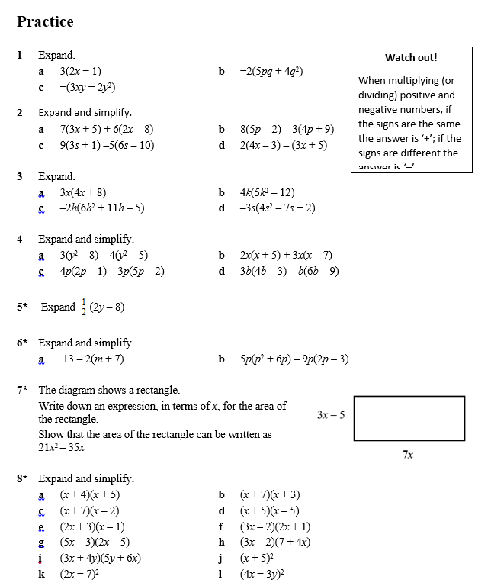
Expanding brackets and simplifying expressions
Task 1: Using the examples, practice expanding brackets and simplifying expressions.

Slide 4
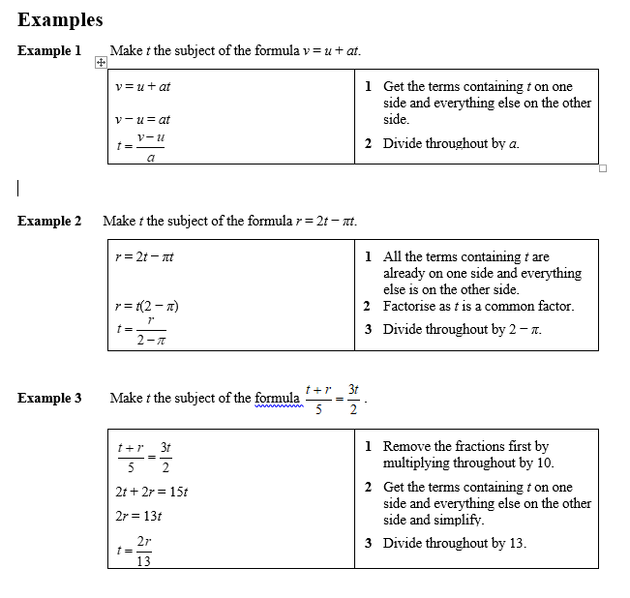
Rearranging equations
Key points
To change the subject of a formula, get the terms containing the subject on one side and everything else on the other side.
You may need to factorise the terms containing the new subject.

Slide 5
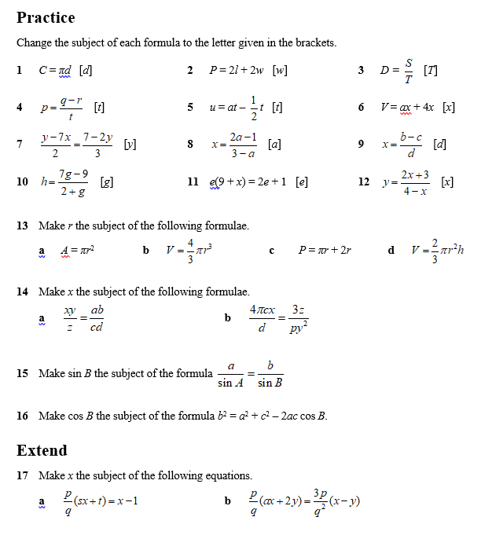
Rearranging equations
Task 2: Using the examples, practice these questions.

Slide 6
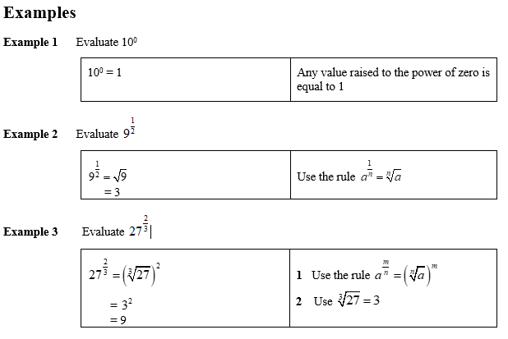
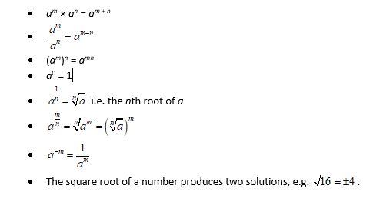
Rules of indices
Key points

Slide 7
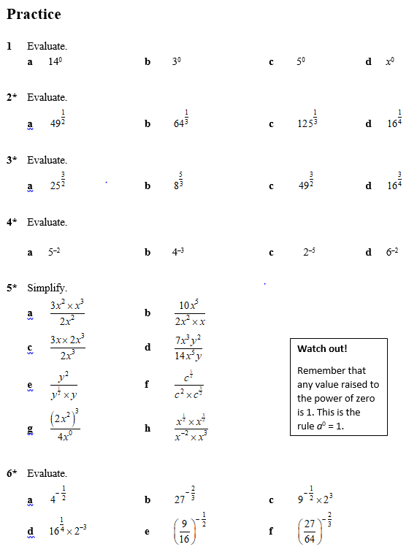
Rules of indices
Task 3: Using the examples, practice these questions.

Slide 8
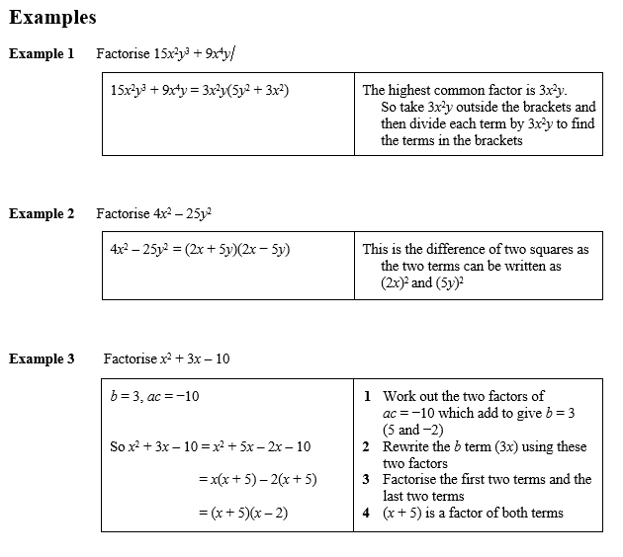
Factorising expressions
Key points
Factorising an expression is the opposite of expanding the brackets.
A quadratic expression is in the form ax² + bx + c, where a ≠ 0.
To factorise a quadratic equation find two numbers whose sum is b and whose product is ac.
An expression in the form x² – y² is called the difference of two squares. It factorises to (x – y)(x + y).

Slide 9
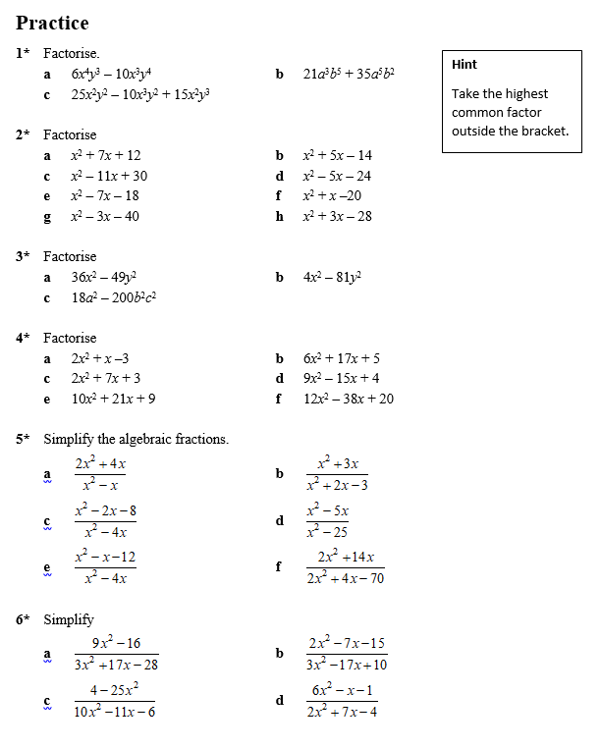
Factorising expressions
Task 4: Using the examples, practice these questions.

Slide 10
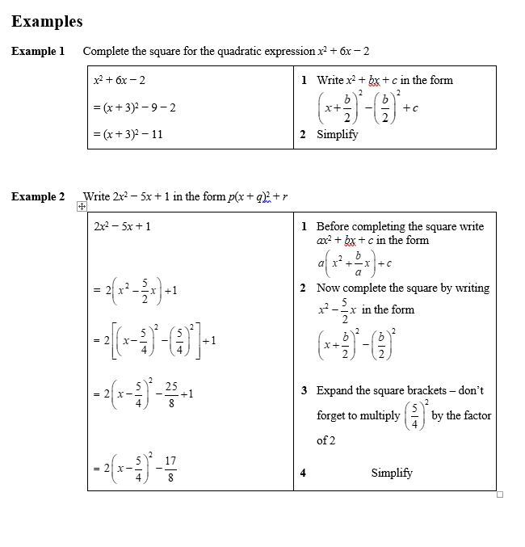
Completing the square
Key points
Completing the square for a quadratic rearranges ax² + bx + c into the form p(x + q)² + r
If a ≠ 1, then factorise using a as a common factor.

Slide 11
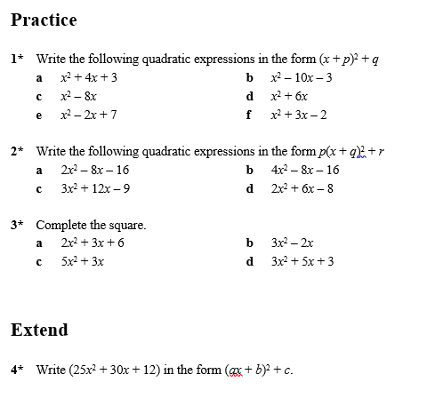
Completing the square
Task 5: Using the examples, practice these questions.

Slide 12
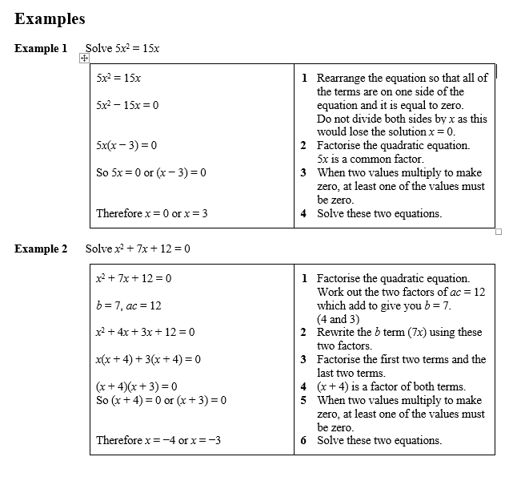
Solving quadratic equations by factorisation
Key points
A quadratic equation is an equation in the form ax² + bx + c = 0 where a ≠ 0.
To factorise a quadratic equation find two numbers whose sum is b and whose products is ac.
When the product of two numbers is 0, then at least one of the numbers must be 0.
If a quadratic can be solved it will have two solutions (these may be equal).

Slide 13
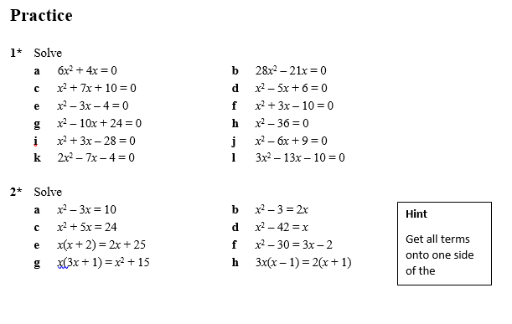
Solving quadratic equations by factorisation
Task 6: Using the examples, practice these questions.

Slide 14
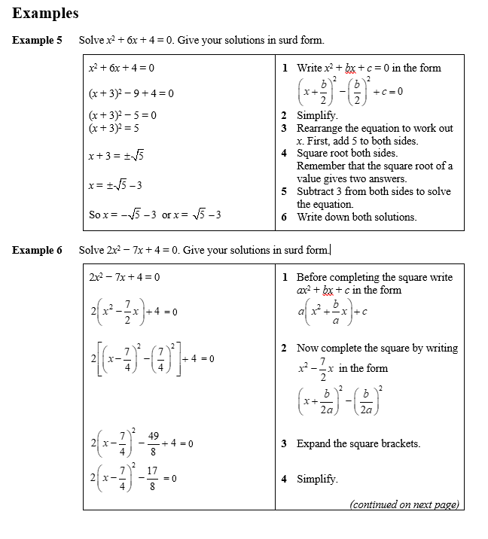
Solving quadratic equations by completing the square
Key points
Completing the square lets you write a quadratic equation in the form p(x + q)² + r = 0.

Slide 15
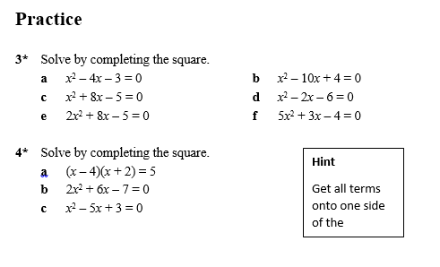
Solving quadratic equations by completing the square
Task 7: Using the examples, practice these questions.

Slide 16
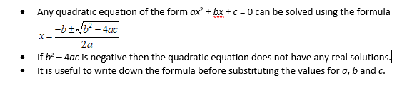
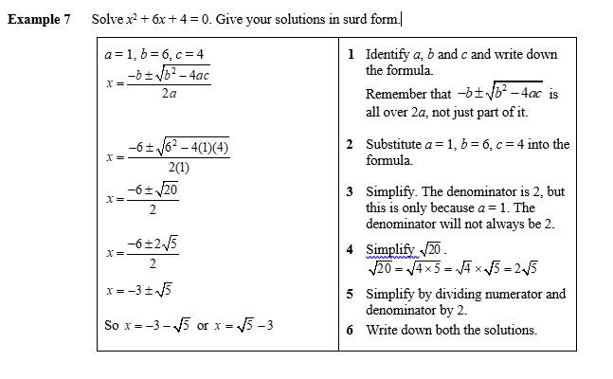
Solving quadratic equations by using the formula
Key points

Slide 17
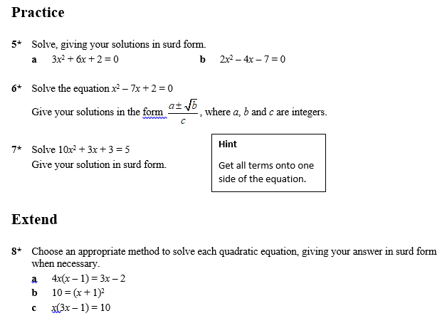
Solving quadratic equations by using the formula
Task 8: Using the examples, practice these questions.

Slide 18
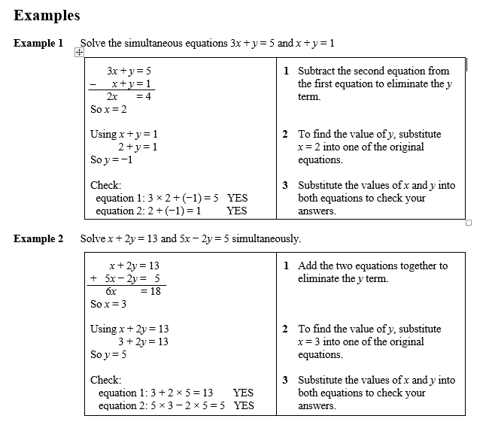
Solving linear simultaneous equations using the elimination method
Key points
Two equations are simultaneous when they are both true at the same time.
Solving simultaneous linear equations in two unknowns involves finding the value of each unknown which works for both equations.
Make sure that the coefficient of one of the unknowns is the same in both equations.
Eliminate this equal unknown by either subtracting or adding the two equations.

Slide 19
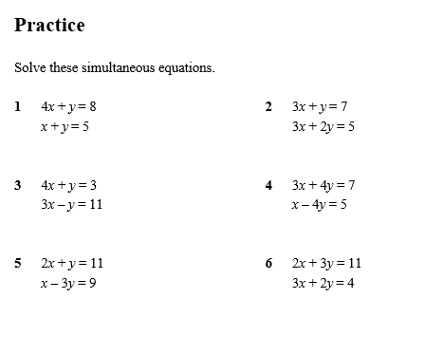
Solving linear simultaneous equations using the elimination method
Task 9: Using the examples, practice these questions.

Slide 20
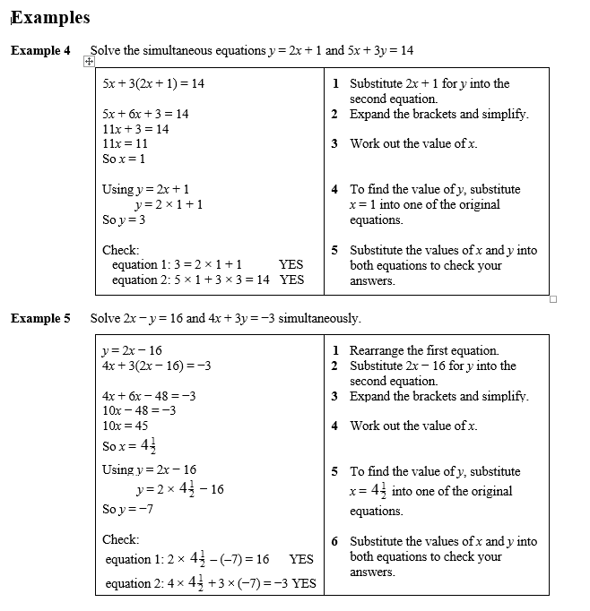
Solving linear simultaneous equations using the substitution method
Key points
The substitution method is the method most commonly used for A level. This is because it is the method used to solve linear and quadratic simultaneous equations.

Slide 21
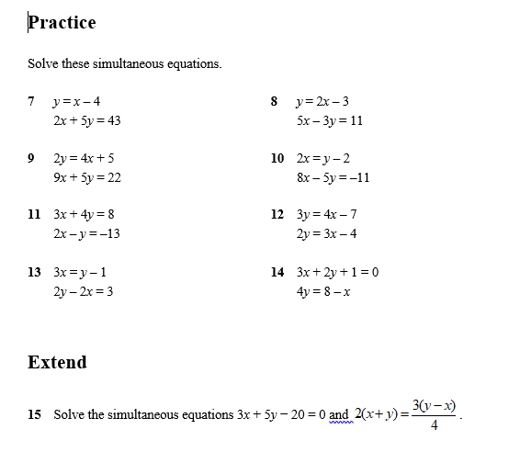
Solving linear simultaneous equations using the substitution method
Task 10: Using the examples, practice these questions.

Slide 22
Please email your completed work to:
Mrs Turner
STurner@thekings.staffs.sch.uk

