Slide 1

Transition Tasks
Psychology

Slide 2

Book Recommendation:
The Little Book of Psychology
Very handy little book which summarises major theories and thinkers in psychology. Easy to access format and each theory and thinker is put into the context of what came before them and what would come after.

Slide 3
Task 1:
Produce a timeline of key thinkers in psychology.

Slide 4
Task 2:
Watch the clip
‘Part 1 Primal Fear - BBC Explorations’
Summarise the main points using bullet points. (Psychopathy)

Slide 5
Task 3:
Research and produce a fact sheet on two key studies:
1) Milgram’s (1963) Obedience to Authority
2) Zimbardo’s Stanford Prison Experiment.

Slide 6
Task 4:
Research Pavlov’s famous experiment. Create a cartoon strip to show how it worked. (Approaches)

Slide 7
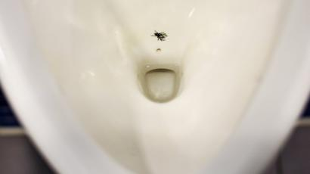
Task 5:
Research into the Nudge Unit. Create an information sheet detailing what the unit does and why it is important. (Research Methods)
Challenge – explain this image of a fly painted on a urinal

Slide 8
Task 6:
Read this article on eyewitness testimony - https://www.scientificamerican.com/article/do-the-eyes-have-it/ .
Write an explanation of why eyewitness testimony can be flawed. (Memory)
Challenge – research into and summarise how psychology is being used to improve the reliability of eyewitness testimony.

Slide 9
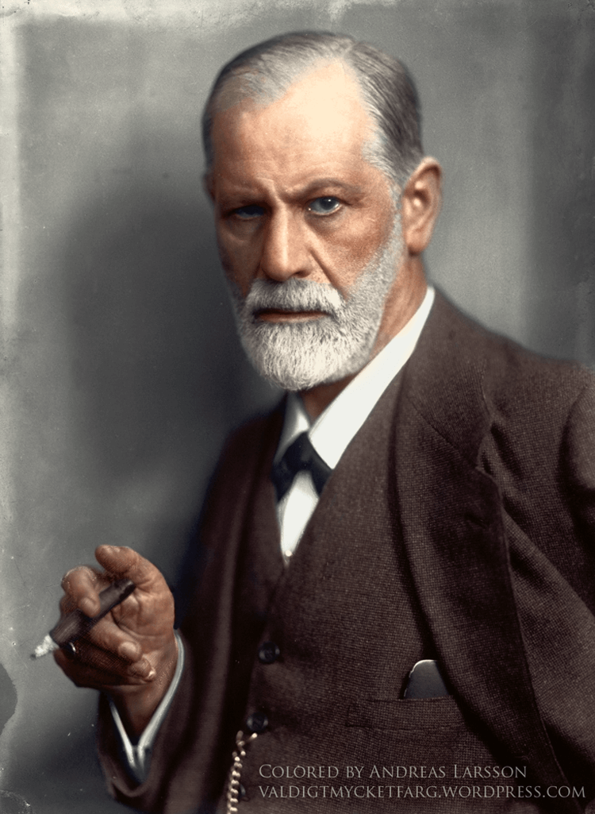
Influential person: Sigmund Freud
When people think of psychology, many think of Freud. His work supported the belief that not all mental illnesses have physiological causes and he also offered evidence that cultural differences have an impact on psychology and behaviour. Modern psychologists believe that his analytical abilities were tinged with a bit of sexism, atheism, and a whole lot of ‘mommy issues’ and our lessons on his theories are always lively. However, his work and writings contributed to our understanding of personality, clinical psychology, human development, and abnormal psychology.

Slide 10
Please email your completed work to:
Miss Brown ABrown@thekings.staffs.sch.uk

