Slide 1
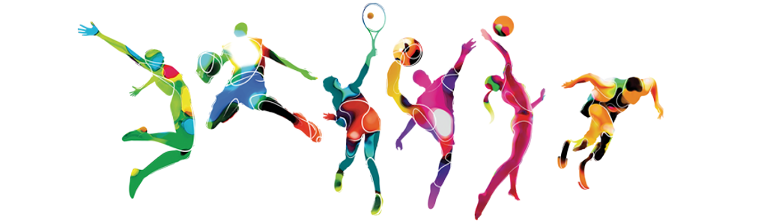

Level 3 Cambridge Technical Extended Certificate
Sport and Physical Activity
Year 11 transition work
In order to help you make the best possible start to your studies, we have put together some bridging work that you will need to complete before September. Doing your best in this work will ensure you make the most of the early weeks, which we know are really important in getting the best you can from your studies.

Slide 2
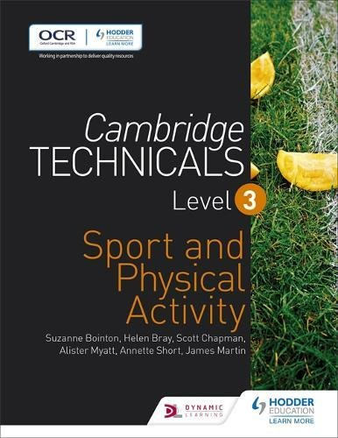
What will I be studying?
Book Recommendation
This book contains all of the units you will study with lots of information and practice for examinations that you will take.
Name of course: Level 3 Cambridge Technical in Sport and Physical Activity
Duration: 2 years
This course includes a range of theoretical units and practical based units. All units are assessed through a written examination (2 units) or through coursework. Some of the coursework will also involve participation in practical sporting and leadership activities.
Components
Unit 1: Body systems and the effects of physical activity (exam based unit)
Unit 2: Sports coaching and activity leadership (coursework based unit)
Unit 3: Sports organisation and development (exam based unit)
Unit 11: Exercise for specific groups (coursework based unit)
Unit 12: Nutrition and diet for sport and exercise (coursework based unit)
Unit 17: Sports injuries and rehabilitation (coursework based unit)

Slide 3
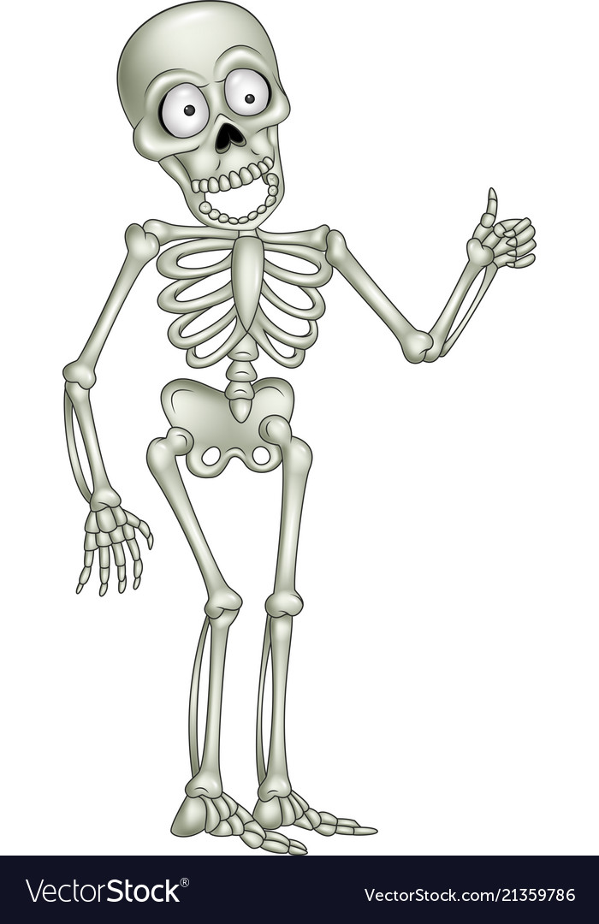
Unit 1 – Task 1 - The Body Systems
For each of the following body systems, find a blank diagram and then label in your own handwriting – do not just find a labelled diagram on Google and print it off!
For the muscular system you may want to split into the identified joints and have separate labelled diagrams. There are quite a few muscles to label!
Axial skeleton
Cranium
Sternum
Ribs
Vertebral column
  Cervical vertebrae
  Throacic vertebrae
  Lumbar vertebrae
  Sacrum
  coccyx
Skeletal system
Scapula
Clavicle
Humerus
Radius
Ulna
Carpals
Metacarpals
Phalanges
Illium
Ishium
Pubis
Femur
Patella
Tibia
Fibula
Tarsals
Talus
Metatarsals
Muscular system
Shoulder – deltoid, latissimus dorsi, pectoralis major, trapezius, teres major
Elbow – biceps brachii, triceps brachii
Radio-ulnar – pronator teres, supinator muscle
Wrist – wrist flexors, wrist extensors
Vertebral column – rectus abdominus, erector spinae, internal and external obliques
Hip – iliopsoas, gluteus maximus, gluteus medius, gluteus minimus, adductor longus, adductor brevis, adductor magnus
Knee – rectus femoris, vastus medialis, vastus intermedius, vastus lateralis, biceps femoris, semimembranosus, semitendinosus
Ankle – tibialis anterior, gastrocnemius, soleus
Cardiovascular system
Atria
Ventricles
Bicuspid and tricuspid valves
Pulmonary and aortic valves
Aorta
Venae cavae
Pulmonary artery
Pulmonary vein
Respiratory system
Nasal cavity
Epiglottis
Pharynx
Larynx
Trachea
Bronchi
Brochioles
Alveoli

Slide 4
Unit 1 – Task 2 - The Body Systems
Now you have a comprehensive set of labelled diagrams of the body systems, you should produce a written report on the following body systems:
Skeletal system
Describe and explain the following functions of the skeleton
Shape
Support
Protection
Movement
Blood cell production
Mineral storage
Muscular system
Describe the following types of muscle function
Agonist
Antagonist
Fixator
Describe the following types of muscle contraction
Isometric
Concentric
Eccentric
Cardiovascular system
Describe the structure of the following blood vessels
Arteries
Arterioles
Capillaries
Venules
Veins
Respiratory system
Explain the mechanics of breathing
Inspiration
Expiration
Describe and explain gaseous exchange at the alveoli
The following resources may help you complete these tasks:
http://www.bbc.co.uk/science/humanbody/body/factfiles/skeleton_anatomy.shtml
http://humananatomybody.info/full-body-muscle-lable/
www.brianmac.co.uk
www.teachpe.com
www.livestrong.com
https://www.ptdirect.com/training-design/anatomy-and-physiology/skeletal-muscle-roles-and-contraction-types
http://cliparts.co/heart-diagram-unlabeled

Slide 5

Unit 2
Task: Research and define the following words which are central to the Sports Coaching and leadership unit.
Keyword / Term: | Definition:
Duty of care
Leadership
Characteristics
Autocratic
Cohesion
Democratic
Laissez faire

Slide 6
Unit 2
Task: Research and define the following words which are central to the Sports Coaching and leadership unit.
Keyword / Term: | Definition:
Social loafer
NACH (personality)
NAF (personality)
Physical activity readiness questionnaire
Risk assessment
Safeguarding

Slide 7


Unit 3: Sports organisation and development
The organisation of sport in the UK can be quite complex, with multiple agencies and organisations, both inside of and outside of the UK, working together at different levels on different agendas. One of the key areas which most, if not all, of the organisations involved in sport in the UK are most concerned with is sports development and the increase of participation in sport and physical activity, both to improve the health of the nation but also to aid the development of elite athletes who can compete and achieve on an international level.
In this unit you will gain an understanding of the organisations involved in sport in the UK, their roles and responsibilities and how they work together. You will also gain an understanding of sports development including the organisations involved, who sports development is targeted at and why, how sports development is carried out and how the success of sports development initiatives can be measured.
Unit 3
Task: Sport England leaflet
Create an informative leaflet on the work
of Sport England. Your leaflet should include information on the following:
What is the role and purpose of Sport England?
How do Sport England work with the National Lottery?
How do Sport England provide funding?
How do Sport England support different groups of people to become active?
Provide a case study of a group of people / sports club / individual that Sport England have supported to become active in sport.

