Slide 1
Geographical Enquiry:
Sustainable Development in Borneo
Spring 1

Slide 2
EXPLORE
VIPERs
In geography, you will receive two homework tasks this topic. Task 2 (VIPERS) will be awarded as Meaningful Homework, as this applies your knowledge from the first task. We have included both tasks below, so you know what you will be doing in advance. We will set one task at a time on ClassCharts.
Task 1:
Create a dual coded mind-map using the information from the knowledge organiser.
Guidance Notes:
Read the knowledge organiser carefully and highlight at least five key points in each box. Your mind-map must include your highlighted points and a minimum of five images. You may also add your own research.
Success Criteria:
Highlight the geography terms for this topic
Define at least two key terms and use them in a sentence
Classify information into social, economic and environmental factors
Explain how one piece of information is connected/important to you e.g. population growth.
Task 2:
Using all of the information on your knowledge organiser, answer the VIPERs question below in full sentences.
Guidance Notes:
Vocabulary: ‘Ongoing deforestation has brought plenty of changes’ what are these changes
a) Trees decrease b) Trees increase c) trees stay the same
Infer: ‘Borneo is rich in biological diversification‘ Explain how this can benefit areas like Borneo.
Predict: How might the UK and other developed countries impact Borneo?
Explain: explain how deforestation can lead to extinction.
Review: ? Would you like to live in Borneo? Why/why not? Where would you live?
Success Criteria:
Highlight the geography terms for this topic
Respond to the command word in the question
Select and use evidence from the information boxes in your answer.

Slide 3
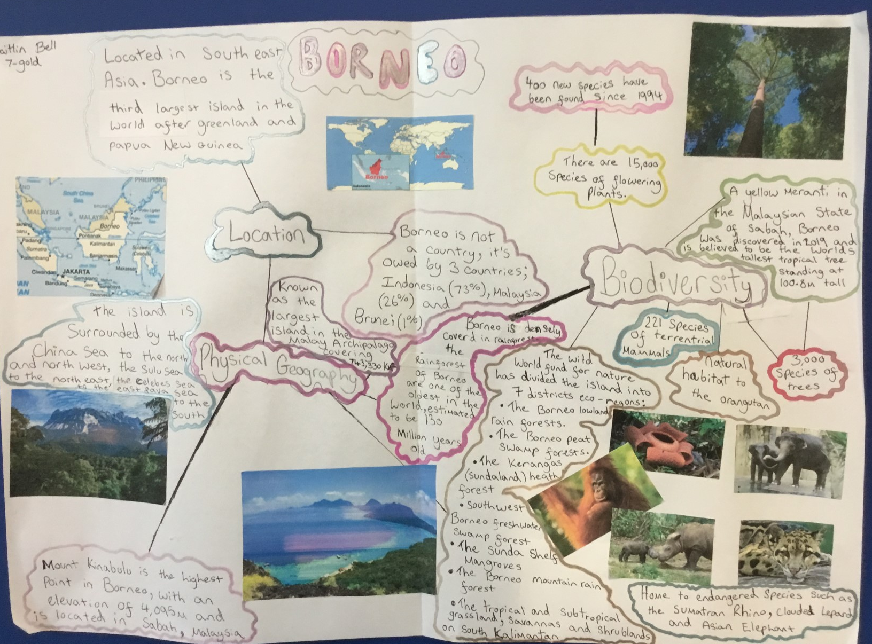
This is an Example of a good 'EXPLORE' homework
the topic used in this example is the same as your homework task. Remember to use your own ideas and research too.
EXPLORE
Strength:
Geography key terms are used effectively and information classified into appropriate headings.
Weakness:
Explaining how one piece of information is linked to you
And Next Step:
Explain how people in the U.K. might be connected to Borneo.

Slide 4
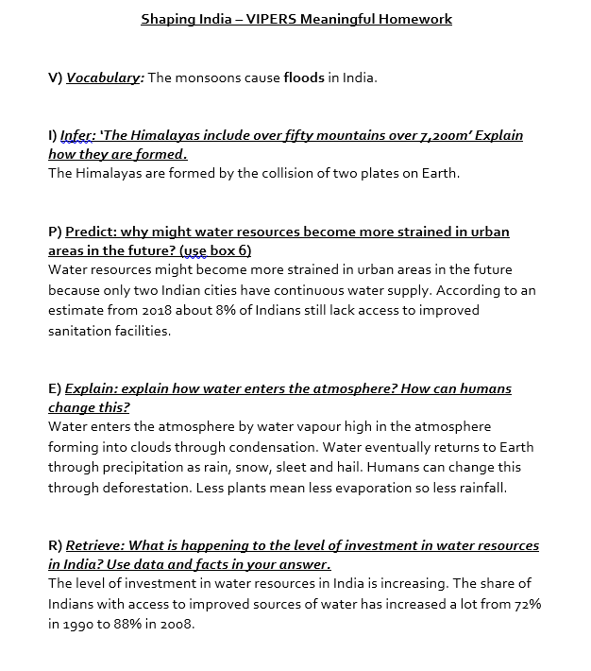
This is an Example of a good 'vipers' homework the questions used in this example may be different from your homework task, this is to give you the opportunity to apply your own understanding.
Strength:
Data used effectively as evidence in your answers.
Weakness:
Giving a second step in the sequence in the 'infer' question.
Next Step:
Why do two continental plates cause mountain ranges?
VIPERs

