Slide 1
Geographical Enquiry:
Plastic Pollution
Spring 1

Slide 2
EXPLORE
VIPERs
In geography, you will receive two homework tasks this topic. Task 2 (VIPERS) will be awarded as Meaningful Homework, as this applies your knowledge from the first task. We have included both tasks below, so you know what you will be doing in advance. We will set one task at a time on ClassCharts.
Task 1:
Create a dual coded mind-map using the information from the knowledge organiser.
Guidance Notes:
Read the knowledge organiser carefully and highlight at least five key points in each box. Your mind-map must include your highlighted points and a minimum of five images. You may also add your own research.
Success Criteria:
Highlight the geography terms for this topic
Define at least two key terms and use them in a sentence
Classify information into social, economic and environmental factors
Explain how one piece of information is connected/important to you e.g. differences in quality of life.
Task 2:
Using all of the information on your knowledge organiser, answer the VIPERs question below in full sentences.
Guidance Notes:
Vocabulary: The main plastics in the oceans are from
a) Ships b) planes c) Land
Infer: 14 millions tonnes of plastic end up in the oceans .’ Explain why this impacts the environment
Predict: what might happen to the oceans in the future?
Explain: explain an alternative to plastic
Review: Do you think we need to act on plastic pollution? Why?
Success Criteria:
Highlight the geography terms for this topic
Respond to the command word in the question
Select and use evidence from the information boxes in your answer.

Slide 3
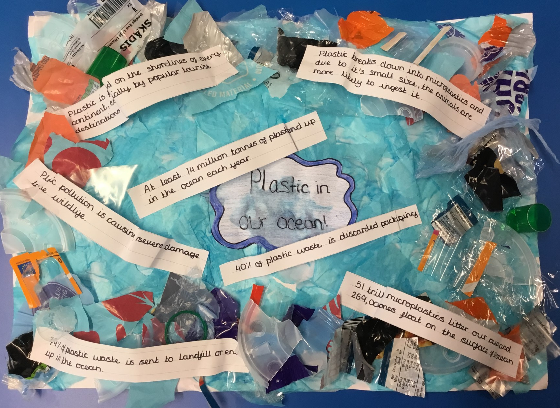
This is an Example of a good 'EXPLORE' homework
the topic used in this example is the same as your homework task. Remember to use your own ideas and research too.
EXPLORE
Strength:
A creative piece of homework showcasing the challenge of plastic pollution
Weakness:
Key terminology is not clear
And Next Step:
add the definitions for the key terms like micro-plastics and landfill.

Slide 4
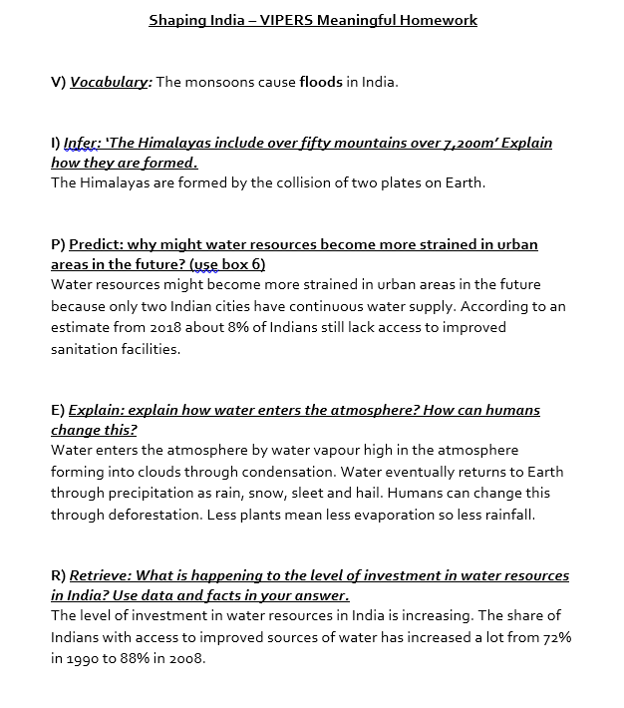
This is an Example of a good 'vipers' homework the questions used in this example may be different from your homework task, this is to give you the opportunity to apply your own understanding.
Strength:
Data used effectively as evidence in your answers.
Weakness:
Giving a second step in the sequence in the 'infer' question.
Next Step:
Why do two continental plates cause mountain ranges?
VIPERs

Slide 5
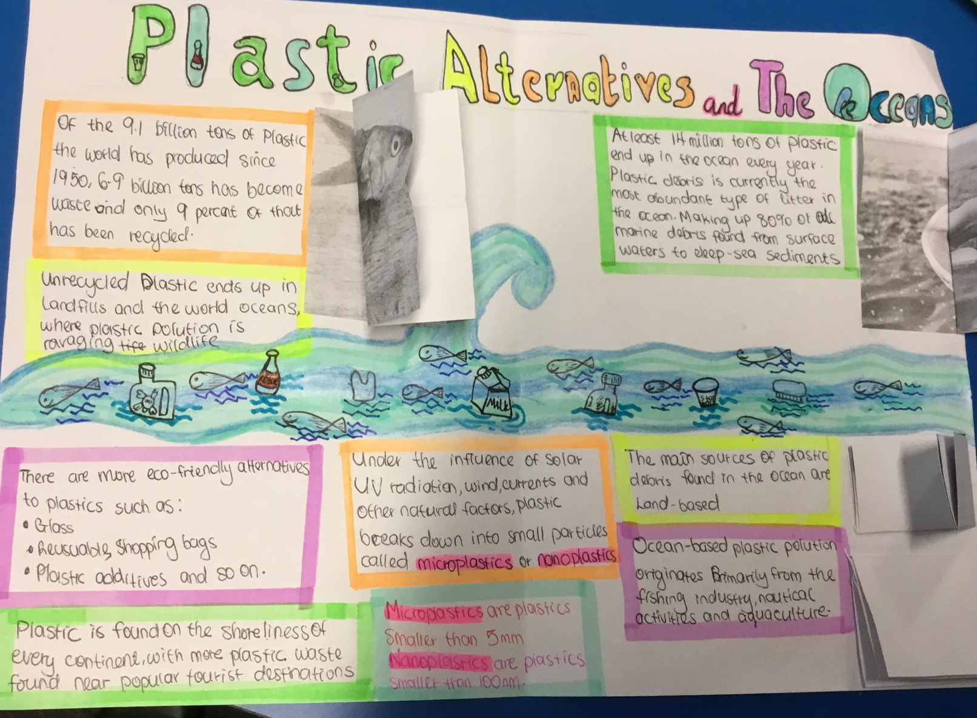
EXPLORE
Strength:
Lots of figures used in your key facts.
Weakness:
No clear link to you
And Next Step:
Make clear the connection the data has to you

Slide 6
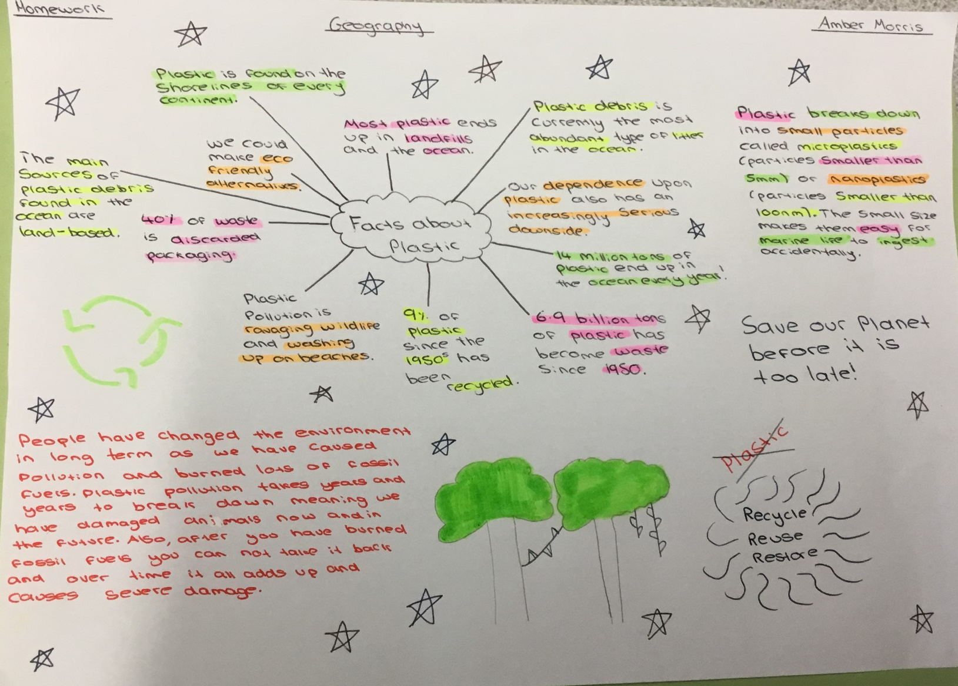
EXPLORE
Strength:
Two key words have been defined
Weakness:
Unclear what the highlighted colours represent
And Next Step:
Produce a key to suggest what each of the different coloured highlighting means

