Slide 1
Global Development
Spring 1

Slide 2
Homework 1
Homework 2
In geography, you will receive two guided GCSEPod retrieval tasks per half-term. We have included both tasks below, so you know what you will be doing in advance. We will set one task at a time on Weduc.
Task 1:
Watch the GCSEPod on top-down and bottom-up development strategies. Create a duel coded mind-map of the information from the Pod, then complete the retrieval quiz (assignment) linked to the Pod.
Guidance Notes:
Watch the Pod at least once – you may want to pause it to make notes.
You may wish to present your information in a creative way or using a different revision technique e.g. revision cards. You are free to make your own choice about the way you present your work, as long as you meet the ‘success criteria’ below.
Success Criteria:
Your information is linked to the content of the Pod
To have at least ten branches to your mind-map
To include at least five images to represent the information
To define at least two key terms and use them in a sentence
Retrieval quiz competed at ‘mastery’ level – 80% or better.
EXTENSION = +50 track-it points:
Extend – classify the branches of your mind-map into three categories e.g. social, economic and environmental factors.
Task 2:
Watch the GCSEPod on employment structure. Create a duel coded mind-map of the information from the Pod, then complete the retrieval quiz (assignment) linked to the Pod.
Guidance Notes:
Watch the Pod at least once – you may want to pause it to make notes.
You may wish to present your information in a creative way or using a different revision technique e.g. revision cards. You are free to make your own choice about the way you present your work, as long as you meet the ‘success criteria’ below.
Success Criteria:
Your information is linked to the content of the Pod
To have at least ten branches to your mind-map
To include at least five images to represent the information
To define at least two key terms and use them in a sentence
Retrieval quiz competed at ‘mastery’ level – 80% or better.
EXTENSION = +50 track-it points:
Extend – classify the branches of your mind-map into three categories e.g. social, economic and environmental factors.

Slide 3
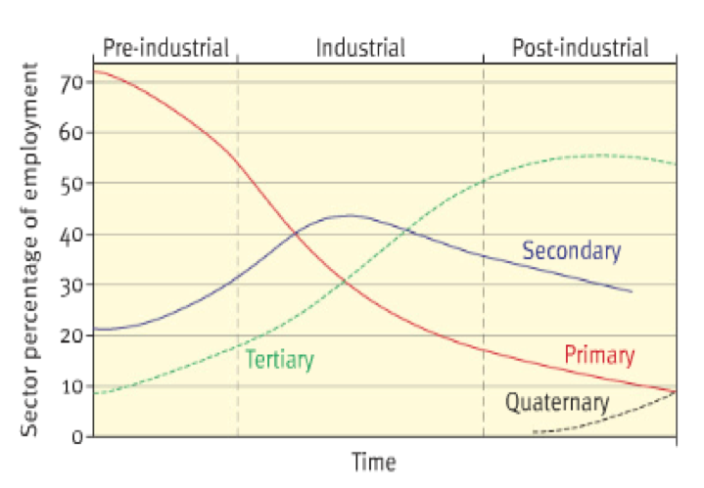
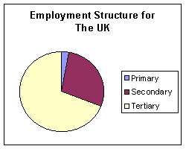

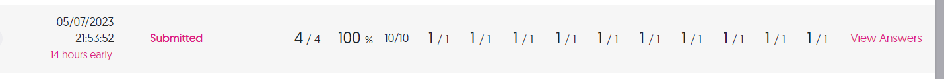
Primary (agriculture, forestry, mining, fishing) Rural areas tend to have more primary employment in farming, mining, quarrying and fishing. ...
Secondary (manufacturing) ...
Tertiary (retail, services, office work) ...
Quaternary (scientific research, ICT)
Task 1:
Watch the GCSEPod on employment structure. Create a duel coded mind-map of the information from the Pod, then complete the retrieval quiz (assignment) linked to the Pod.
Guidance Notes:
Watch the Pod at least once – you may want to pause it to make notes.
You may wish to present your information in a creative way or using a different revision technique e.g. revision cards. You are free to make your own choice about the way you present your work, as long as you meet the ‘success criteria’ below.
Success Criteria:
Your information is linked to the content of the Pod
To have at least ten branches to your mind-map
To include at least five images to represent the information
To define at least two key terms and use them in a sentence
Retrieval quiz competed at ‘mastery’ level – 80% or better.
EXTENSION = +50 track-it points:
Extend – classify the branches of your mind-map into three categories e.g. social, economic and environmental factors.
EMPLOYMENT STRUCTURES
An employment structure of a place or country simply looks at the percentage of working age people employed in primary, secondary and tertiary industries

Slide 4
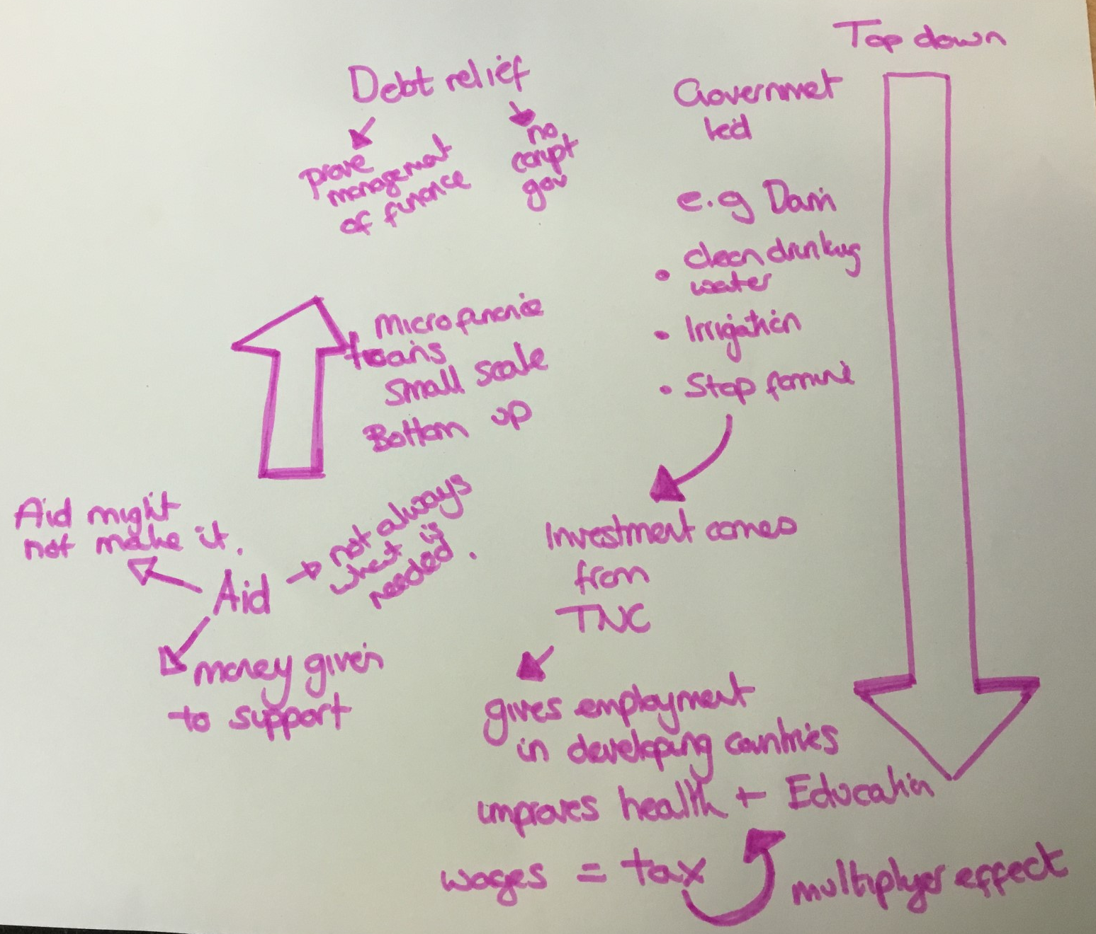
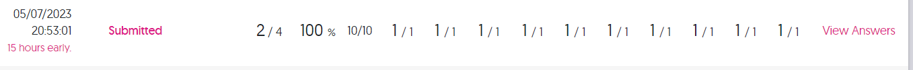
Task 1:
Watch the GCSEPod on top-down and bottom-up development strategies. Create a duel coded mind-map of the information from the Pod, then complete the retrieval quiz (assignment) linked to the Pod.
Guidance Notes:
Watch the Pod at least once – you may want to pause it to make notes.
You may wish to present your information in a creative way or using a different revision technique e.g. revision cards. You are free to make your own choice about the way you present your work, as long as you meet the ‘success criteria’ below.
Success Criteria:
Your information is linked to the content of the Pod
To have at least ten branches to your mind-map
To include at least five images to represent the information
To define at least two key terms and use them in a sentence
Retrieval quiz competed at ‘mastery’ level – 80% or better.
EXTENSION = +50 track-it points:
Extend – classify the branches of your mind-map into three categories e.g. social, economic and environmental factors.

