Slide 1

Meaningful Homeworks
Year 9

Slide 2
Spring 1 – An Inspector Calls (HWK 1)
Task: Produce a road map for Act 1, Act 2 or Act 3.
Guidance:
Accurately identifies evidence to sequence the plot of the play
Identifies adjectives to describe characters at points of the text
Makes inference about evidence
Identifies dramatic/writer techniques used
Links to contextual understanding of the play
Considers the effect on the audience
Success Criteria:
SR – Select and retrieve
WT – Writer's techniques
I – Inference
CON – Context
Z – Zoom
EA – Effect on audience

Slide 3
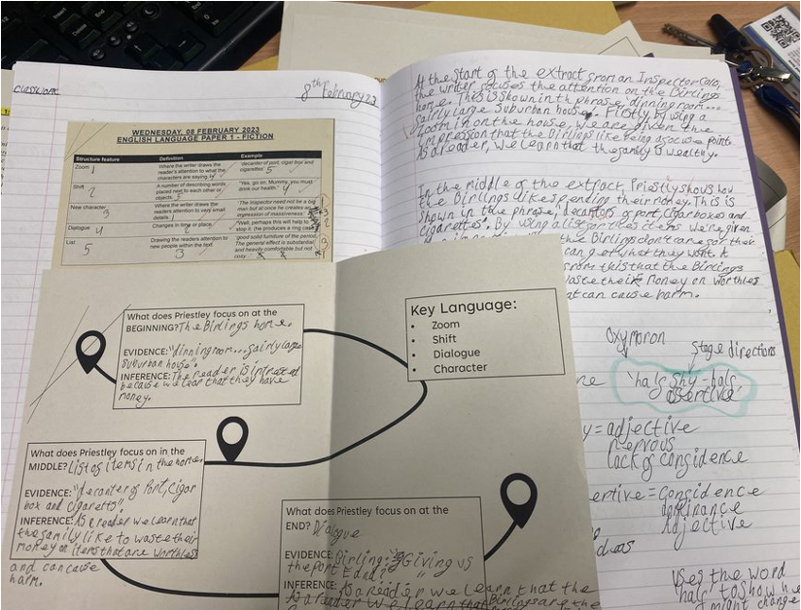
Spring 1 – An Inspector Calls (HWK 1)
Task: Produce a road map for Act 1, Act 2 or Act 3.
Guidance:
Accurately identifies evidence to sequence the plot of the play
Identifies adjectives to describe characters at points of the text
Makes inference about evidence
Identifies dramatic/writer techniques used
Links to contextual understanding of the play
Considers the effect on the audience
Success Criteria:
SR – Select and retrieve
WT – Writer's techniques
I – Inference
CON – Context
Z – Zoom
EA – Effect on audience
A similar example which focuses on only structure, rather than language and context. Your homework will need additional events/mention of inferences and context.

