Slide 1
Amazing Places:
Mega Cities
Spring 2

Slide 2
EXPLORE
VIPERs
In geography, you will receive two homework tasks this topic. Task 2 (VIPERS) will be awarded as Meaningful Homework, as this applies your knowledge from the first task. We have included both tasks below, so you know what you will be doing in advance. We will set one task at a time on ClassCharts.
Task 1:
Create a dual coded mind-map using the information from the knowledge organiser.
Guidance Notes:
Read the knowledge organiser carefully and highlight at least five key points in each box. Your mind-map must include your highlighted points and a minimum of five images. You may also add your own research.
Success Criteria:
Highlight the geography terms for this topic
Define at least two key terms and use them in a sentence
Classify information into social, economic and environmental factors
Explain how one piece of information is connected/important to you e.g. population growth.
Task 2:
Using all of the information on your knowledge organiser, answer the VIPERs question below in full sentences.
Guidance Notes:
Vocabulary: Population change occurs for how many reasons?
a) One b) Two c) three
Infer: ‘the Bullring shopping centre includes 140 shops generating employment and income for the local economy‘ Explain how this can benefit areas like Birmingham.
Predict: Birmingham and Mexico both have increasing population, what do you think this means for their future?
Explain: explain how a larger population can create pressures for towns and cities.
Review: ? Would you like to live in Birmingham or Mexico? Why/why not? Where would you live?
Success Criteria:
Highlight the geography terms for this topic
Respond to the command word in the question
Select and use evidence from the information boxes in your answer.

Slide 3
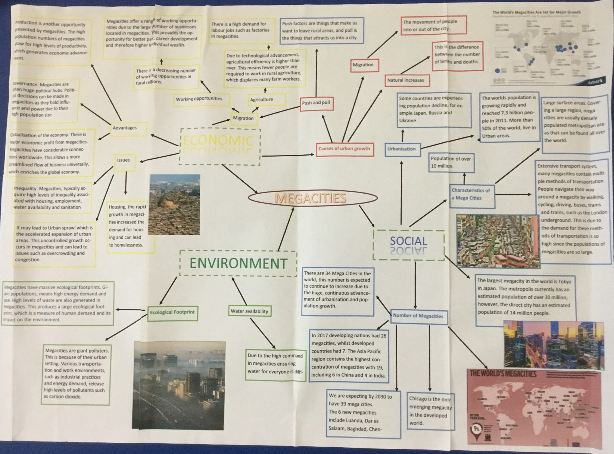
This is an Example of a good 'EXPLORE' homework
the topic used in this example is the same as your homework task. Remember to use your own ideas and research too.
EXPLORE
Strength:
A wide amount of own research has been completed to include lots of key facts about mega cities
Weakness:
Explaining how one piece of information is linked to you
And Next Step:
Consider how life would differ living in a mega city compared to Kidsgrove

Slide 4
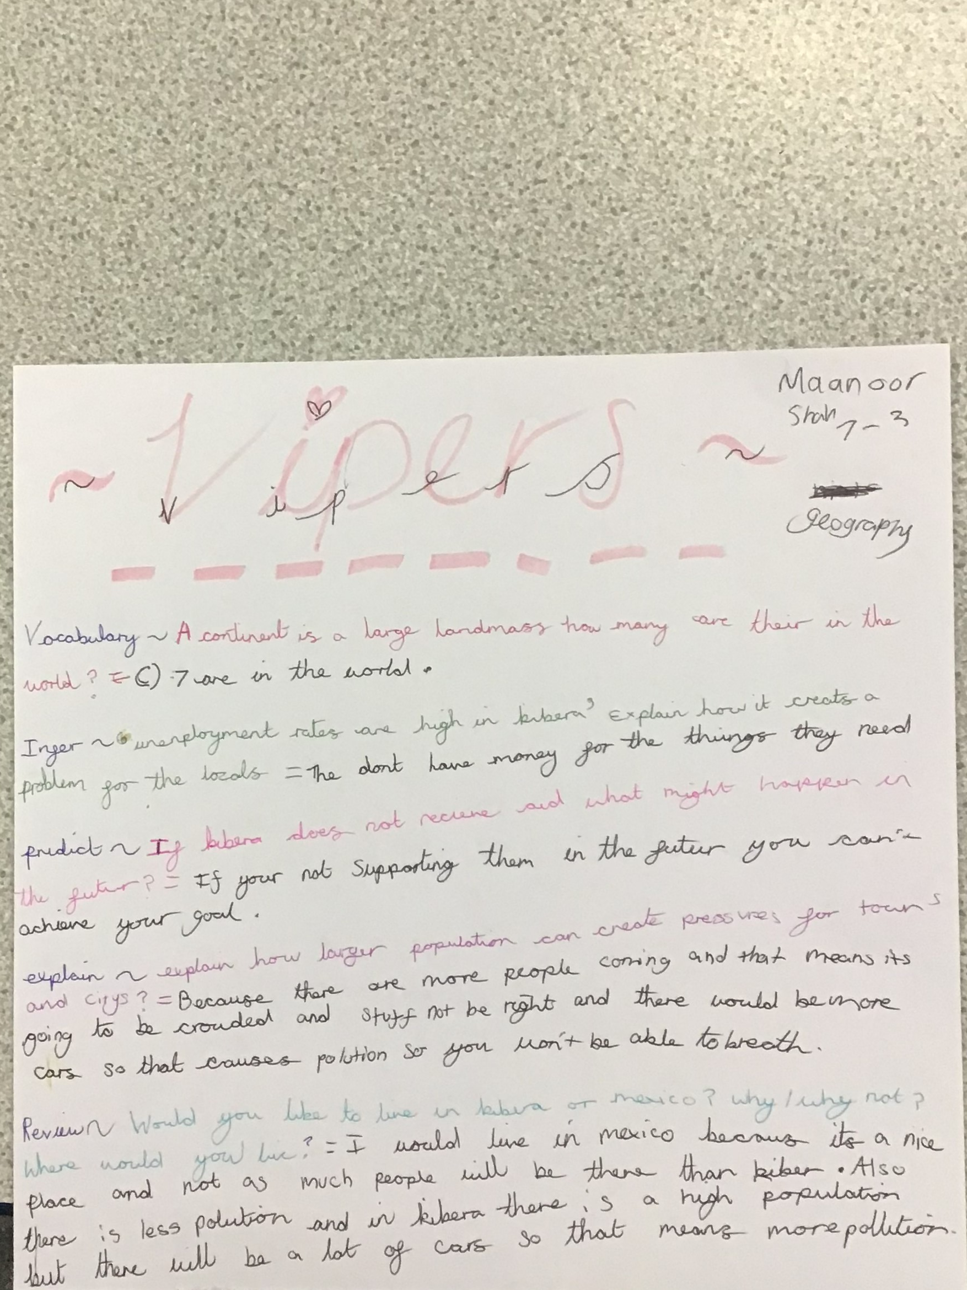
This is an Example of a good 'vipers' homework the questions used in this example may be different from your homework task, this is to give you the opportunity to apply your own understanding.
Strength:
Key terms for the topic used in each answer e.g. pollution and population.
Weakness:
Giving a second reason for the predict question.
Next Step:
How might people be affected by a lack of education?
VIPERs

