Slide 1
A Divided World:
California Case Study
Spring 2

Slide 2
EXPLORE
VIPERs
In geography, you will receive two homework tasks this topic. Task 2 (VIPERS) will be awarded as Meaningful Homework, as this applies your knowledge from the first task. We have included both tasks below, so you know what you will be doing in advance. We will set one task at a time on ClassCharts.
Task 1:
Create a dual coded mind-map using the information from the knowledge organiser.
Guidance Notes:
Read the knowledge organiser carefully and highlight at least five key points in each box. Your mind-map must include your highlighted points and a minimum of five images. You may also add your own research.
Success Criteria:
Highlight the geography terms for this topic
Define at least two key terms and use them in a sentence
Classify information into social, economic and environmental factors
Explain how one piece of information is connected/important to you e.g. differences in quality of life.
Task 2:
Using all of the information on your knowledge organiser, answer the VIPERs question below in full sentences.
Guidance Notes:
Vocabulary: ‘The San Andreas Fault is a continental transform fault that extends roughly 1,200 kilometers through California.’
Land mass b) Oceanic c) moving
Infer: ‘freezing temperatures are rare even in winter’. Explain why this is the case.
Predict: why might the city of LA be larger that San Diego? Why might the job types be different?
Explain: explain why most of the population live near to the coast.
Review: Would you like to live in California? Why/why not? Where would you live?
Success Criteria:
Highlight the geography terms for this topic
Respond to the command word in the question
Select and use evidence from the information boxes in your answer.

Slide 3
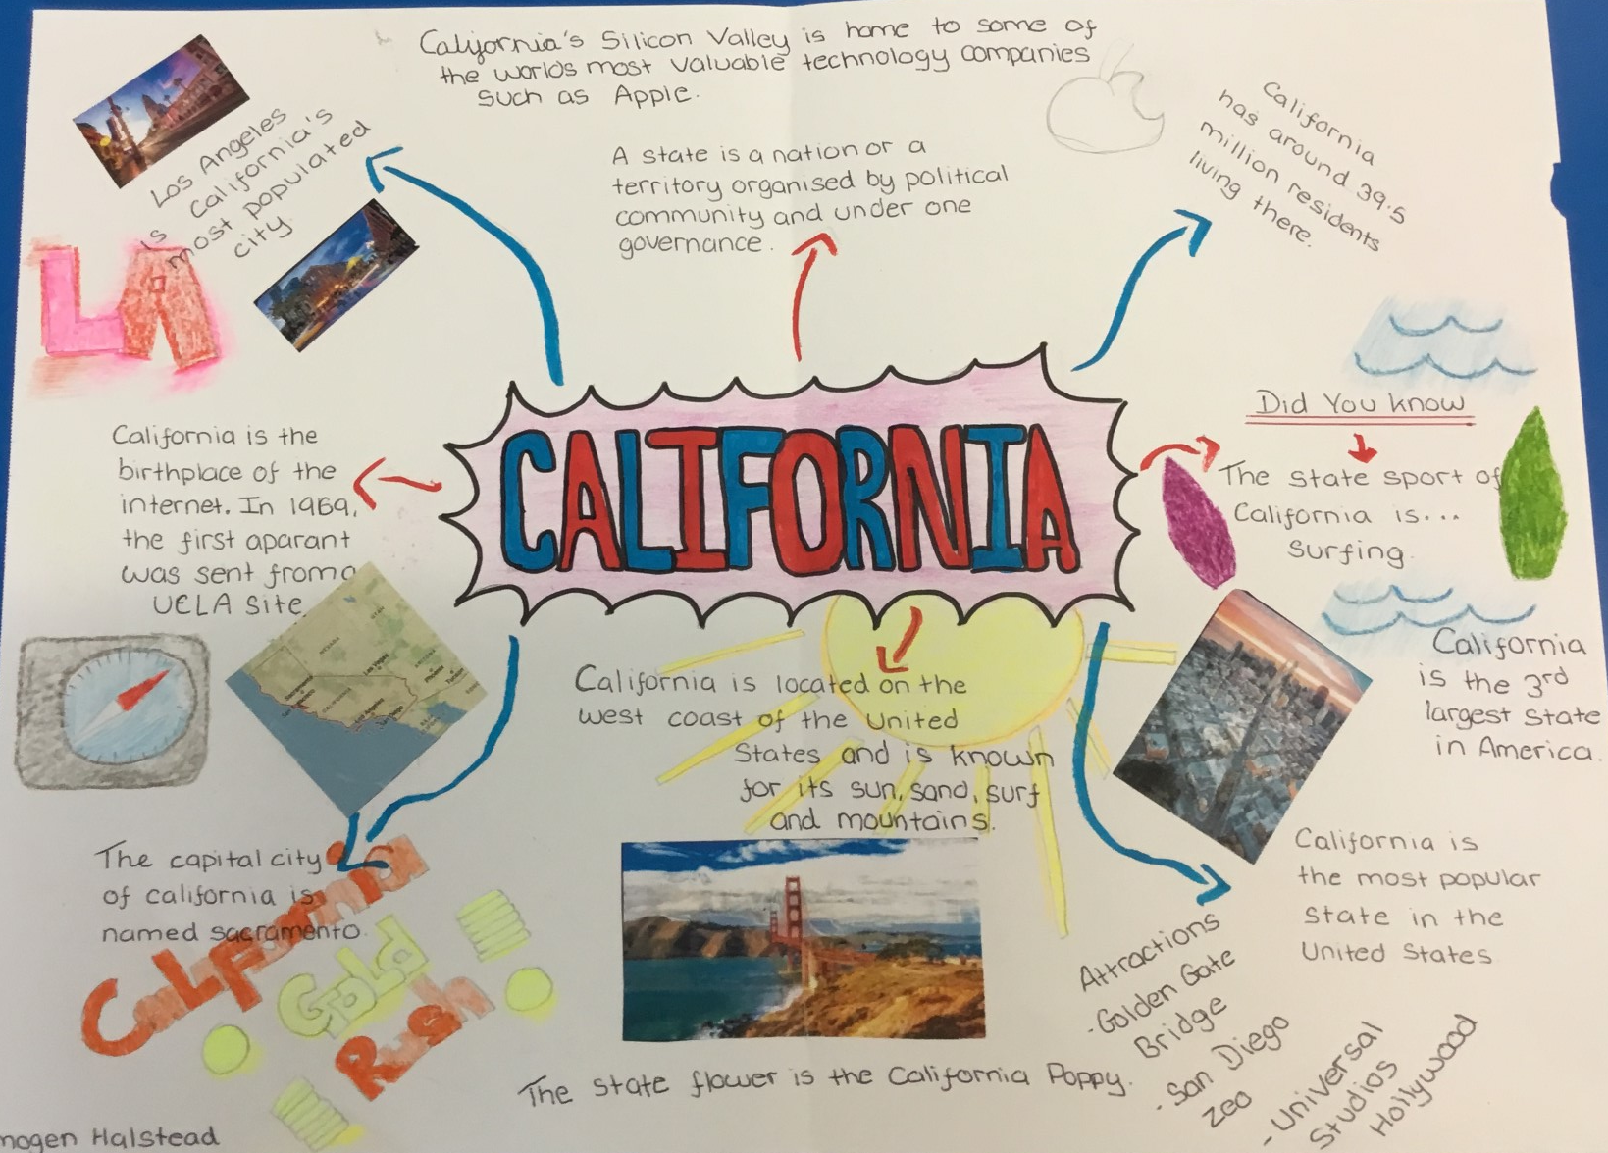
This is an Example of a good 'EXPLORE' homework
the topic used in this example is the same as your homework task. Remember to use your own ideas and research too.
EXPLORE
Strength:
Good selection of facts about California
Weakness:
Limited key terms
And Next Step:
Try applying key terms social, economic and environmental to your facts heling to categorise the information

Slide 4
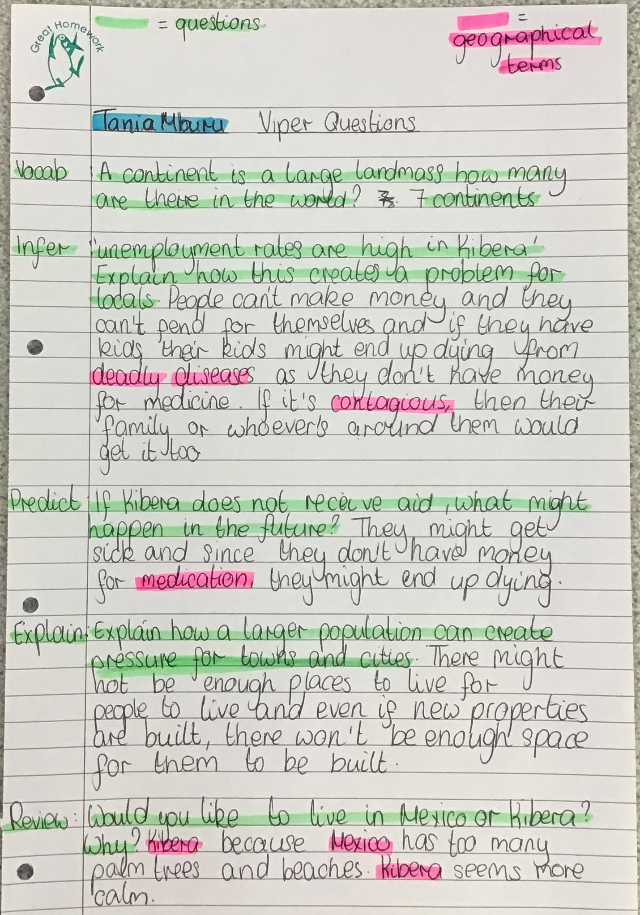
This is an Example of a good 'vipers' homework the questions used in this example may be different from your homework task, this is to give you the opportunity to apply your own understanding.
Strength: key terminology has been highlighted to show geographical vocabulary.
Weakness: explaining 'multiplier-effects' when giving reasons.
Next Step: Why will a higher death rate lead to lower levels of development?
VIPERs

Slide 5
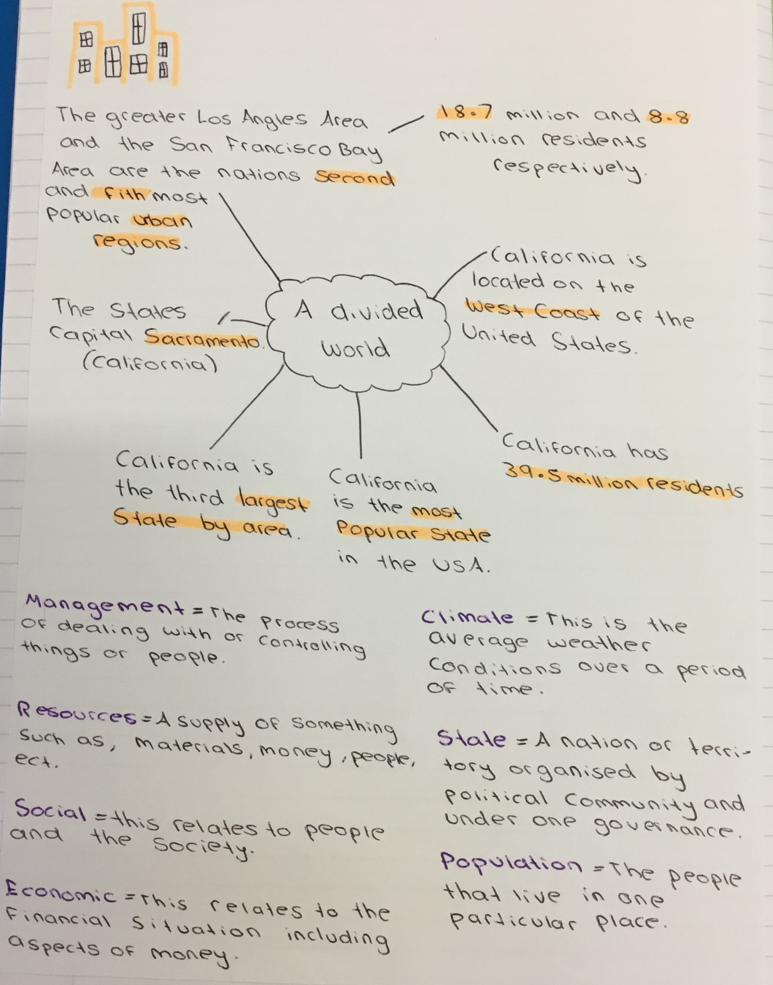
EXPLORE
Strength:
Clearly identified a large number of key terms
Weakness:
Explaining how one piece of information is linked to you
And Next Step:
Consider how population in California is different to Kidsgrove and how that might lead to difference is Quality of life

