Slide 1
Year 10 Spring 2 Meaningful Homework
Task: You have been contacted by a local nursery who are looking for support in terms of how they can help to develop children aged 0-5 years physically. They would like you to choose one of their key age groups; 0-18 months, 18 months – 3 years and 3-5 years and identify a range of resources / toys / activities that they could use to increase their physical development.
Guidance:
- Use magazines and the internet to cut out pictures to create a display of resources which help to promote physical development for either; 0-18 months, 18 months – 3 years or 3 -5 years.
- For 3 of the chosen resources you need to describe how it helps to promote physical development making reference to key terminology such as fine motor skills, gross motor skills, hand eye coordination, foot and leg coordination, spatial awareness, strength, staying healthy and self care.
Success criteria:
- I have identified a range of resources / toys / activities that promote physical development in a chosen age category between 0 and 5 years old
- For three of the selected resources, I have justified, using key terminology how this positively promotes physical development

Slide 2
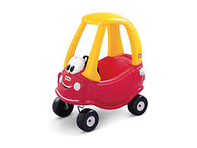
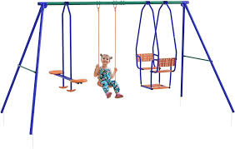
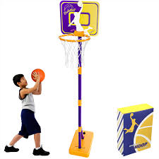
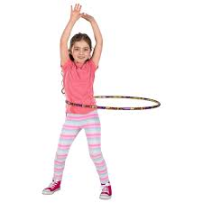
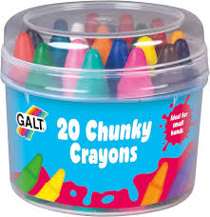
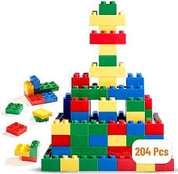
Toys which promote physical development in 3–5 year olds
Ride-on toys, such as tricycles, balance bikes, and scooters, promote physical development in 3-5 year olds in several ways. These toys enhance gross motor skills as children learn to propel themselves forward using their legs and feet, developing strength in their lower body muscles. Riding requires coordination and balance, which are gradually improved as children steer and maneuver around obstacles. By engaging in outdoor play with ride-on toys, children also enhance their spatial awareness and depth perception, learning to judge distances and navigate their surroundings safely. Additionally, these activities promote cardiovascular fitness and endurance as children engage in active play, contributing to their overall physical health and well-being. Ride-on toys provide opportunities for children to gain confidence in their physical abilities while enjoying active play experiences that support their developmental milestones.
Chunky crayons promote physical development in 3-5 year olds by encouraging the development of fine motor skills and hand-eye coordination. Their larger size and ergonomic design make them easier for young children to grasp and manipulate, helping them strengthen the muscles in their hands and fingers as they draw, scribble, and color. Using chunky crayons requires children to practice proper pencil grip and control, which are essential skills for later writing readiness. As children apply varying pressures to create different shades and lines, they also refine their motor control and dexterity. Moreover, the vibrant colors and creative expression encouraged by chunky crayons stimulate cognitive development and imagination, providing a multisensory experience that supports overall physical and artistic growth in early childhood.
Hula hoops promote physical development in 3-5 year olds by encouraging a range of movements that enhance coordination, balance, and gross motor skills. As children attempt to keep the hula hoop spinning around their waist or try different tricks like spinning it on their arms or legs, they engage core muscles and develop spatial awareness. This activity also promotes bilateral coordination as they coordinate movements on both sides of their body to keep the hoop in motion. Hula hooping requires rhythm and timing, which helps children refine their motor planning abilities. Additionally, playing with hula hoops encourages physical activity and cardiovascular fitness, contributing to overall health and well-being. The challenge of mastering hula hooping skills boosts children's confidence and persistence, fostering a positive attitude towards physical activity and skill development during playtime.

