Slide 1
Spring 2 Meaningful Homework
Task:
You have decided that you want to track the intensity of your training sessions to determine which training zone you are working in. In order to do this, you are going to conduct research into the different types of technology which are available to track the intensity of exercise. You will then create a poster for the gym which informs other clients of the different types of technology that can be used including a heart rate monitor, smart watch and apps for a smart phone. For each piece of technology you must explain how it works, explain how it can track the intensity of exercise and the advantages and disadvantages of each type of technology.
Success criteria:
I have described how heart rate monitors, smart watches and apps can be used to track exercise intensity
I have explained how each piece of technology works
I have explained the advantages and disadvantages of each piece of technology
Guidance:
Use the internet to research the different types of technology which can be used to track the intensity of exercise and the advantages and disadvantages

Slide 2
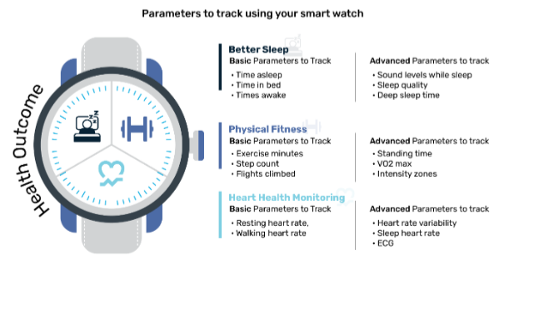
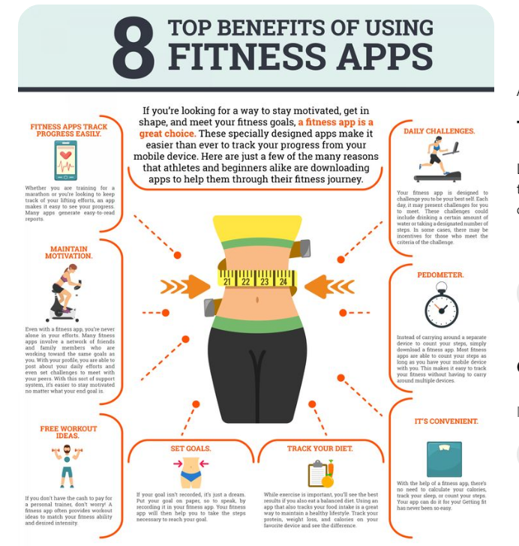
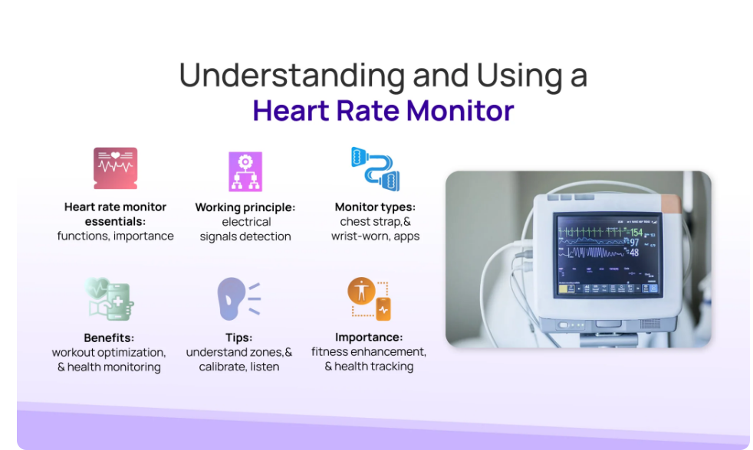
Advantages of using smart watches to track exercise intensity:
Real-time Monitoring: Provides immediate feedback on heart rate, calories burned, and other metrics.
Personalized Insights: Tailors fitness advice based on individual performance data.
Goal Tracking: Helps set and monitor progress towards specific fitness goals.
Motivation: Encourages consistency and effort through reminders and alerts.
Data Accuracy: Offers precise measurement of exercise intensity through advanced sensors.
Disadvantages of using smart watches to track exercise intensity:
Cost: High-quality smartwatches can be expensive.
Battery Life: Frequent charging may be required, especially with intensive use.
Accuracy Issues: Sensors may not always provide accurate data, especially during high-intensity or dynamic movements.
Distraction: Notifications and other smartwatch features can distract from workouts.
Advantages of using heart rate monitors to track exercise intensity:
Accuracy: Provides precise measurement of heart rate, often more reliable than smartwatches.
Real-time Feedback: Offers immediate data on exercise intensity, helping to maintain optimal workout levels.
Goal Setting: Enables users to set specific heart rate zones for different training objectives.
Motivation: Encourages users to reach and maintain target heart rate zones, enhancing workout effectiveness.
Disadvantages of using heart rate monitors to track exercise intensity:
Comfort: Chest strap monitors can be uncomfortable or restrictive for some users.
Limited Functionality: Primarily focused on heart rate, lacking the multifunctional capabilities of smartwatches.
Cost: High-quality monitors can be expensive.
Advantages of using apps to track exercise intensity:
Convenience: Easily accessible on smartphones, which most users already have.
Cost-Effective: Many apps are free or low-cost compared to dedicated fitness devices.
Comprehensive Tracking: Often integrates various metrics like heart rate, GPS, calories burned, and more.
Customization: Offers personalized workout plans and adjusts based on user performance.
Disadvantages of using apps to track exercise intensity:
Accuracy Issues: Data can be less accurate compared to dedicated fitness devices.
Battery Drain: Continuous use of tracking apps can significantly drain smartphone battery.
Dependence on Smartphone: Requires carrying a smartphone during workouts, which can be inconvenient.

