Slide 1

Meaningful Homeworks
Year 9

Slide 2
Spring 2 – Power & Conflict: Conflict Cluster (HWK 1)
Task:
Imagine you are a soldier in the trenches. Write a letter home to a loved one describing the winter conditions. Your letter should be at least one side of A4.
Guidance:
Your work should be reflective of the soldiers’ experiences that we have learnt about so far in our study of Power and Conflict poems.
Use the following GCSEPod on letter writing to ensure you include the basics: https://members.gcsepod.com/shared/podcasts/chapter/85136
Use a range of ambitious language
Attempts to use language features, e.g. pathetic fallacy, personification and metaphor
Shows accurate spelling, punctuation and grammar
Uses the correct structure of a letter with linked/relevant ideas
Clearly communicates the soldier’s perspective of war
Uses at least five different pieces of punctuation
Success Criteria:
AV – Ambitious vocabulary
WT – Writer's techniques
L – Layout
P – Purpose
RP – Range of punctuation
Eng – Engaging
Sp – Accurate spelling
G - Grammar

Slide 3
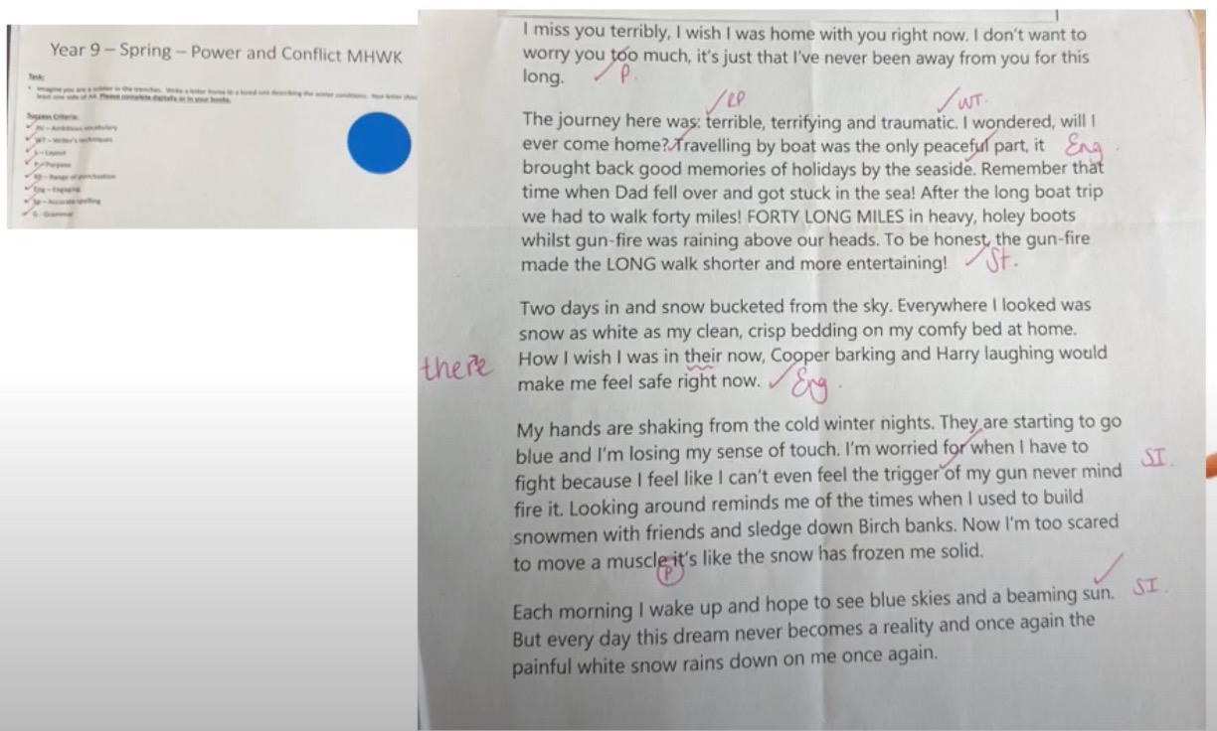
Spring 2 – Power & Conflict: Conflict Cluster (HWK 1)
Task:
Imagine you are a soldier in the trenches. Write a letter home to a loved one describing the winter conditions. Your letter should be at least one side of A4.
Guidance:
Your work should be reflective of the soldiers’ experiences that we have learnt about so far in our study of Power and Conflict poems.
Use the following GCSEPod on letter writing to ensure you include the basics: https://members.gcsepod.com/shared/podcasts/chapter/85136
Use a range of ambitious language
Attempts to use language features, e.g. pathetic fallacy, personification and metaphor
Shows accurate spelling, punctuation and grammar
Uses the correct structure of a letter with linked/relevant ideas
Clearly communicates the soldier’s perspective of war
Uses at least five different pieces of punctuation
Success Criteria:
AV – Ambitious vocabulary
WT – Writer's techniques
L – Layout
P – Purpose
RP – Range of punctuation
Eng – Engaging
Sp – Accurate spelling
G - Grammar

