Slide 1
River Landscapes
Summer 1

Slide 2
Homework 1
Homework 2
In geography, you will receive two guided GCSEPod retrieval tasks per half-term. We have included both tasks below, so you know what you will be doing in advance. We will set one task at a time on Weduc.
Task 1:
Watch the GCSEPod on river processes. Create a duel coded mind-map of the information from the Pod, then complete the retrieval quiz (assignment) linked to the Pod.
Guidance Notes:
Watch the Pod at least once – you may want to pause it to make notes.
You may wish to present your information in a creative way or using a different revision technique e.g. revision cards. You are free to make your own choice about the way you present your work, as long as you meet the ‘success criteria’ below.
Success Criteria:
Your information is linked to the content of the Pod
To have at least ten branches to your mind-map
To include at least five images to represent the information
To define at least two key terms and use them in a sentence
Retrieval quiz competed at ‘mastery’ level – 80% or better.
EXTENSION = +50 track-it points:
Extend – classify the branches of your mind-map into three categories e.g. social, economic and environmental factors.
Task 2:
Watch the GCSEPod on river landforms. Create a duel coded mind-map of the information from the Pod, then complete the retrieval quiz (assignment) linked to the Pod.
Guidance Notes:
Watch the Pod at least once – you may want to pause it to make notes.
You may wish to present your information in a creative way or using a different revision technique e.g. revision cards. You are free to make your own choice about the way you present your work, as long as you meet the ‘success criteria’ below.
Success Criteria:
Your information is linked to the content of the Pod
To have at least ten branches to your mind-map
To include at least five images to represent the information
To define at least two key terms and use them in a sentence
Retrieval quiz competed at ‘mastery’ level – 80% or better.
EXTENSION = +50 track-it points:
Extend – classify the branches of your mind-map into three categories e.g. social, economic and environmental factors.

Slide 3
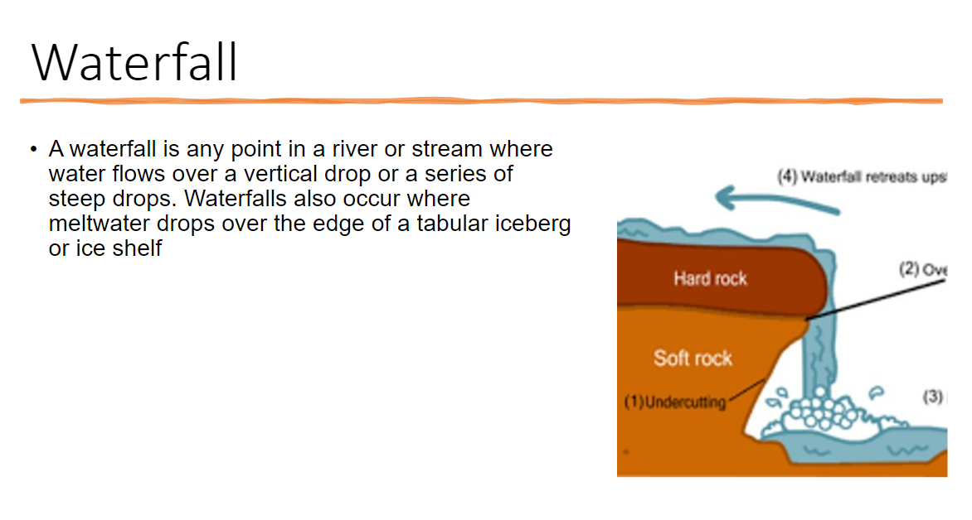
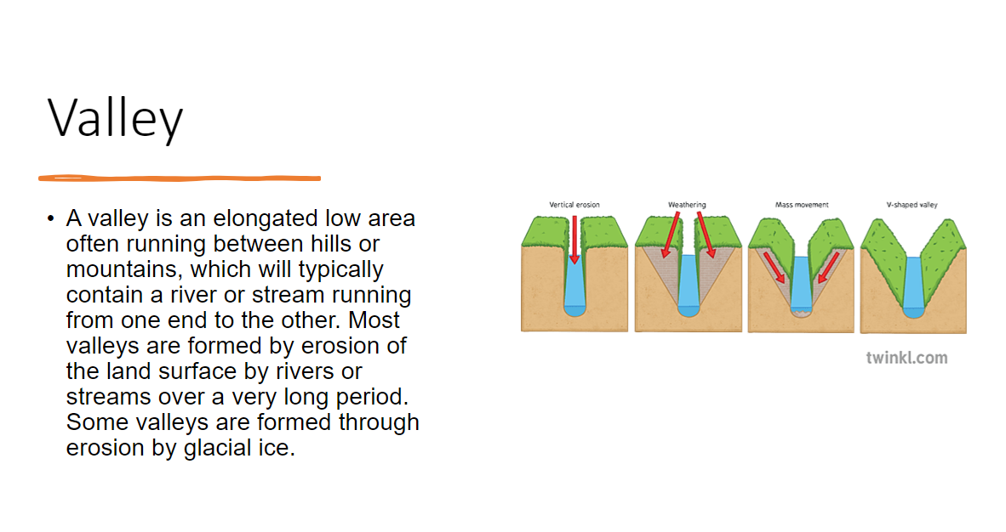
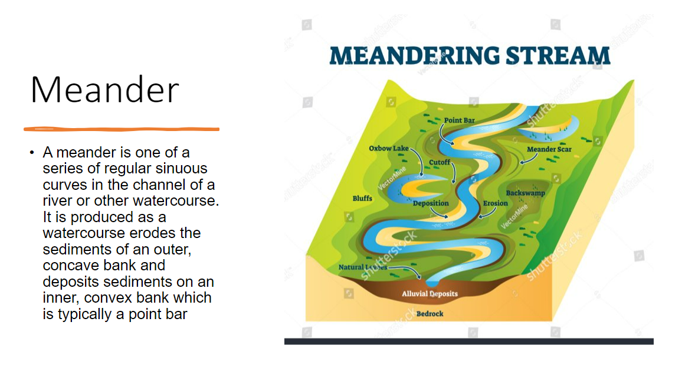
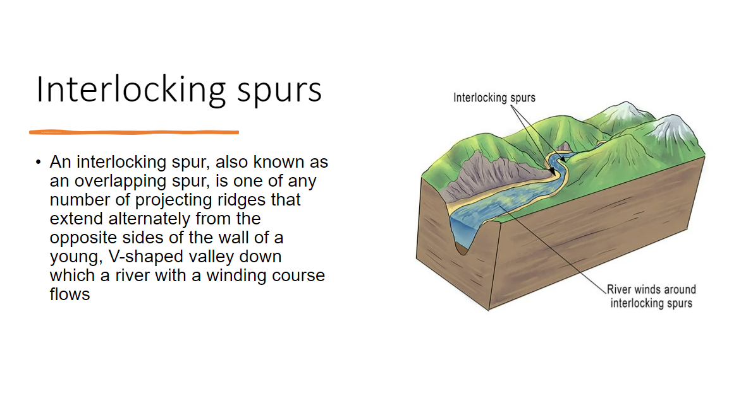
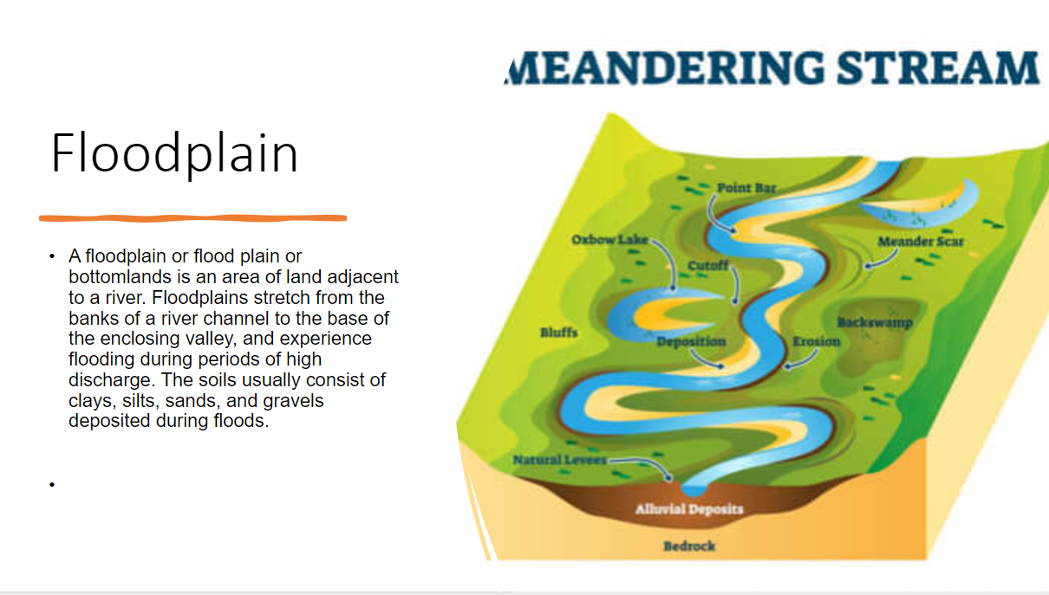
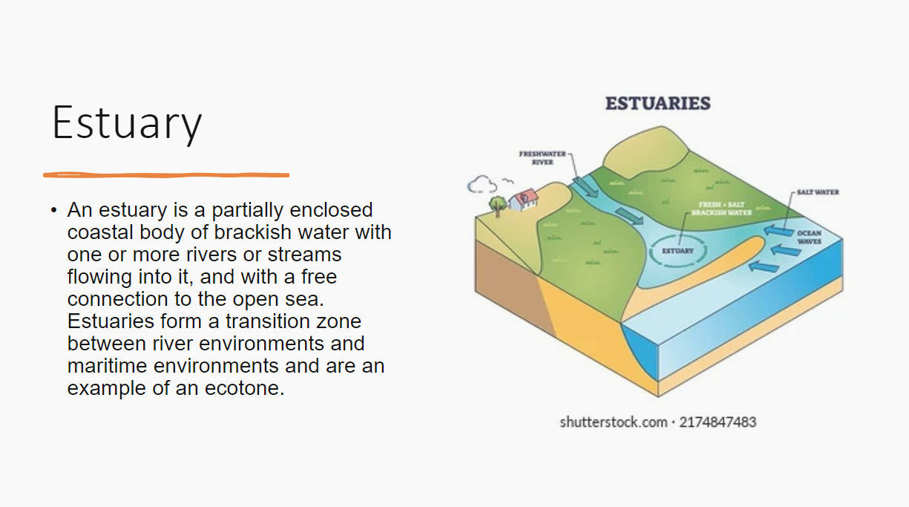

Task 2:
Watch the GCSEPod on river landforms. Create a duel coded mind-map of the information from the Pod, then complete the retrieval quiz (assignment) linked to the Pod.
Guidance Notes:
Watch the Pod at least once – you may want to pause it to make notes.
You may wish to present your information in a creative way or using a different revision technique e.g. revision cards. You are free to make your own choice about the way you present your work, as long as you meet the ‘success criteria’ below.
Success Criteria:
Your information is linked to the content of the Pod
To have at least ten branches to your mind-map
To include at least five images to represent the information
To define at least two key terms and use them in a sentence
Retrieval quiz competed at ‘mastery’ level – 80% or better.
FEEDBACK:
Strength – you have included a range of features with links to images using PowerPoint to organise your information.
Weakness – miss opportunity explain processes and geology links
Next step – how is a waterfall is formed by erosion and geology?

Slide 4
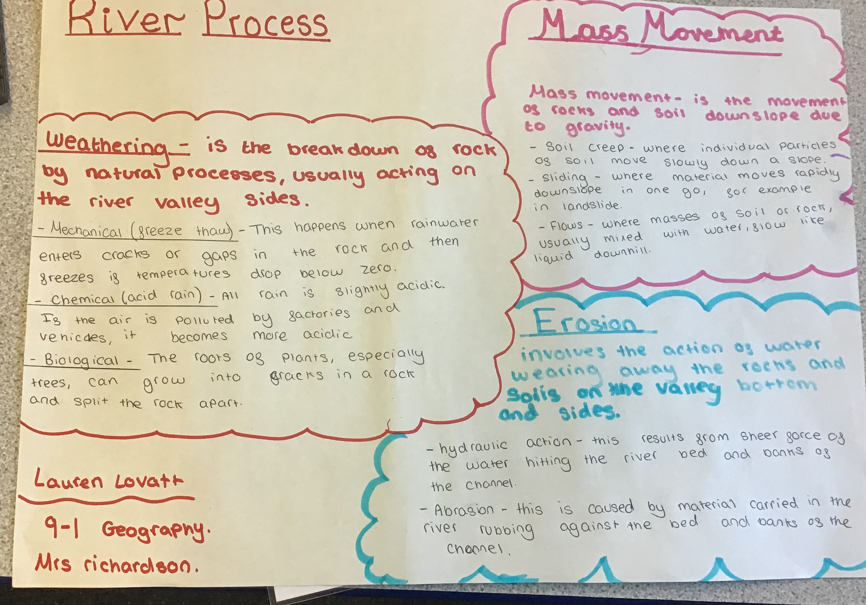
Task 1:
Watch the GCSEPod on river processes. Create a duel coded mind-map of the information from the Pod, then complete the retrieval quiz (assignment) linked to the Pod.
Guidance Notes:
Watch the Pod at least once – you may want to pause it to make notes.
You may wish to present your information in a creative way or using a different revision technique e.g. revision cards. You are free to make your own choice about the way you present your work, as long as you meet the ‘success criteria’ below.
Success Criteria:
Your information is linked to the content of the Pod
To have at least ten branches to your mind-map
To include at least five images to represent the information
To define at least two key terms and use them in a sentence
Retrieval quiz competed at ‘mastery’ level – 80% or better.
FEEDBACK:
Strength – you have included a range of process.
Weakness – miss opportunity dual code with images.
Next step – how do these processes affect the river?

