Slide 1
Shaping India
Summer 1 – Summer 2

Slide 2
EXPLORE
VIPERs
In geography, you will receive two homework tasks this topic. Task 2 (VIPERS) will be awarded as Meaningful Homework, as this applies your knowledge from the first task. We have included both tasks below, so you know what you will be doing in advance. We will set one task at a time on ClassCharts.
Task 1:
Create a dual coded mind-map using the information from the knowledge organiser.
Guidance Notes:
Read the knowledge organiser carefully and highlight at least five key points in each box. Your mind-map must include your highlighted points and a minimum of five images. You may also add your own research.
Success Criteria:
Highlight the geography terms for this topic
Define at least two key terms and use them in a sentence
Classify information into social, economic and environmental factors
Explain how one piece of information is connected/important to you e.g. population growth.
Task 2:
Using all of the information on your knowledge organiser, answer the VIPERs question below in full sentences.
Guidance Notes:
Vocabulary: ‘the monsoons cause what in India?’
floods b) drought c) migration
Infer: ‘The Himalayas include over fifty mountains over 7,200m’ Explain how they are formed.
Predict: why might water resources become more strained in urban areas in the future? (use box 6)
Explain: explain how water enters the atmosphere? How can humans change this?
Retrieve: What is happening to the level of investment in water resources in India? Use data and facts in your answer.
Success Criteria:
Highlight the geography terms for this topic
Respond to the command word in the question
Select and use evidence from the information boxes in your answer.

Slide 3
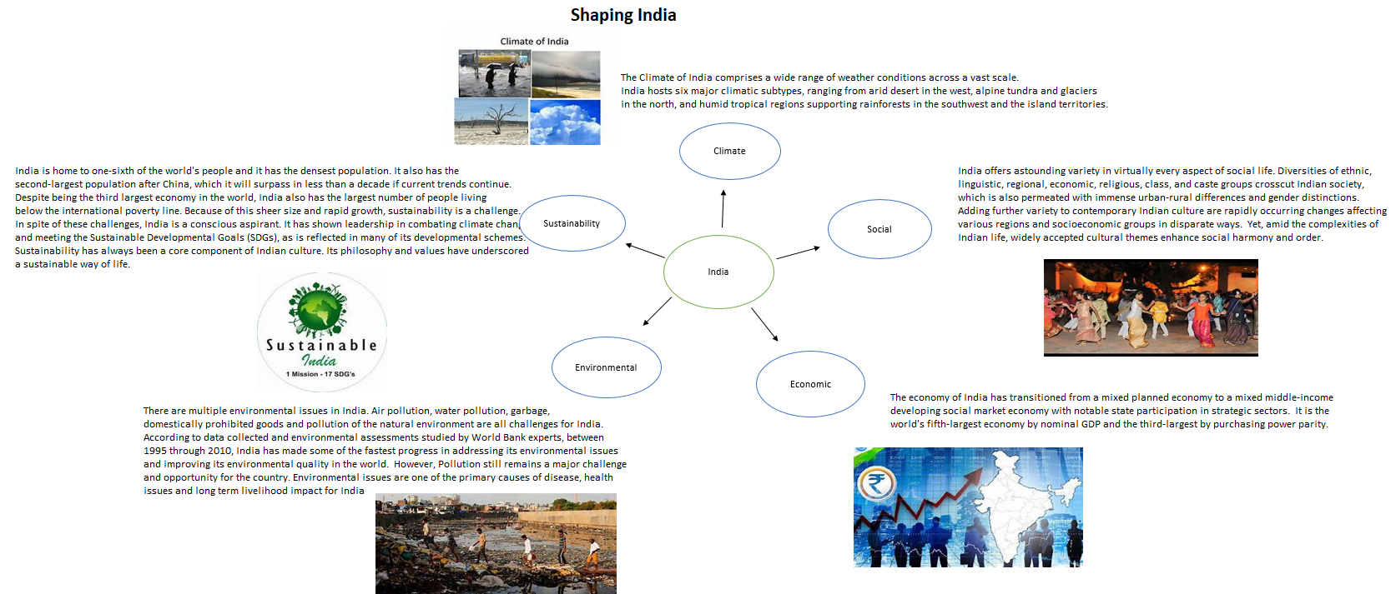
This is an Example of a good 'EXPLORE' homework
the topic used in this example is the same as your homework task. Remember to use your own ideas and research too.
EXPLORE
Strength:
Geography key terms are used effectively and information classified into appropriate headings.
Weakness:
Explaining how one piece of information is linked to you
And Next Step:
Consider how population growth in India could be a challenge for the U.K.

Slide 4
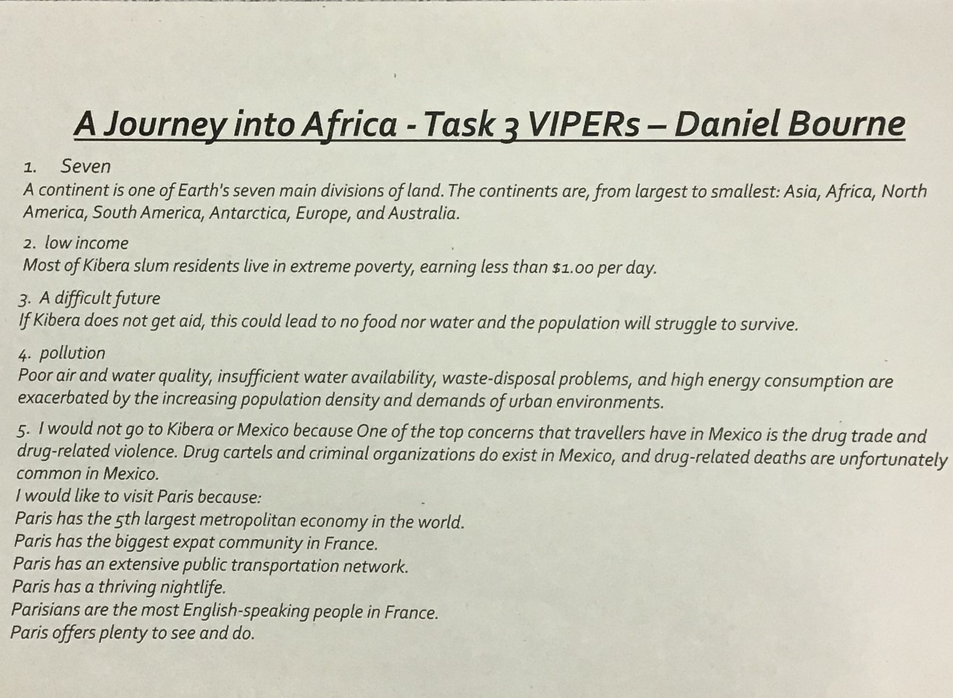
This is an Example of a good 'vipers' homework the questions used in this example may be different from your homework task, this is to give you the opportunity to apply your own understanding.
Strength: excellent use of key terms 'water quality, population and urban'.
Weakness: explaining impacts of pollution
Next Step: How are people affected by air and water pollution?
VIPERs

Slide 5
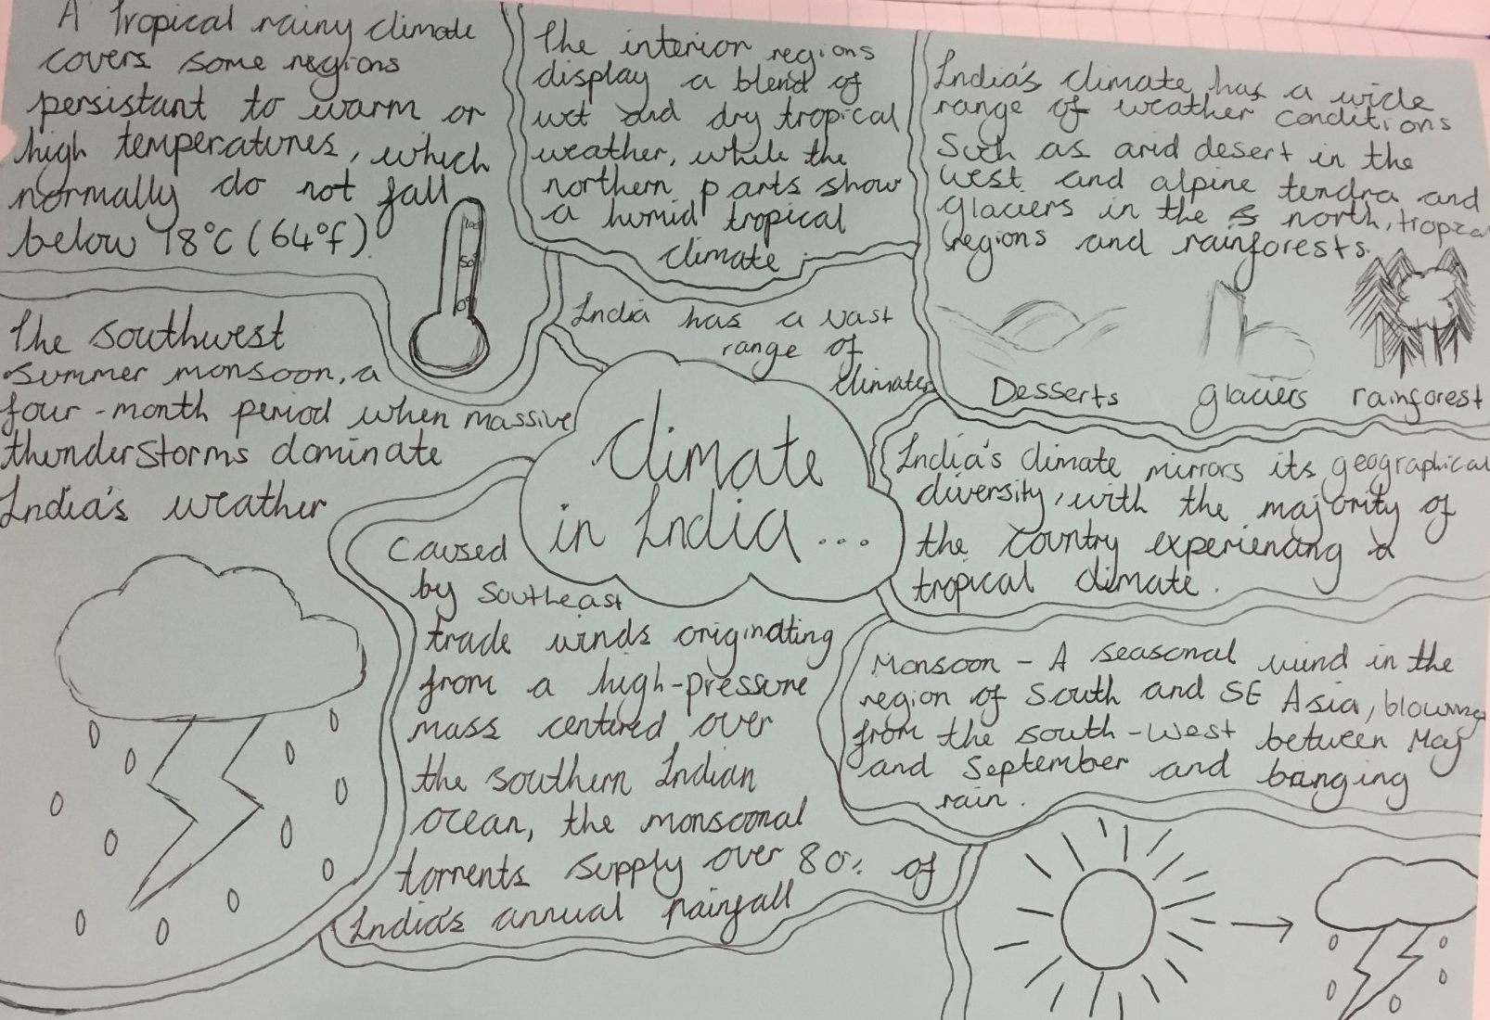
EXPLORE
Strength:
A clear focus on climate with a wide range of facts
Weakness:
Explaining how one piece of information is linked to you
And Next Step:
Consider how the climate in India differs to the UK climate

Slide 6
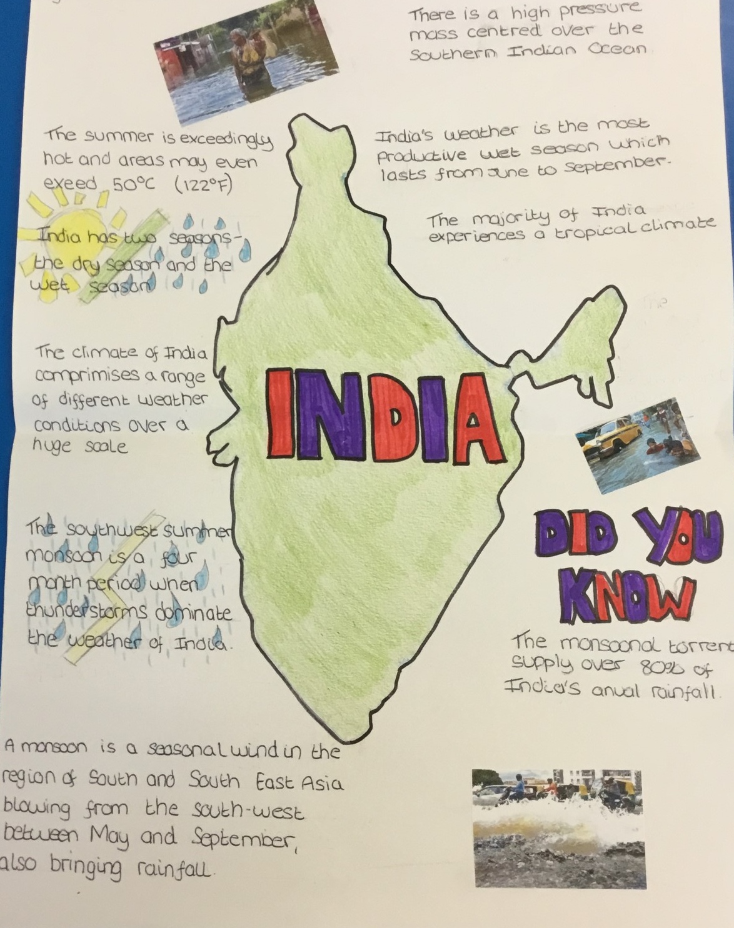
EXPLORE
Strength:
Clear geographical knowledge on the climate of India used
Weakness:
Making wider connections
And Next Step:
Consider the social impacts of living in a monsoonal climate

