Slide 1

Meaningful Homeworks
Year 9

Slide 2
Summer 1 – Descriptive and Narrative Writing (HWK 2)
Task:
Using the image stimulus provided, use the 'Drop, shift, zoom, link' method to help plan what details you would focus on to produce a piece of narrative writing which includes description.
Guidance:
Drop – drop the reader into the action. Why are you there? What happened to take you there? What is it like?
Shift – shift the focus of what you describe. What do you notice about this part of the room? Describe using the language devices recommended.
Zoom – focus on the tiny, tiny details in this part of the image! Say a lot about a little.
Link – use a flashback or another structural feature to take the reader back in time and reveal more about how you got to this place.
Demonstrates accuracy in spelling, punctuation and grammar
Selects a range of relevant vocabulary
Attempts to craft language through using attempting to use some range of language devices
Uses at least five different pieces of punctuation
Success Criteria:
St – Structure
D - Developed
Eng – Engaging
Sp – Spelling is accurate
G – Grammar
WT – Writer's techniques
AV – Ambitious vocabulary
RP – Range of punctuation

Slide 3
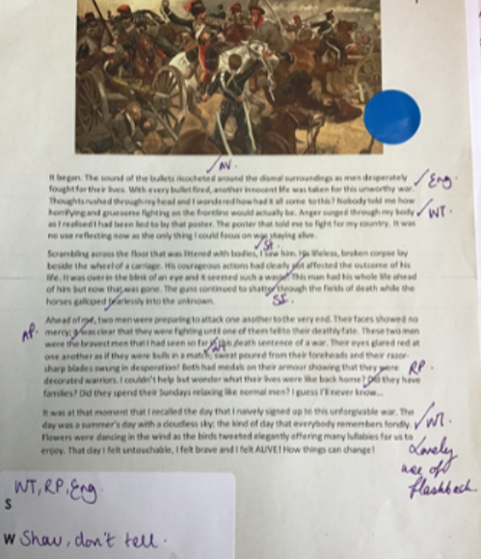
Summer 1 – Descriptive and Narrative Writing (HWK 2)
Task:
Using the image stimulus provided, use the 'Drop, shift, zoom, link' method to help plan what details you would focus on to produce a piece of narrative writing which includes description.
Guidance:
Drop – drop the reader into the action. Why are you there? What happened to take you there? What is it like?
Shift – shift the focus of what you describe. What do you notice about this part of the room? Describe using the language devices recommended.
Zoom – focus on the tiny, tiny details in this part of the image! Say a lot about a little.
Link – use a flashback or another structural feature to take the reader back in time and reveal more about how you got to this place.
Demonstrates accuracy in spelling, punctuation and grammar
Selects a range of relevant vocabulary
Attempts to craft language through using attempting to use some range of language devices
Uses at least five different pieces of punctuation
Success Criteria:
St – Structure
D - Developed
Eng – Engaging
Sp – Spelling is accurate
G – Grammar
WT – Writer's techniques
AV – Ambitious vocabulary
RP – Range of punctuation

