Slide 1
A Journey into Africa
Summer 1 – Summer 2

Slide 2
EXPLORE
VIPERs
In geography, you will receive three homework tasks this topic. Task 2 (VIPERS) will be awarded as Meaningful Homework, as this uses your knowledge from the other tasks. We have included all three tasks below, so you know what you will be doing in advance. We will set one task at a time on ClassCharts.
Task 1:
Create a dual coded mind-map using the information from the knowledge organiser.
Guidance Notes:
Read the knowledge organiser carefully and highlight at least five key points in each box. Your mind-map must include your highlighted points and a minimum of five images. You may also add your own research.
Success Criteria:
Highlight the geography terms for this topic
Define at least two key terms and use them in a sentence
Classify information into social, economic and environmental factors
Explain how one piece of information is connected/important to you e.g. population growth.
Task 2:
Using all of the information on your knowledge organiser, answer the VIPERs question below in full sentences.
Guidance Notes:
Vocabulary: A continent is a large landmass how many are their in the world
a) One b) five c) seven
Infer: ‘unemployment rates are high in Kibera‘ Explain how this creates a problem for locals
Predict: If Kibera does not receive aid what might happen in the future?
Explain: explain how a larger population can create pressures for towns and cities.
Review: ? Would you like to live in Kibera or Mexico? Why/why not? Where would you live?
Success Criteria:
Highlight the geography terms for this topic
Respond to the command word in the question
Select and use evidence from the information boxes in your answer.

Slide 3
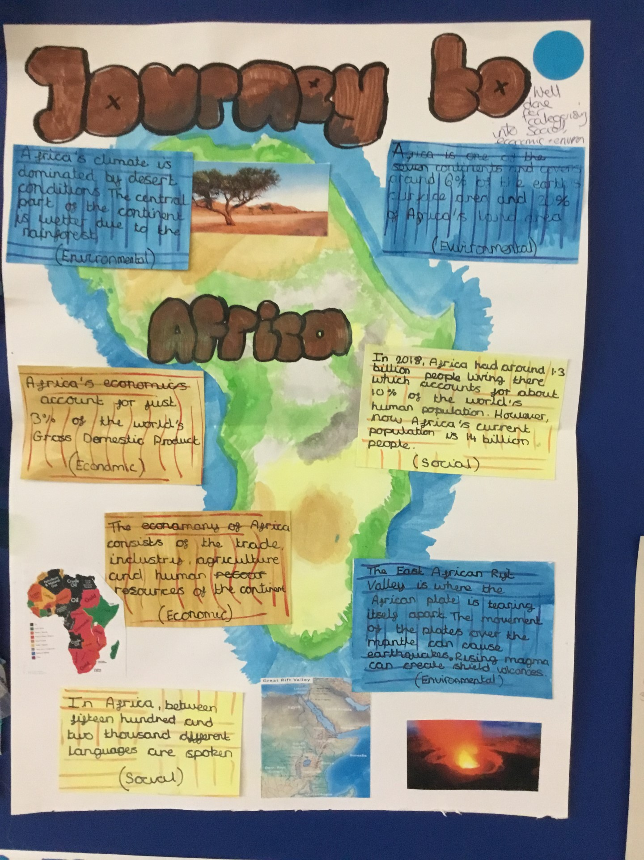
This is an Example of a good 'EXPLORE' homework
the topic used in this example is the same as your homework task. Remember to use your own ideas and research too.
EXPLORE
Strength:
Categorised facts into categories of social, economic and environmental
Weakness:
Explaining how one piece of information is linked to you.
And Next Step:
Explain how life in Arica might differ to your own.

Slide 4
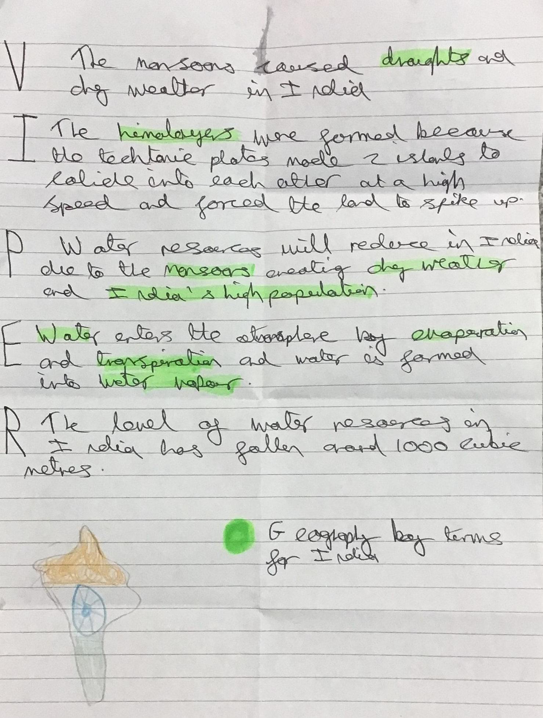
This is an Example of a good 'vipers' homework the questions used in this example may be different from your homework task, this is to give you the opportunity to apply your own understanding.
Strength:
Key terms for the topic highlighted in each answer and specific example used.
Weakness:
Giving a second reason for the retrieve question.
Next Step:
Why might water resources in be falling in this location?
VIPERs

