Slide 1







FORM TIME

Slide 2
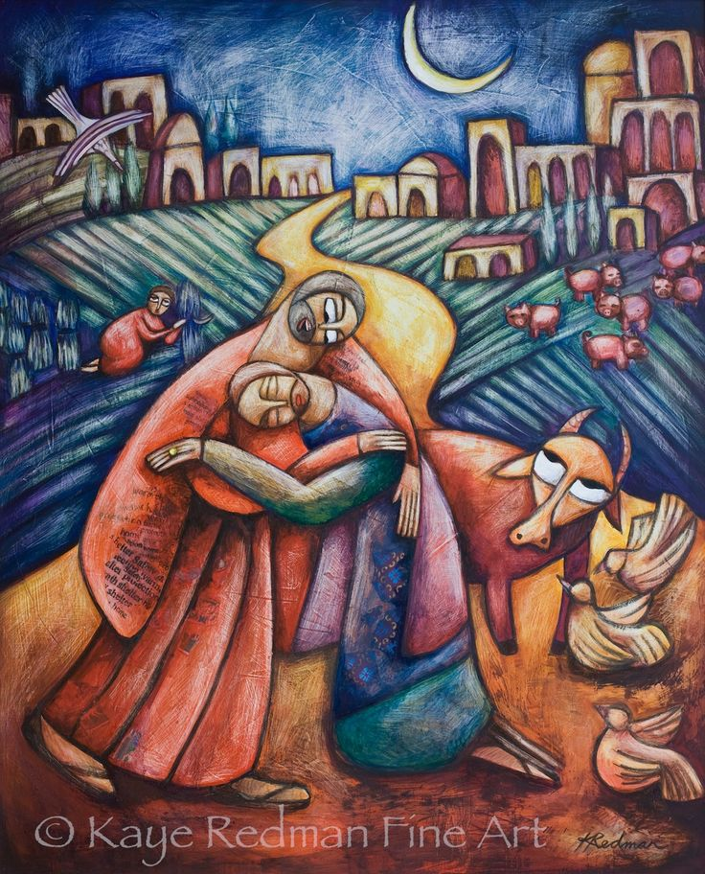


What would happen if patience was missing?
“Love is patient, love is kind.
It does not envy, it does not boast, it is not proud.
It does not dishonour others, it is not self-seeking, it is not easily angered,
it keeps no record of wrongs.
Love does not delight in evil but rejoices with the truth.
It always protects, always trusts, always hopes, always perseveres.”

Slide 3
DEFINITION Waiting calmly without getting angry or giving up; staying steady when things take time or don’t go your way. | CHARACTERISTICS? (what does it look like?)
EXAMPLES (School & life) | NON-EXAMPLES (Opposites / misconceptions)
PATIENCE

Slide 4


Slide 5
MONDAY - Collective Worship
in the Hall

Slide 6

Our Academy Vision
Discovering 'life in all its fullness' (John 10:10)
Rooted in the life and teaching of Jesus the King, we:
• Aspire to grow into the people God calls us to be.
• Belong to a community where everyone is known and valued.
• Care for others with compassion and courage.
Through the vision, we live out the Christian faith with hope, dignity, and love shaping lives of purpose, service, and “life in all its fullness”.

Slide 7
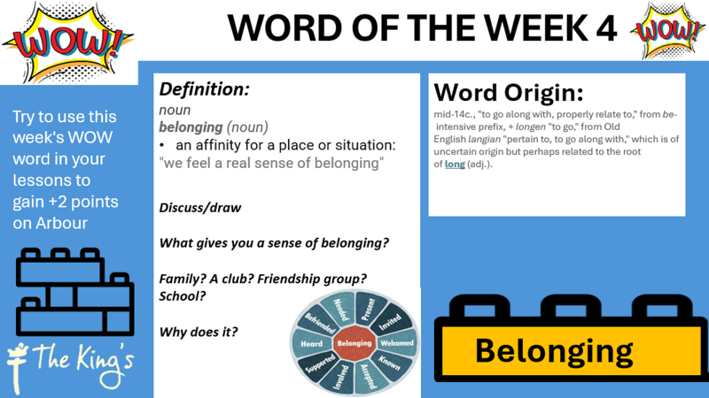

Slide 8
TUESDAY

Slide 9


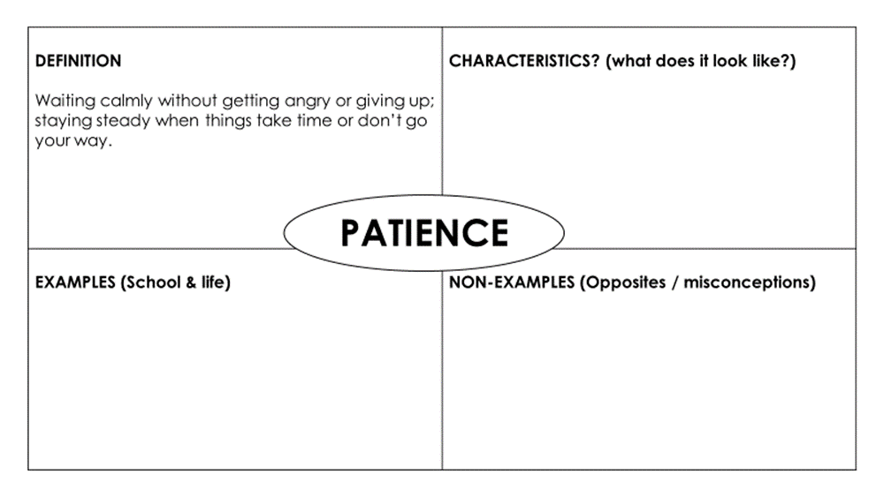
Something to consider
Caring means patience
"Love is patient."
What do you think we mean when we talk about patience?
Where could I show patience today (in class, online, at home)?

Slide 10
DEFINITION Waiting calmly without getting angry or giving up; staying steady when things take time or don’t go your way. | CHARACTERISTICS? (what does it look like?)
EXAMPLES (School & life) | NON-EXAMPLES (Opposites / misconceptions)
PATIENCE

Slide 11
DEFINITION Waiting calmly without getting angry or giving up; staying steady when things take time or don’t go your way. | CHARACTERISTICS? (what does it look like?) Takes a breath and listens before responding Stays calm in queues, delays, or slow progress Keeps trying—even when work is tricky or slow Gives others time to speak or improve Uses kind words and a steady tone
EXAMPLES (School & life) Re-drafting an essay until it’s right Letting a classmate finish before you jump in Practising an instrument daily for small improvements Waiting your turn during group work Sticking with revision over weeks, not cramming | NON-EXAMPLES (Opposites / misconceptions) Snapping or rolling eyes when things take time Quitting a task after the first mistake Talking over someone because they’re slow Sending a rude message because of a delay Expecting instant results without effort
PATIENCE

Slide 12
Our Academy Vision
Discovering 'life in all its fullness' (John 10:10)
Rooted in the life and teaching of Jesus the King, we:
• Aspire to grow into the people God calls us to be.
• Belong to a community where everyone is known and valued.
• Care for others with compassion and courage.
Through the vision, we live out the Christian faith with hope, dignity, and love shaping lives of purpose, service, and “life in all its fullness”.

Slide 13


Gathering
Leader: Let us begin our time of daily worship:
As your Word reveals your kingdom ...

Slide 14
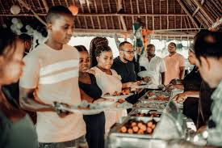
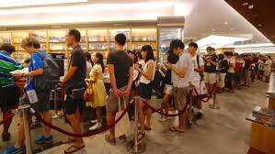
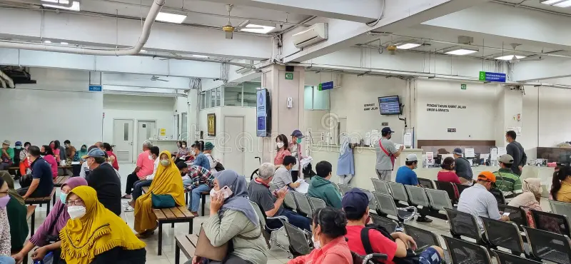
What would happen if patience was missing?
How would people in the queue feel if everyone pushed to the front?
What problems or conflicts might arise if nobody waited their turn?
How is this situation like our school community when patience is missing?
What difference could one person’s patience make to the whole group?

Slide 15
“Love is patient.” - 1 Corinthians 13
Patience is care in action: listening without rushing, waiting without anger, being gentle with others.
Why does caring often require patience?
Who do you find it hardest to be patient with, and why?
How could showing patience make school life kinder?

Slide 16

God of patience,
Help us to slow down, to listen carefully, and to care for others with gentleness and understanding.
Teach us to see the needs of those around us, even when they are quiet or hidden.
Give us strength to be patient not only with others, but also with ourselves as we learn and grow.
Shape our community into one that waits with kindness and acts with love.
Amen.

Slide 17
Dismissal
Leader: Jesus the promise of hope
Leader: Build our school community
Everyone: Amen.

Slide 18
BUSINESS

Slide 19



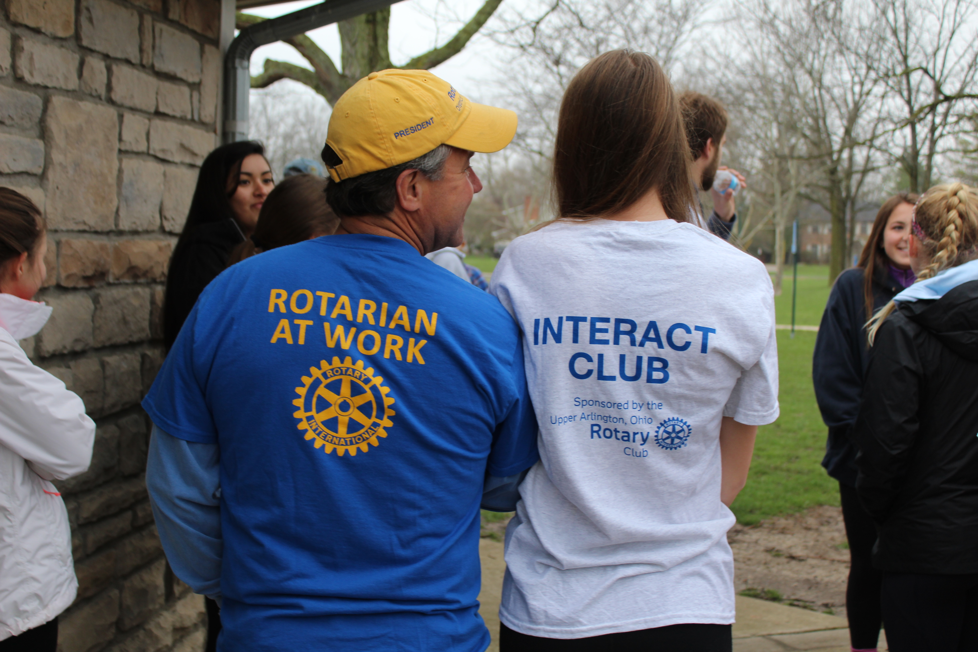
Join Our Club!
What’s involved?
Interact clubs organize at least two projects every year, one that helps their school or community and one that promotes international understanding. Rotary club sponsors mentor and guide Interactors as they carry out projects and develop leadership skills.
Join the new Rotary Interact Club
Every Monday 3:05-4:05pm
1.6
With Mrs Berrisford, Miss Thwaites & Cressida Dickens- District Rotarian
Come along and join a team that’s going to make a change locally and Internationally!!!
What are the benefits?
Connect with leaders in your community and around the world to:
Take action to make a difference in your school and community
Discover new cultures and promote international understanding
Become a leader in your school and community
Have fun and make new friends from around the world

Slide 20
WEDNESDAY

Slide 21
Something to consider
Caring means forgiveness
Sometimes caring means letting go of grudges.
What can you remember about the parable of the Lost Son?
How does this link to the concept of forgiveness?

Slide 22
Our Academy Vision
Discovering 'life in all its fullness' (John 10:10)
Rooted in the life and teaching of Jesus the King, we:
• Aspire to grow into the people God calls us to be.
• Belong to a community where everyone is known and valued.
• Care for others with compassion and courage.
Through the vision, we live out the Christian faith with hope, dignity, and love shaping lives of purpose, service, and “life in all its fullness”.

Slide 23
Gathering
Leader: Let us begin our time of daily worship:
As your Word reveals your kingdom ...

Slide 24
“Love… keeps no record of wrongs.” - 1 Corinthians 13:5
Forgiveness sets people free — both the one who hurt us and ourselves.
Why do we sometimes cling to past hurts?
How does forgiveness show care for yourself as well as others?
What would our community look like if forgiveness came first?

Slide 25
Our Father in heaven,
hallowed be Your name,
Your kingdom come,
Your will be done,
on earth as in heaven.
Give us today our daily bread.
Forgive us our sins
as we forgive those who sin against us.
Lead us not into temptation
but deliver us from evil.
For the kingdom, the power,
and the glory are Yours
now and for ever. Amen.

Slide 26
Dismissal
Leader: Jesus the promise of hope
Leader: Build our school community
Everyone: Amen.

Slide 27
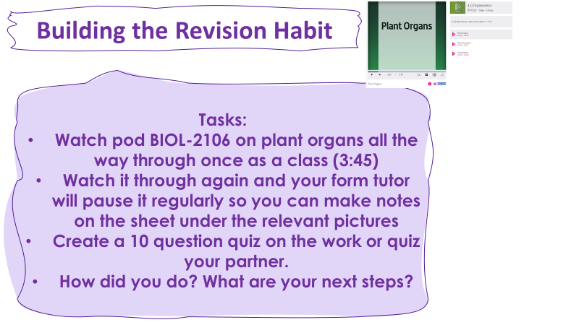

STUDENT SUPPORT

Slide 28
THURSDAY

Slide 29
Something to consider
Caring means forgiveness
Sometimes caring means letting go of grudges.
What can you remember about the parable of the Lost Son?
How does this link to the concept of forgiveness?

Slide 30
Our Academy Vision
Discovering 'life in all its fullness' (John 10:10)
Rooted in the life and teaching of Jesus the King, we:
• Aspire to grow into the people God calls us to be.
• Belong to a community where everyone is known and valued.
• Care for others with compassion and courage.
Through the vision, we live out the Christian faith with hope, dignity, and love shaping lives of purpose, service, and “life in all its fullness”.

Slide 31
Gathering
Leader: Let us begin our time of daily worship:
As your Word reveals your kingdom ...

Slide 32
“Love… keeps no record of wrongs.” - 1 Corinthians 13:5
Forgiveness sets people free — both the one who hurt us and ourselves.
Why do we sometimes cling to past hurts?
How does forgiveness show care for yourself as well as others?
What would our community look like if forgiveness came first?

Slide 33
Our Father in heaven,
hallowed be Your name,
Your kingdom come,
Your will be done,
on earth as in heaven.
Give us today our daily bread.
Forgive us our sins
as we forgive those who sin against us.
Lead us not into temptation
but deliver us from evil.
For the kingdom, the power,
and the glory are Yours
now and for ever. Amen.

Slide 34
Dismissal
Leader: Jesus the promise of hope
Leader: Build our school community
Everyone: Amen.

Slide 35
RSHE

Slide 36
FRIDAY

Slide 37
Something to consider

Slide 38
Our Academy Vision
Discovering 'life in all its fullness' (John 10:10)
Rooted in the life and teaching of Jesus the King, we:
• Aspire to grow into the people God calls us to be.
• Belong to a community where everyone is known and valued.
• Care for others with compassion and courage.
Through the vision, we live out the Christian faith with hope, dignity, and love shaping lives of purpose, service, and “life in all its fullness”.

Slide 39
Gathering
Leader: Let us begin our time of daily worship:
As your Word reveals your kingdom ...

Slide 40
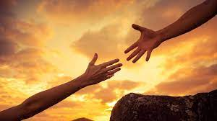
“

Slide 41

Our Academy Prayer
Lord God,
Thank you for our school, our teachers and the gifts and talents you have given us. Help us to achieve our potential and make outstanding steps of progress today.
Forgive us when we fail to behave in the ways that You value and help us to be a community built on Your truth and love, growing us into a people that make a positive impact on the world.
Help us to imitate Your justice and grace, to include and value everyone we meet and to trust in You each day.
In Jesus name, Amen.

Slide 42
Dismissal
Leader: Jesus the promise of hope
Leader: Build our school community
Everyone: Amen.

Slide 43

Something to consider
Caring means perseverance
“What would happen if they had given up halfway?”
  What do we miss out on when perseverance is absent?
  How do we feel when others give up on us?
  How can caring help us to “go the distance” for each other?

Slide 44
Our Academy Vision
Discovering 'life in all its fullness' (John 10:10)
Rooted in the life and teaching of Jesus the King, we:
• Aspire to grow into the people God calls us to be.
• Belong to a community where everyone is known and valued.
• Care for others with compassion and courage.
Through the vision, we live out the Christian faith with hope, dignity, and love shaping lives of purpose, service, and “life in all its fullness”.

Slide 45
Gathering
Leader: Let us begin our time of daily worship:
As your Word reveals your kingdom ...

Slide 46
“Love always protects, always trusts, always hopes, always perseveres.” - 1 Corinthians 13:7
True care doesn’t give up when things get difficult. It walks alongside others, even in tough times.
Who in your life has shown “persevering care” for you?
Why is it important to keep caring, even when it’s hard?
How could we as a school commit to persevering in care?

Slide 47
Our Academy Prayer
Lord God,
Thank you for our school, our teachers and the gifts and talents you have given us. Help us to achieve our potential and make outstanding steps of progress today.
Forgive us when we fail to behave in the ways that You value and help us to be a community built on Your truth and love, growing us into a people that make a positive impact on the world.
Help us to imitate Your justice and grace, to include and value everyone we meet and to trust in You each day.
In Jesus name, Amen.

Slide 48
Dismissal
Leader: Jesus the promise of hope
Leader: Build our school community
Everyone: Amen.

Slide 49

CELEBRATION

