Slide 1




Strategies for STUDENTS AND Parents
How you can support with learning and revision

Slide 2
HOW?
You don’t need to understand or know anything about the subject to help your child revise. Read through the knowledge organiser with your child then ask them to explain it to you – ‘teaching’ you helps them to reinforce their learning.

Slide 3
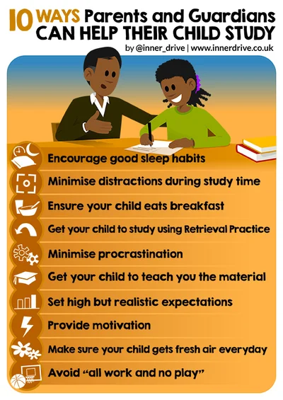
Set the environment
Before we look at the strategies and techniques on how to revise, lets look at the learning environment. There lots of things we can do as parents and guardians that will encourage our children's’ learning to be as effective and efficient as possible.
https://blog.innerdrive.co.uk/10-ways-parents-can-help-their-child-revise

Slide 4
Sleeping Habits
Sleep is vital for memory consolidation, a process which is integral to learning. Parents/guardians can help by ensuring their child follows a regular sleep schedule, getting the recommended 8-10 hours of sleep each night.
This becomes even more crucial during the exam season, when quality sleep can enhance concentration and memory. Studies indicate that sleep helps form new neural connections and prioritise important information, enabling better recall during exams. In fact, prioritising sleep during exams has been shown to lead to higher grades.

Slide 5
2. Minimise Distractions
In an age of digital distractions, parents and guardians can aid their child's revision by creating a calm, distraction-free environment. This may look like looking after their child’s phone for them during study sessions, turning the TV off, or helping them ensure their desk is tidy.
Multiple studies have debunked the myth of efficient multitasking, showing that the mere presence of a phone can cause a 20% decline in performance – even if students don’t use it. Encouraging students to put away their phones during revision can reduce errors and improve productivity.
For more information on this subject, take a look at our guide to mobile phone management for students.

Slide 6
3. Encourage a Nutritious Breakfast
Despite the common knowledge that breakfast is the most important meal of the day, studies show that a significant percentage of teenagers regularly skip breakfast, with over 60% of teenage boys and 70% of teenage girls doing so.
Parents can play a crucial role in reversing this trend, emphasising the importance of a nutritious morning meal. Research indicates that children who skip breakfast or rely on energy drinks perform worse in attention and memory tasks compared to their breakfast-eating counterparts.

Slide 7
4. Implement Retrieval Practice
Retrieval Practice, a strategy that involves recalling previously learned knowledge by generating an answer to a question, is one of the most effective revision techniques. It helps strengthen memory traces and increases the likelihood of long-term information retention and can take many forms, from past papers to quizzes.
One great way to utilise Retrieval Practice at home is by using flashcards. For example, parents and guardians can encourage their child to use the Leitner System, a handy way to make the best of flashcards.
More revision strategies coming up!

Slide 8
5. Combat Procrastination
Procrastination is a common challenge among students, with 75% considering themselves procrastinators and half of these viewing it as problematic.
Parents and guardians can help combat procrastination by setting a structured routine for their child’s revision, limiting distractions such as mobile phones and ensuring they start their revision as early as possible. Studies suggest that once a task is started, even for a few minutes, the brain's inherent desire for task completion kicks in—a phenomenon known as the Zeigarnik Effect.

Slide 9
6. Get your child to teach you the material
A powerful way to reinforce understanding is for students to teach the material to someone else. Known as the Protégé Effect, this technique improves memory recall and enhances understanding. When students prepare to explain the material to others, they organise and clarify their thoughts, leading to a deeper comprehension of the subject matter.
So, parents and guardians could utilise the Protégé Effect by getting their child to teach them about some of the key concepts they need to master.

Slide 10
7. Set High expectations
A review of 37 studies found that high parental expectations significantly contribute to improving student grades. These expectations instil belief and motivate students to work harder. However, it's crucial that these expectations are paired with supportive actions that enable the child to develop resilience and overcome setbacks.

Slide 11

8. Provide Motivation
Motivating a child to revise can be tricky. However, research shows that highlighting the practical applications of the revising content can increase motivation. Parents can share examples of how they've used the knowledge they learned at school later in life, thus making learning more relatable and engaging.
However, it’s important to note that motivation can be a tricky thing to master. For example, using incentives can have its pros and cons – there is more advice on this in the website.

Slide 12
9. Encourage regular outdoor exercise
Daily outdoor exercise is beneficial for students, especially during revision periods. Studies show that even a short 12-minute walk can improve a student's mood and increase concentration levels by up to 21%, even when facing daunting tasks.
This is another great habit that parents and guardians can help their child to set, for example by reminding them to take an outdoor break halfway through their revision session – and perhaps even joining them for a walk.

Slide 13
10. Balance Work and Play
While studying is important, it's equally crucial to set aside time for relaxation and leisure. High stress levels can negatively impact a child's well-being and even the quality of their revision.
Incorporating a healthy balance of screen time, socialising, partaking in hobbies and exercising within study can actually contribute to exam success by providing necessary mental breaks. This will help students stay motivated and avoid burnout, but will also give their brain the time to consolidate their learning.

Slide 14


Lets look at some research proven revision strategies

Slide 15

Visual or Graphic Organisers
Graphic organisers help children develop their comprehension of a concept or topic by providing a framework to explore links, relationships, causes, effects and more. These effective learning tools allow learners of all ages and abilities to clarify, organise and simplify their own thoughts as well as information that has been given, in a visual manner.
Use Graphic Organisers at any point in the lesson to structure information into understandable chunks:
When taking notes about new information in a lesson to organise ideas
After reading a book to organise the plot
When comparing and contrasting two concepts
As a way to help students classify new information into meaningful categories
To help students find similarities and differences by creating analogies
As a brainstorming tool to generate ideas before students begin an assignment, such as a writing task, a set of word problems, or a lab, to gather ideas or formalise procedures

Slide 16
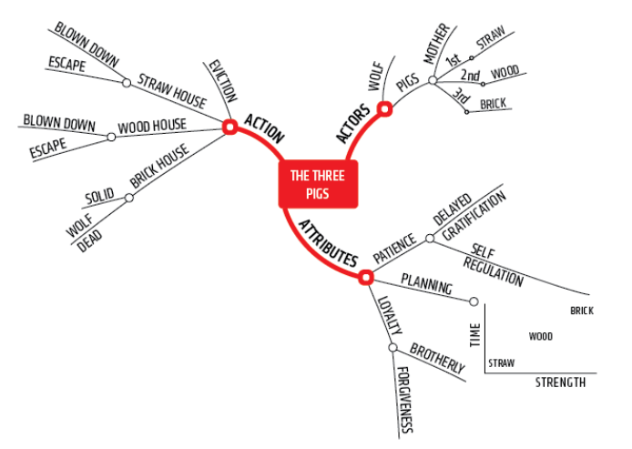
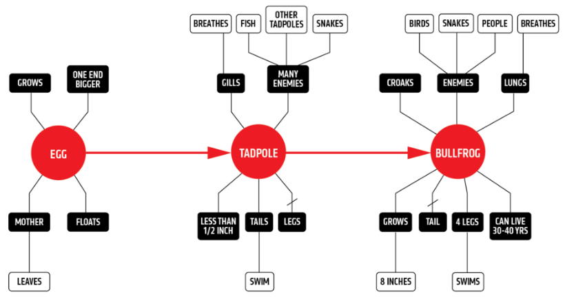
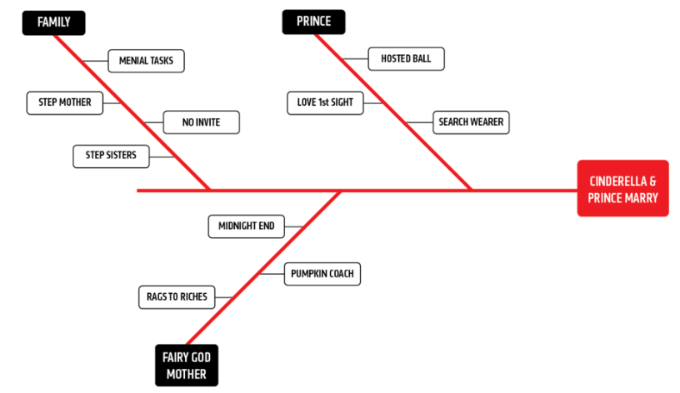
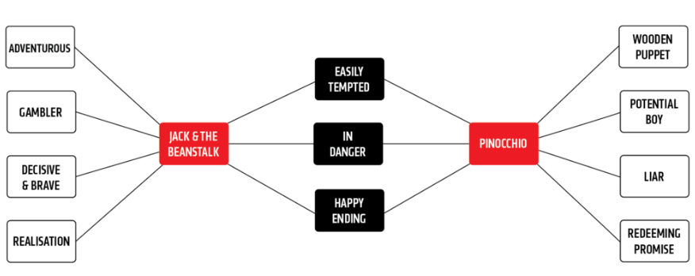
Visual or Graphic Organisers
Graphic organisers help children develop their comprehension of a concept or topic by providing a framework to explore links, relationships, causes, effects and more. These effective learning tools allow learners of all ages and abilities to clarify, organise and simplify their own thoughts as well as information that has been given, in a visual manner.
Variety of examples that can be used
Mind Map
Flowspray
Fishbone
Double Spray

Slide 17
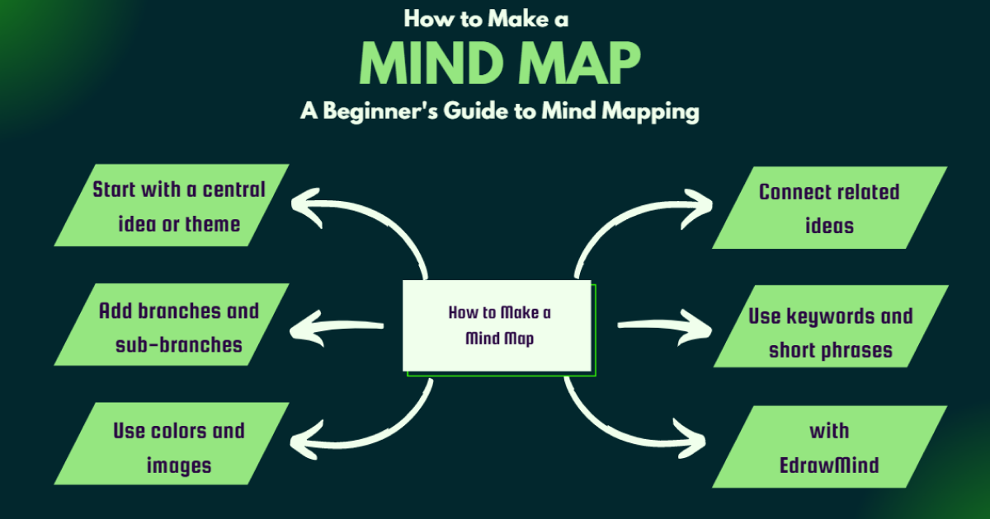
Mind Maps
Try converting the information from the Knowledge Organiser into a mind map or make your own version using clip art imagery if the organiser contains a lot of text. Display on the wall or the fridge door until the memory ‘sticks’.
A mind map is a visual way to display information, and starts with the main topic written in the middle of the page.

Slide 18
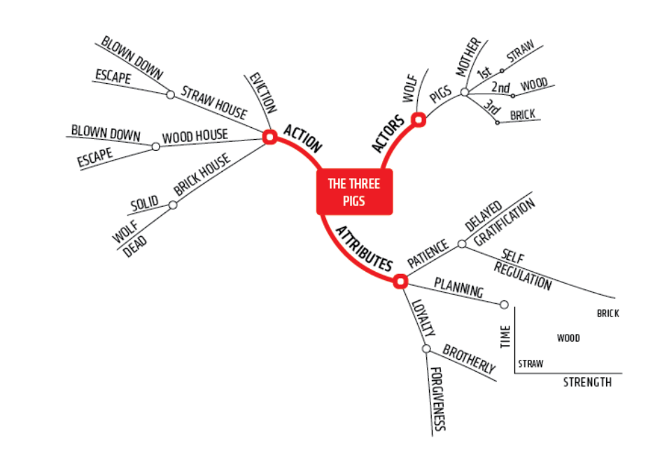
Mind Maps

Slide 19
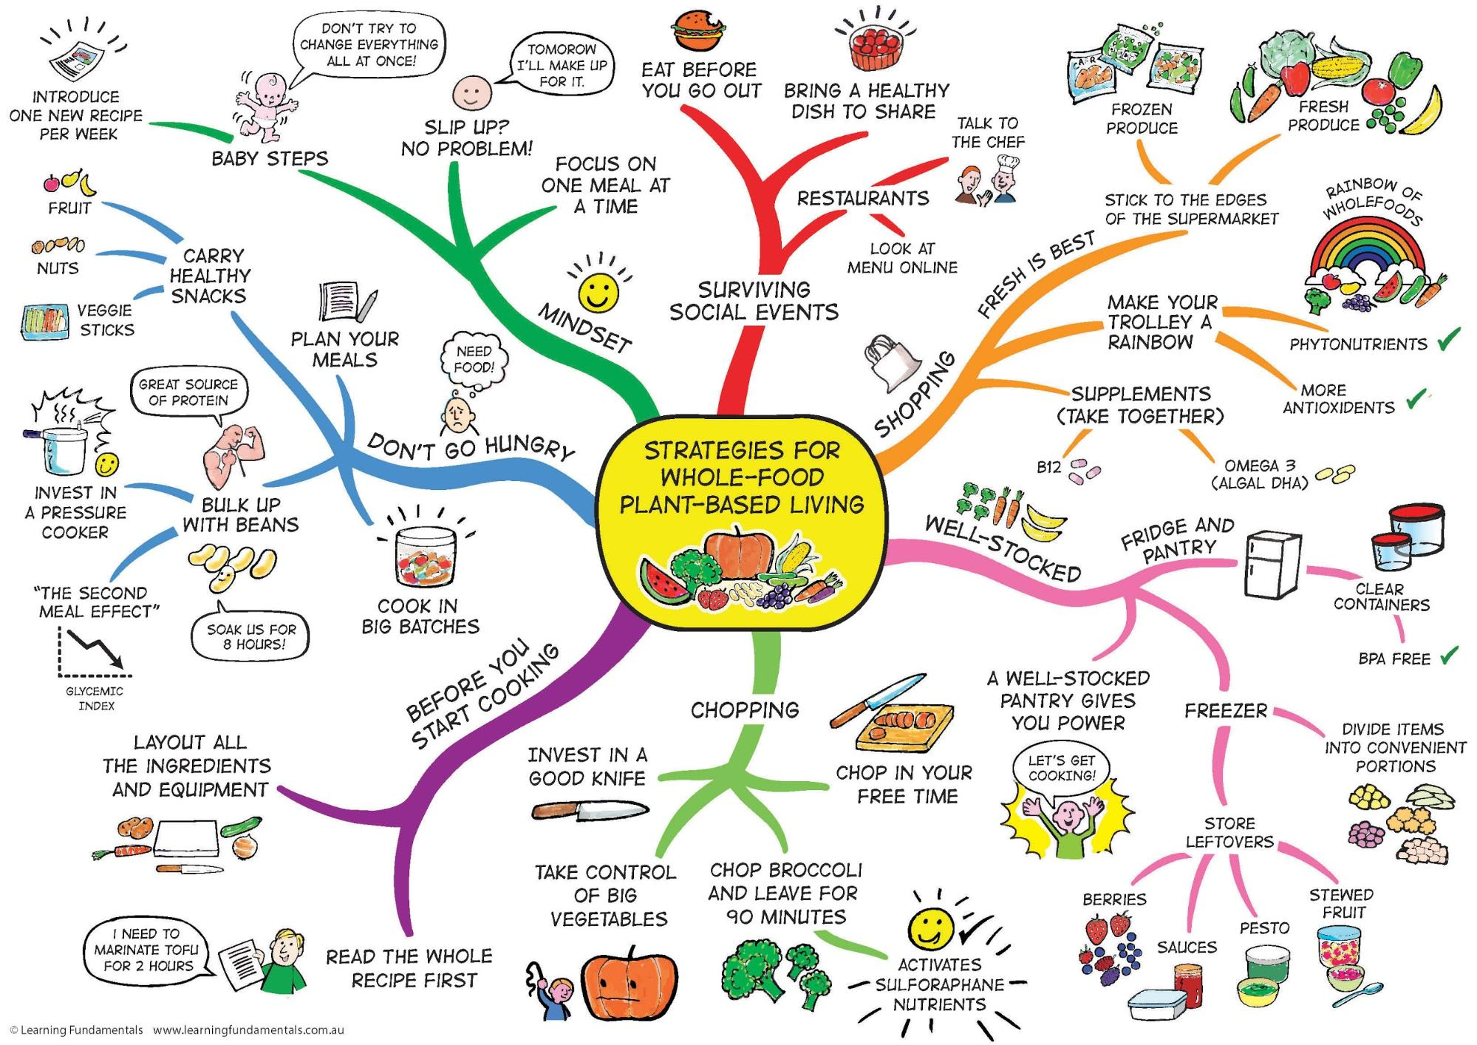
From there, write or draw all of the ideas, words or information that link to it. Continue to do this so you develop lots of smaller branches around your mind map.
Remember...this is visual, so use images, pictures and diagrams rather than lots of words!

Slide 20
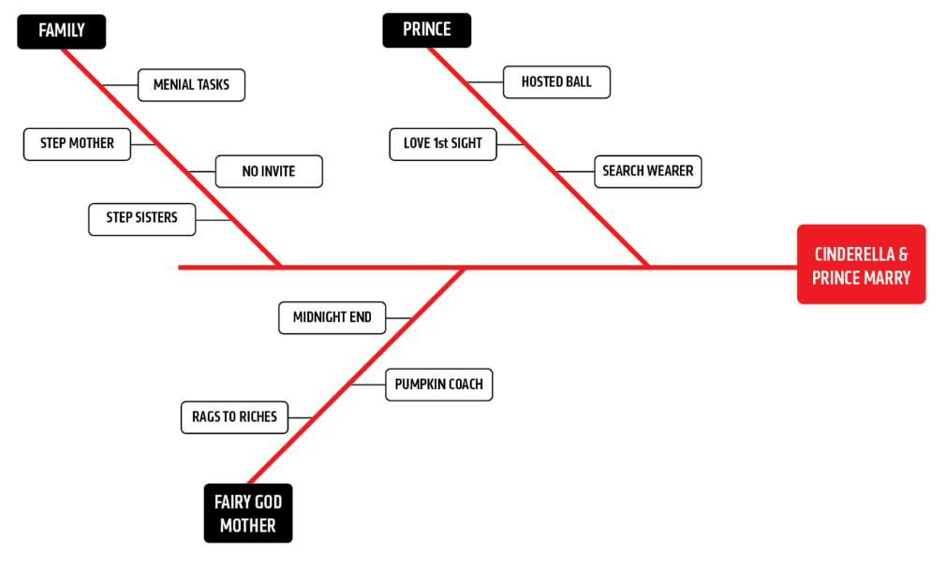
Fishbones
These graphic organisers are used to highlight cause and effect.
They can be used in many different contexts.
They look at why something or someone is the position they are in.
Lets look at this one based on Cinderella

Slide 21
Fishbones

Slide 22
Fishbones
Another example could be linked to T-Rex
Large & powerful for biting
Big muscles for fast running
Mouth
Strong & Sharp Teeth
Legs
Big feet for balance
Biggest Predator
Loud roar
Sharp & Large claws
Really small
Really high
Don’t aid fighting
Vision for seeing prey
Arms
Senses
Can’t be used for eating
Smell for identifying prey

Slide 23
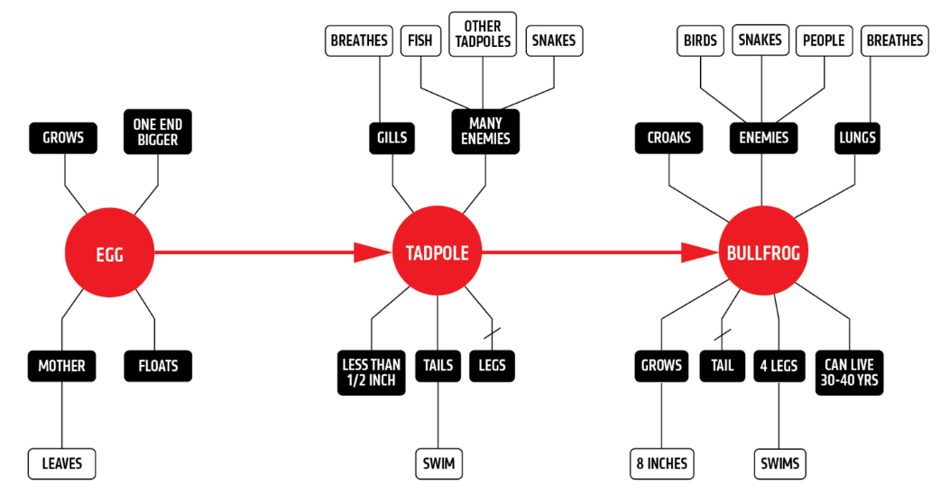
Flowspray
These graphic organisers are used to help chunk time periods and highlight the big changes.
The example here is based on the timeline of a bullfrog.

Slide 24
Flowspray

Slide 25
Flowspray
GCSE Drama example for an extended question response
Intention
Physical
Effect
Vocal
Quote

Slide 26
Flowspray
GCSE Drama example for an extended question response
Intention
Emotions and attitudes.
Intentions.
Actions within the story.
Physical
Effect
Vocal
Quote

Slide 27
Flowspray
GCSE Drama example for an extended question response
Intention
Emotions and attitudes.
Intentions.
Actions within the story.
Physical
Effect
Vocal
Quote
Choose section, and refer to quote.
Know you want to expand on this later.

Slide 28
Flowspray
GCSE Drama example for an extended question response
Intention
Emotions and attitudes.
Intentions.
Actions within the story.
Physical
Effect
Vocal
Quote
Choose section, and refer to quote.
Know you want to expand on this later.
Consider different vocal ideas.
How would ___ use their voice?

Slide 29
Flowspray
GCSE Drama example for an extended question response
Intention
Emotions and attitudes.
Intentions.
Actions within the story.
Physical
Pace/ pitch / pause / accent / volume / tone.
Expressions.
Gestures.
Posture.
Stance.
Use of space.
Gait / movement.
Effect
Vocal
Quote
Choose section, and refer to quote.
Know you want to expand on this later.
Consider different vocal ideas.
How would ___ use their voice?

Slide 30
Flowspray
GCSE Drama example for an extended question response
Intention
Emotions and attitudes.
Intentions.
Actions within the story.
Physical
Pace/ pitch / pause / accent / volume / tone.
Expressions.
Gestures.
Posture.
Stance.
Use of space.
Gait / movement.
Effect
What would this convey to the audience?
What impact do I want to achieve?
Vocal
Quote
Choose section, and refer to quote.
Know you want to expand on this later.
Consider different vocal ideas.
How would ___ use their voice?

Slide 31
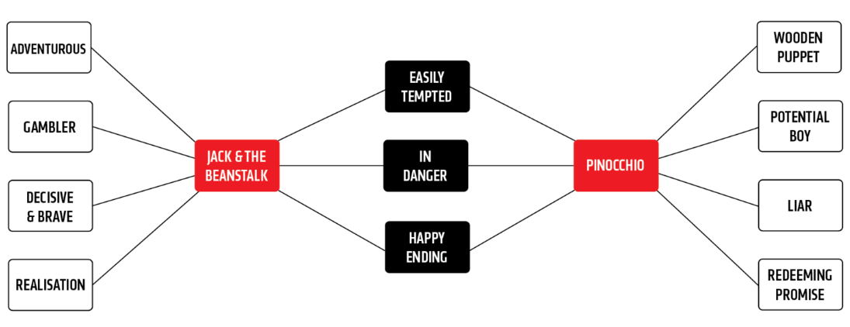
Double Spray
These graphic organisers are used to compare.
They can be used in a variety of contexts.
They can be amended to add more detail as comprehension increase.

Slide 32
Double Spray
This example compares two well known children’s stories

Slide 33
Visual or Graphic Organisers
Variety of examples that can be used
Flowspray
Mind Map
Double Spray
Fishbone

Slide 34

Spelling Tests
Test them regularly on the spellings of key words until they are perfect. Make a note of the ones they get wrong – is there a pattern to the spelling of those words?
If words are spelt wrong
Look-Cover-Write-Check For spellings that children are getting wrong do the following:
Look - Show them the word
Cover - Cover the word up so it can’t be seen
Write - Get your child to write the word down
Check - Check to see if they have spelt it correctly

Slide 35
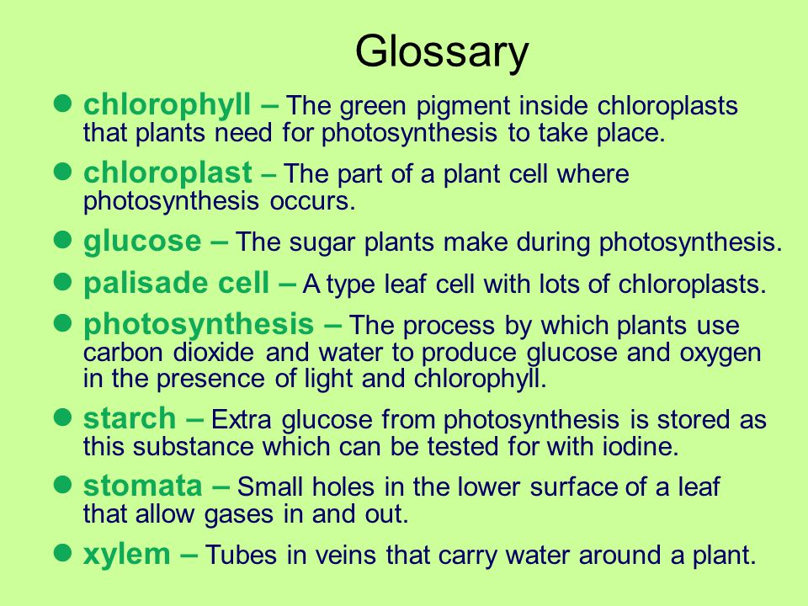
Glossaries
Get them to make a glossary (list) of keywords with definitions or a list of formulae.
They could then put the glossary in the folder and refer back to it time and time again.

Slide 36


Podcast
Try recording the knowledge from their notes as a sound file on their phones, so that your child can listen to it. Some pupils retain more information this way.
Get your child to read out the definitions, key words or formulae whilst you record them.
Or maybe become the star of
the show yourself and record
yourself reading the
information for your child.

Slide 37


Mind the Gap
Read sections from their knowledge organisers or their notes out to them. Start by missing out key words or phrases and get your child to fill the gaps.
Miss out more
and more until they are
word-perfect. This
strategy is particularly
good for remembering
definitions, formulae,
and phrases.

Slide 38
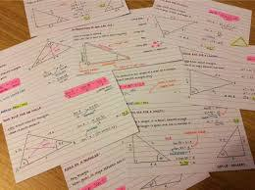
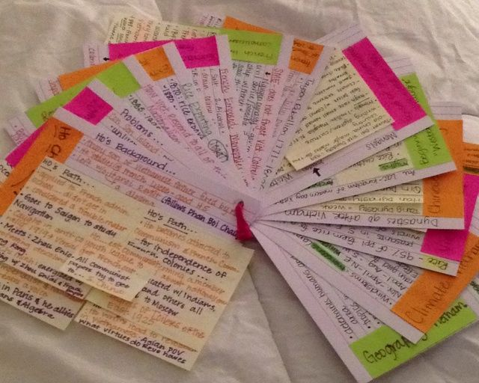
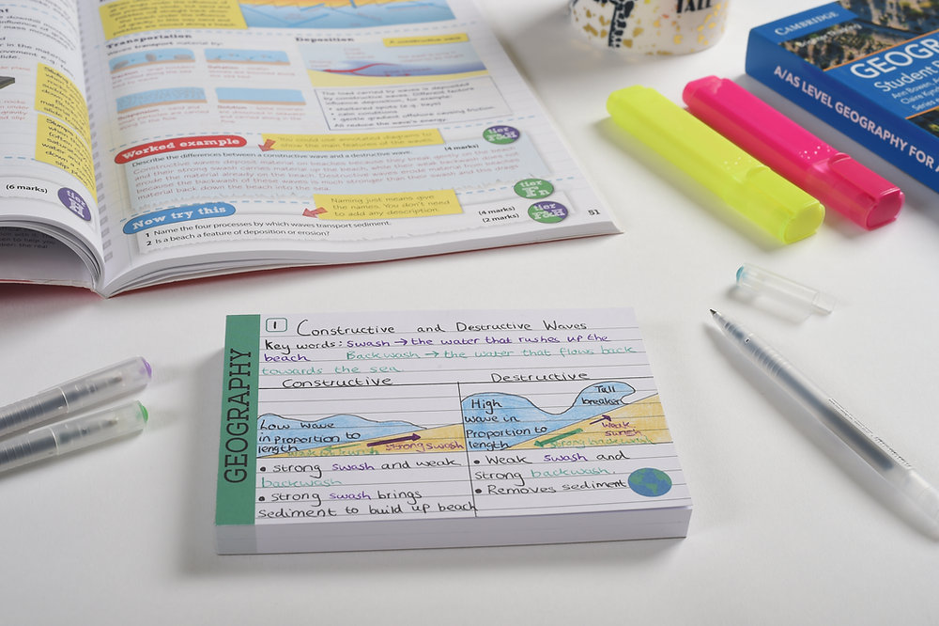
Smaller and Smaller
Get your child to take the information on Knowledge Organiser and reduce it in detail so it fits onto a smaller sheet of paper. Then reduce this again by making the information more concise.
Keep doing this until you can fit only parts of sentences or key words onto a small piece of card.
Then get your child to use this small
card as a prompt to then explain the
topic back to you verbally.

Slide 39
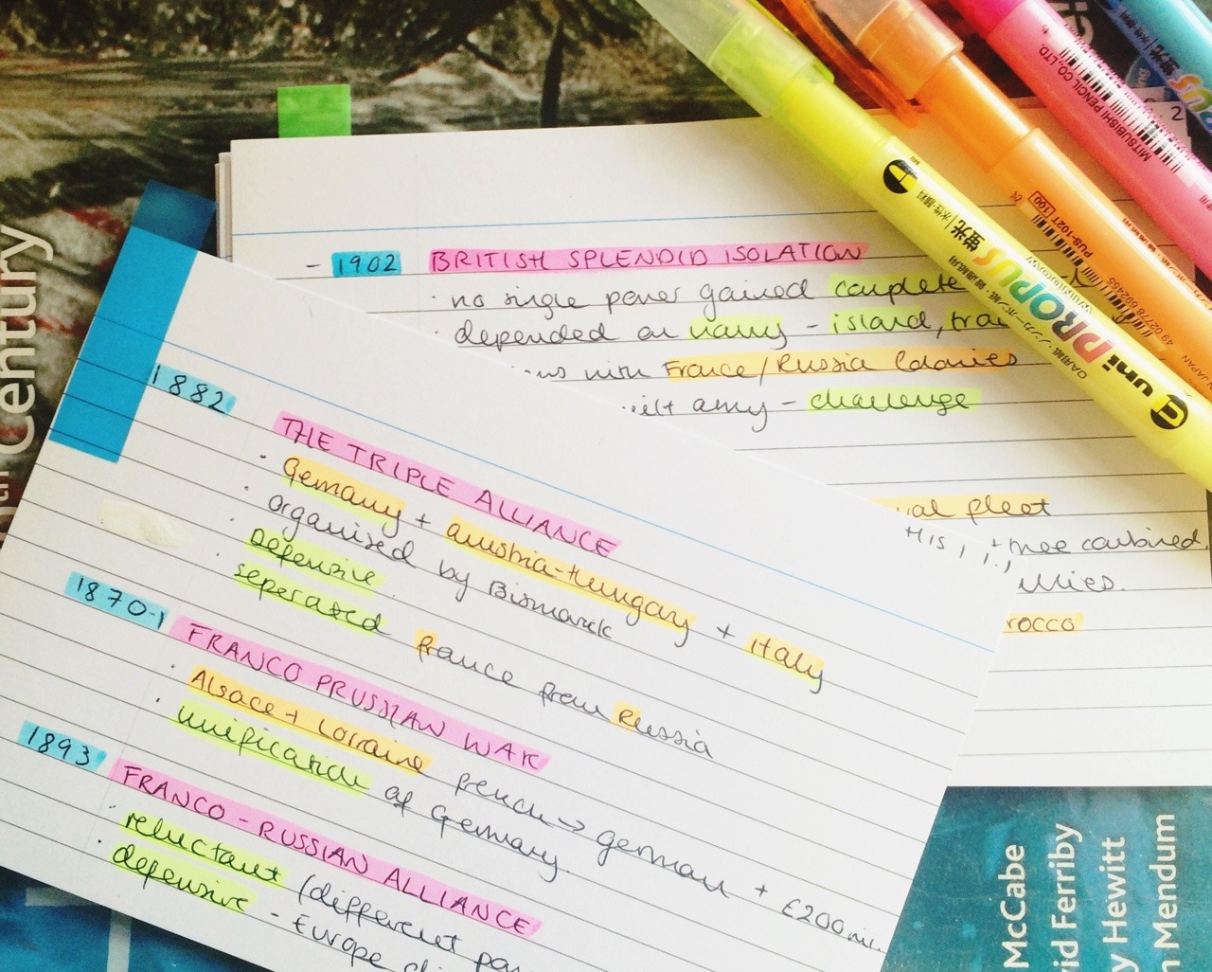
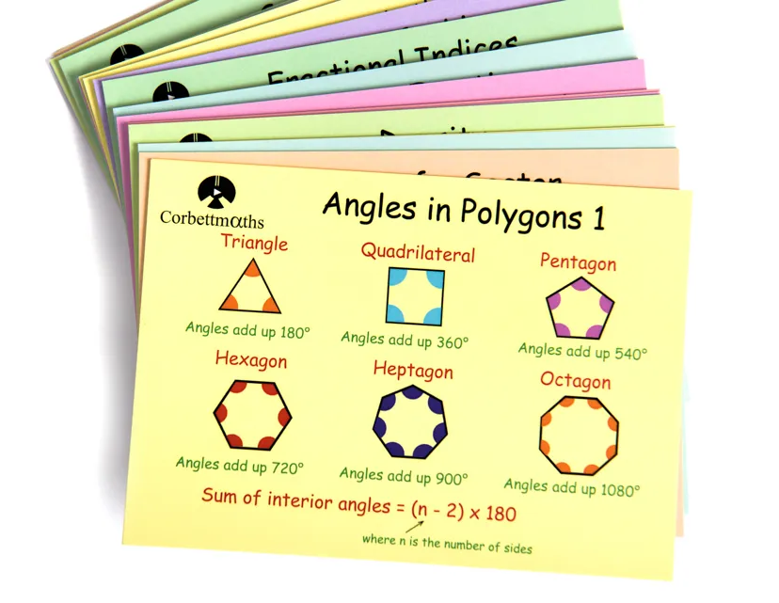
Flash Cards
Using the information on the Knowledge Organiser, books or notes, help your child produce lots of pocket-sized cards that contain the various bits of information for that topic. Include as many visuals as possible, rather than lots of writing.
Students can then carry these around on car journeys or at school to look at and remind themselves quickly of the key information.
Some can be bought, but it is much better to make your own!

Slide 40
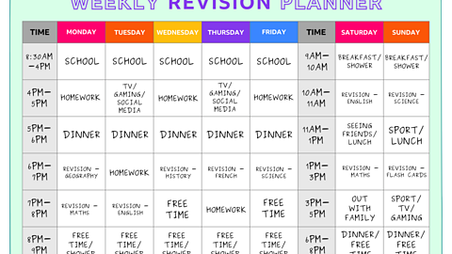
Revision Timetables
These are a plan for when work, rest and play are going to happen in the future. The key with these is balance and a commitment to stick to the plans.
They should be able to be amended too.
If there is a function that has to be attended, then this can go in, but the lost time can be swapped for something else.
Also the plans will change the exams get closer- remember the earlier this starts, the better and easier it will be.

Slide 41
Revision Timetables
 | Monday | Tuesday | Wednesday | Thursday | Friday | Saturday | Sunday
9-11am | School | School | School | School | School | Music HW | Football Match
11-1pm | School | School | School | School | School | Lunch & Free Time | Lunch & Free Time
1-3pm | School | School | School | School | School | RE Revision | Free Time
3-5pm | English HW | RE HW Geog HW | Maths P6 | Science P6 | Football Training | History Homework | Free Time
5-7pm | Tea & Free Time | Tea & Free Time | Tea & Free Time | Tea & Free Time | Tea & Free Time | Tea & Free Time | Tea & Free Time
7-9pm | Maths Revision French Revision | Football Training | History Revision Music Revision | Science HW English Revision | Free Time | Free Time | Maths Revision
9pm onwards | Free Time | Free Time | Free Time | Free Time | Free Time | Free Time | Free Time

Slide 42
Revision Timetables
 | Monday | Tuesday | Wednesday | Thursday | Friday | Saturday | Sunday
9-11am | School | School | School | School | School | Music HW | Football Match
11-1pm | School | School | School | School | School | Lunch & Free Time | Lunch & Free Time
1-3pm | School | School | School | School | School | RE Revision | Free Time
3-5pm | English HW | RE HW Geog HW | Maths P6 | Science P6 | Football Training | History Homework | Free Time
5-7pm | Tea & Free Time | Tea & Free Time | Tea & Free Time | Tea & Free Time | Tea & Free Time | Tea & Free Time | Tea & Free Time
7-9pm | Maths Revision French Revision | Football Training | History Revision Music Revision | Science HW English Revision | Free Time | Free Time | Maths Revision
9pm onwards | Free Time | Free Time | Free Time | Free Time | Free Time | Free Time | Free Time

Slide 43
Revision Timetables
 | Monday | Tuesday | Wednesday | Thursday | Friday | Saturday | Sunday
9-11am | School | School | School | School | School | Music HW | Football Match
11-1pm | School | School | School | School | School | Lunch & Free Time | Lunch & Free Time
1-3pm | School | School | School | School | School | RE Revision | Free Time
3-5pm | English HW | RE HW Geog HW | Maths P6 | Science P6 | Football Training | History Homework | Free Time
5-7pm | Tea & Free Time | Tea & Free Time | Tea & Free Time | Tea & Free Time | Tea & Free Time | Tea & Free Time | Tea & Free Time
7-9pm | Maths Revision French Revision | Football Training | History Revision Music Revision | Science HW English Revision | Free Time | Free Time | Maths Revision
9pm onwards | Free Time | Free Time | Free Time | Free Time | Free Time | Free Time | Free Time

Slide 44
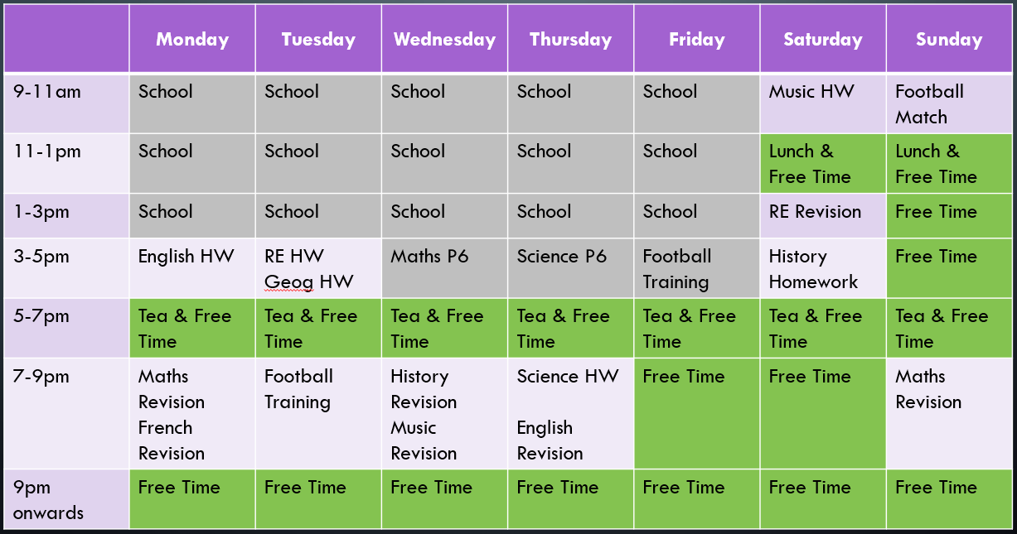
Revision Timetables

Slide 45

Revision Timetables
Further guidance on creating these can be found at the two links below.
Remember these must be able to change with the times, for example if they are half-term break, or during mock exams, or they are on study leave. It must be created with balance in mind!
BBC Bitesize
Third Space Learning

Slide 46
Websites for support
There are plenty of free websites that support learning and revision for all ages..
Some are free like Corbett maths, while others have a charge.
The school pays for some websites so your child can access high quality revision materials.
A good idea is to plan these out in a little timetable – so Tuesday we will do Geography and Wednesday we will do French for example.
Free websites include:
Subject | Web address
Maths | https://corbettmaths.com/
 | https://mmerevise.co.uk/
 | https://www.bbc.co.uk/bitesize/subjects/zqhs34j
English
Science
R.E.
Art
Business
Catering
Drama
Engineering
French
Geography
German

Slide 47

Websites for support
Here are more websites that can be used.
Not every website will work for every person, this is why it is important to try some and see which ones will work for you.
Free websites include:
Subject | Web address
Health & Social Care
History
Information Technology
Music
P.E.
Spanish
Technology

Slide 48



Slide 49

We want our students to flourish, and we know you want the best for your family. Going through these steps helps youngsters develop thinking strategies and perseverance that they will need in every job.
Much the same as when you trained for your job, or learnt to play an instrument or how to play a game effectively. You never do it perfectly first time, but you will get better if you try and practice.
This is the exact reason for students to learning to learn more effectively.

Slide 50
Graphic Organisers
https://bedrocklearning.org/literacy-blogs/using-graphic-organisers-to-improve-reading-comprehension/
Revision Strategies
https://blog.innerdrive.co.uk/the-power-of-practice-and-effective-revision
https://blog.innerdrive.co.uk/4-ways-to-think-more-effectively
https://blog.innerdrive.co.uk/how-we-develop-metacognition
https://blog.innerdrive.co.uk/self-explanation-during-revision

Slide 51


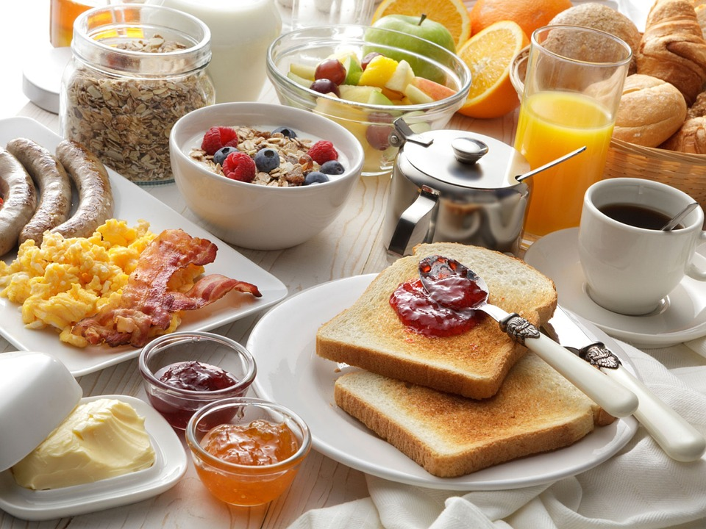


Setting the Scene

Slide 52

Setting the Scene
Balance

Slide 53
Setting the Scene
Sleep

Slide 54
Setting the Scene
Breakfast

Slide 55
Setting the Scene
No Distractions

Slide 56
Setting the Scene
Committing to revision timetable

Slide 57
Setting the Scene
In Summary

Slide 58
Balance
While studying is important, it's equally crucial to set aside time for relaxation and leisure. High stress levels can negatively impact a child's well-being and even the quality of their revision.
Incorporating a healthy balance of screen time, socialising, partaking in hobbies and exercising within study can actually contribute to exam success by providing necessary mental breaks.
This will help students stay motivated and avoid burnout, but will also give their brain the time to consolidate their learning.

Slide 59
Sleep
Sleep is vital for memory consolidation, a process which is integral to learning. Parents/guardians can help by ensuring their child follows a regular sleep schedule, getting the recommended 8-10 hours of sleep each night.
This becomes even more crucial during the exam season, when quality sleep can enhance concentration and memory. Studies indicate that sleep helps form new neural connections and prioritise important information, enabling better recall during exams. In fact, prioritising sleep during exams has been shown to lead to higher grades.

Slide 60
Breakfast
Despite the common knowledge that breakfast is the most important meal of the day, studies show that a significant percentage of teenagers regularly skip breakfast, with over 60% of teenage boys and 70% of teenage girls doing so.
Parents can play a crucial role in reversing this trend, emphasising the importance of a nutritious morning meal. Research indicates that children who skip breakfast or rely on energy drinks perform worse in attention and memory tasks compared to their breakfast-eating counterparts.

Slide 61
Avoiding Distractions
In an age of digital distractions, parents and guardians can aid their child's revision by creating a calm, distraction-free environment. This may look like looking after their child’s phone for them during study sessions, turning the TV off, or helping them ensure their desk is tidy.
Multiple studies have debunked the myth of efficient multitasking, showing that the mere presence of a phone can cause a 20% decline in performance – even if students don’t use it. Encouraging students to put away their phones during revision can reduce errors and improve productivity.
For more information on this subject, take a look at our guide to mobile phone management for students.

Slide 62
Commitment to Revision Timetable
Procrastination is a common challenge among students, with 75% considering themselves procrastinators and half of these viewing it as problematic.
Parents and guardians can help combat procrastination by setting a structured routine for their child’s revision, limiting distractions such as mobile phones and ensuring they start their revision as early as possible. Studies suggest that once a task is started, even for a few minutes, the brain's inherent desire for task completion kicks in—a phenomenon known as the Zeigarnik Effect.

Slide 63
In Summary
Work Life Balance
  Ensure there is plenty of time to get fresh air, see friends, play games, etc.
Sleep
  Aim for 8-10 hrs per night. No games devices or phones for 2hrs before bedtime.
Breakfast
  Boost alertness with a nutritious breakfast so they are ready to learn/ work as soon as they arrive at school.
Distractions
  When revising & working, ensure phones, consoles, tablets, etc are either off or in a different room.
Commitment
  Follow revision timetable.

